Slide 1
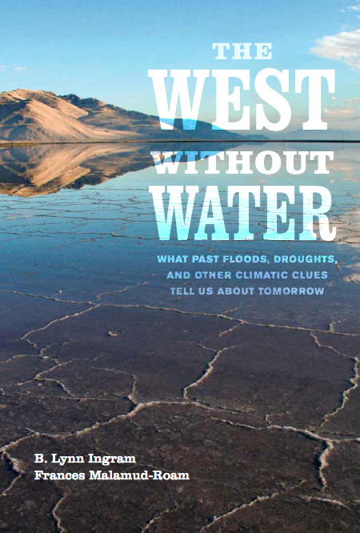
A History of California Climate Extremes: Clues from San Francisco Bay Sediments
Dr. B. Lynn Ingram
Professor, UC Berkeley
Dr. Frances Malamud-Roam
Senior Environmental Planner, Caltrans

Slide 2
Questions addressed in the book:
Based on sedimentary records from San Francisco Bay:
How much does climate vary naturally?
How frequent and severe were past droughts, fires, and floods?
How did they impact past human societies?
How did past warming impact water
resources?

Slide 3
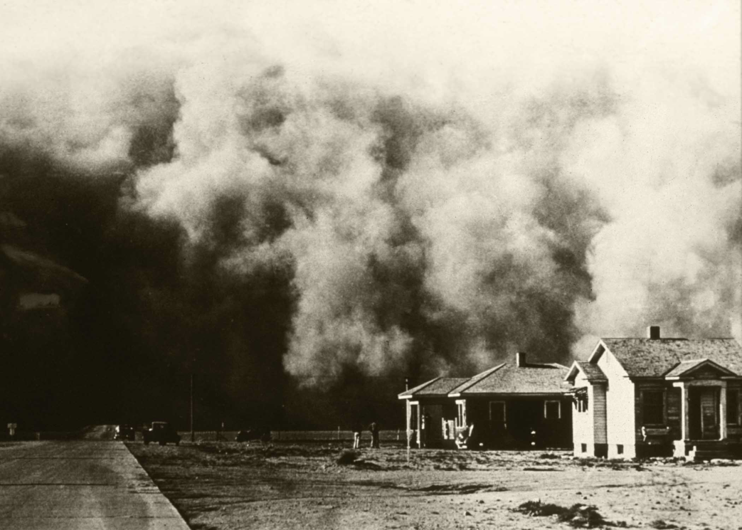
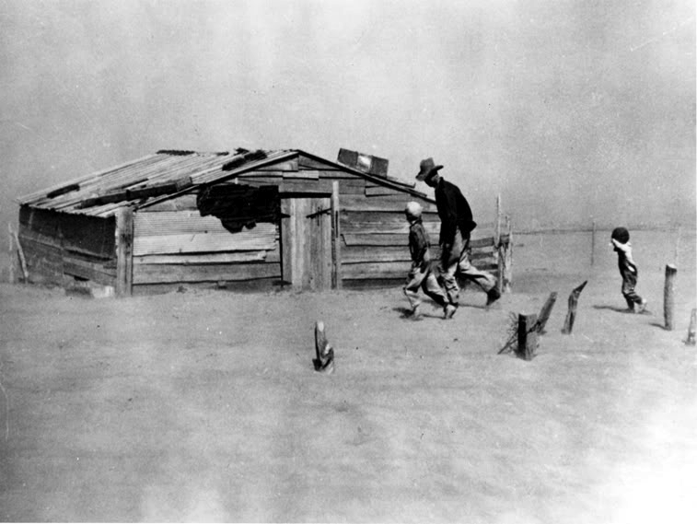
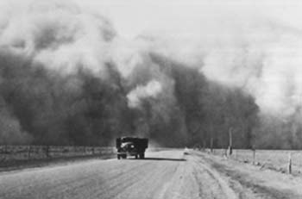
Extremes of the 20th century:
Droughts
The Dust Bowl Drought
1928-1937
(1928-1934 in California)
(1987-1992 drought)
Notes:
The Dust Bowl, 1932

Slide 4
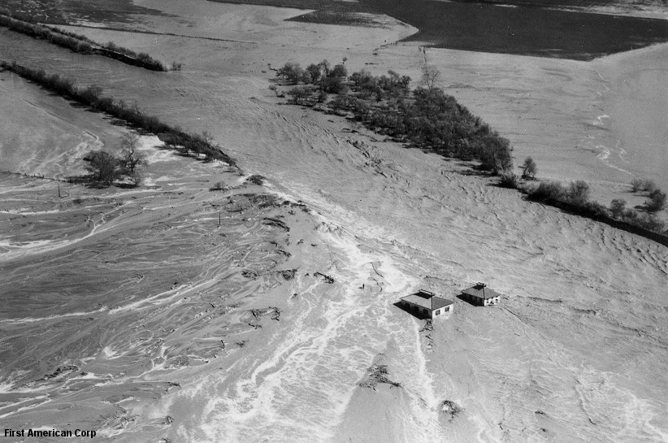
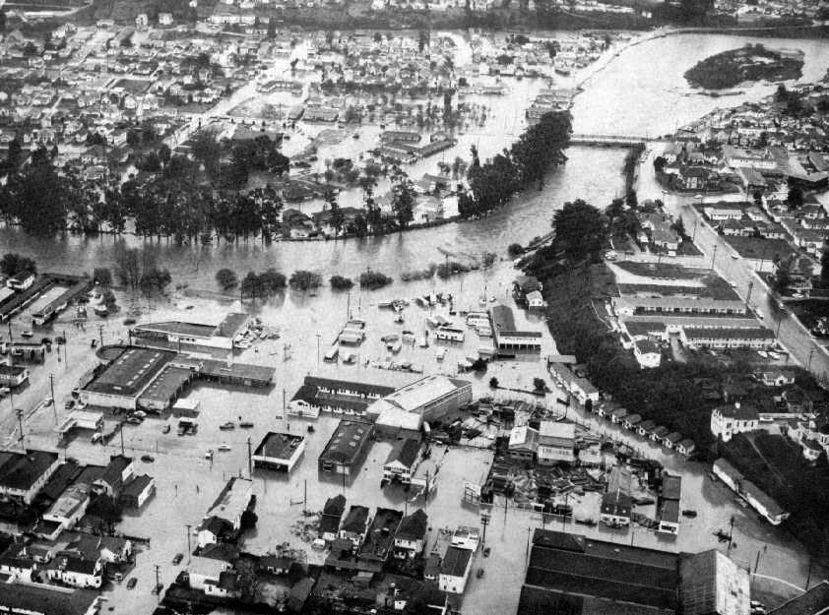
Extremes of the 20th century:
Floods
1938 Orange County
(Santa Ana River)
1955 Santa Cruz
(San Lorenzo River)
And others: 1969, 1983, 1997, 2006…

Slide 5
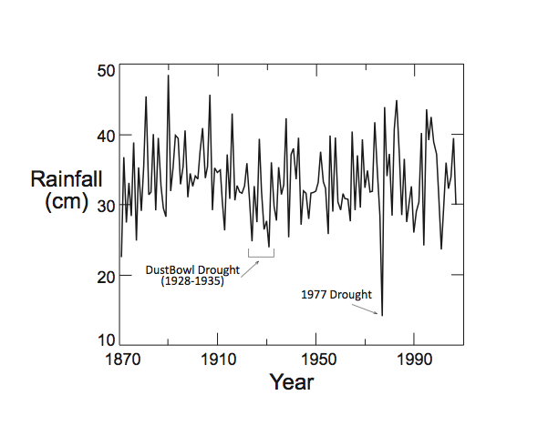
Precipitation highly variable in CA
over the past century

Slide 6
Understanding past climate
Extending the records of climate changes before humans were making measurements
Indirect (proxy) evidence for past climate change contained in the natural environment
  sediments, fossils, trees, lakes, glaciers
  Temperature, precipitation, sea level, wildfire frequency, vegetation type

Slide 7
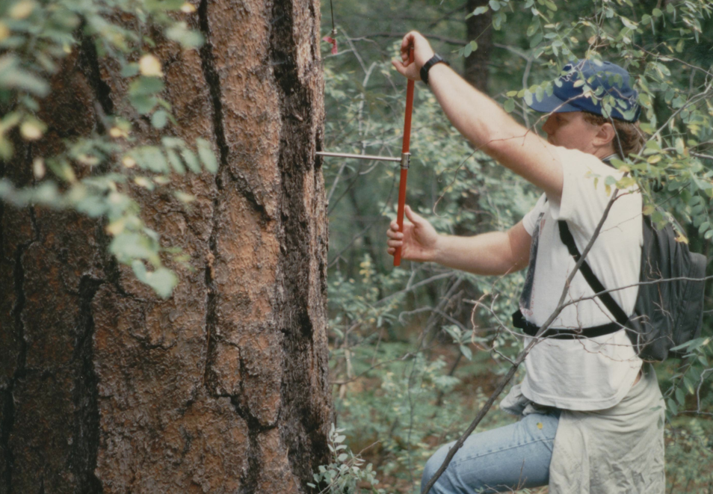
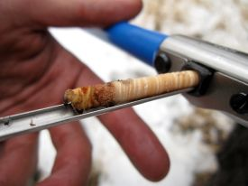
Coring tree-trunks – pencil thin cores
- show yearly growth rings

Slide 8
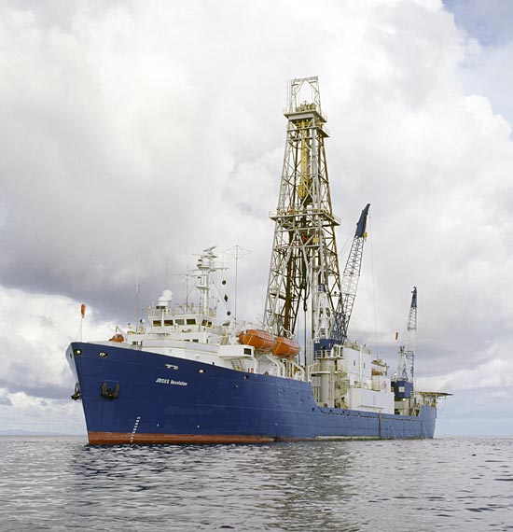
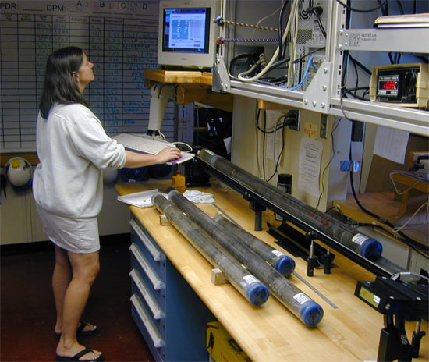
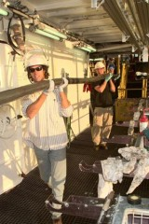
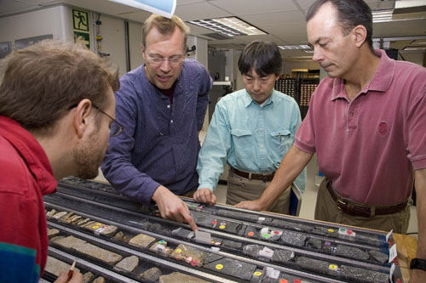
Sediment coring

Slide 9
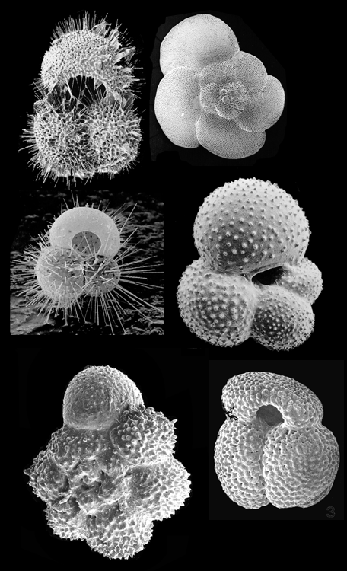
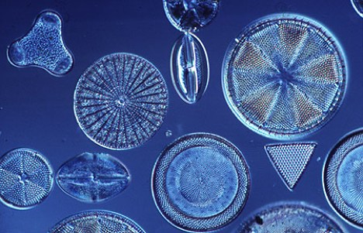
Microfossils (foraminifera, diatoms):
Reflect ambient conditions (water temperature, salinity, nutrient levels)
By using shell chemistry & species assemblages

Slide 10
What have we learned by looking at California’s past history of climate?

Slide 11
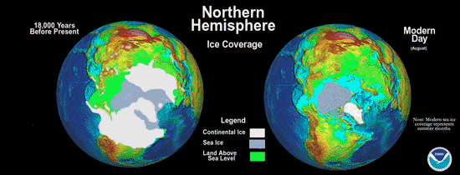
Pleistocene Climate Cycles (2.5 million years to the present)
Glacial Interglacial
Notes:
11

Slide 12
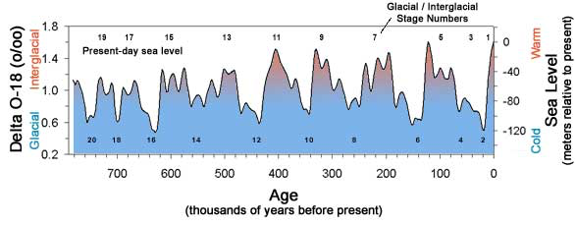
Notes:
This slide is a seguay from previous slide which showed a that eustatic sea level has gone up and down dramatically; this slide shows that the sea level changes are tied to changes in the world volume of water that is locked up in ice, reflecting global climate cycles. Relationship between ice volume and climate is subtle and beyond the scope of this talk, but key point is that on 100 k year cycle, world alternates between glacial periods, which are cold with high volumes of water locked in ice, and interglacial periods when global mean temperatures are higher, less water is locked up in ice more is in the ocean basins and so sea level is relatively high.
This slide shows a time series of the stable isotope O18 which is a index of global ice volume and demonstrates that we are clearly in an interglacial period. It is unclear from this index whether ice extent would increase on decrease in the absence of anthropogenic change.

Slide 13
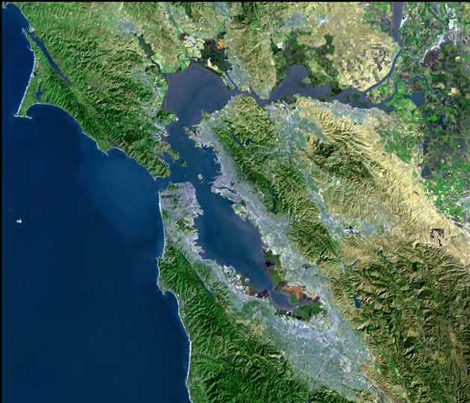
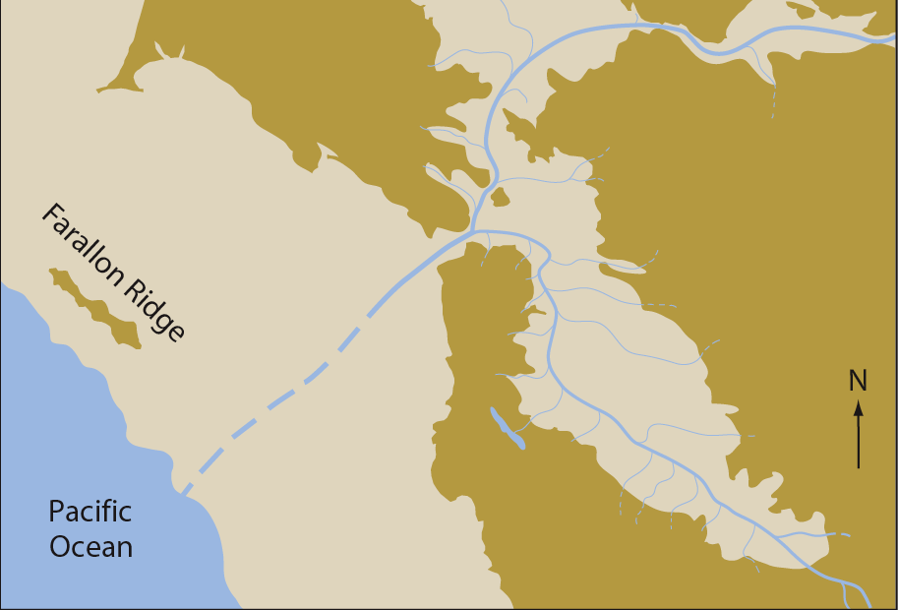
San Francisco Bay: only an estuary during HIGH sea level
Interglacial Glacial

Slide 14
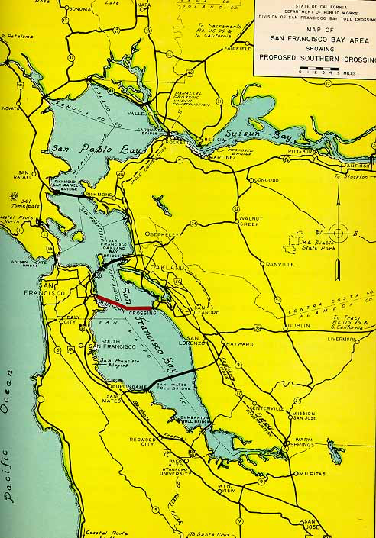
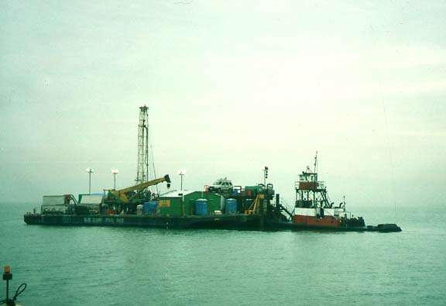
Sediment cores from San Francisco Bay record of past estuaries and climate

Slide 15
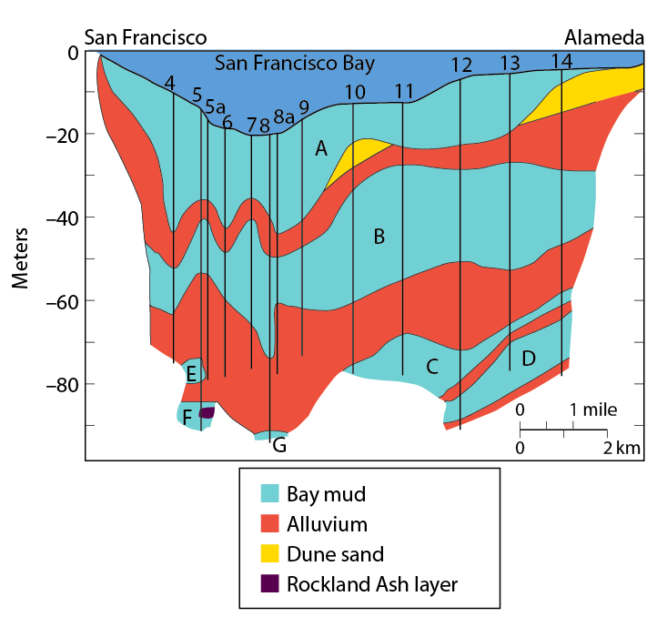
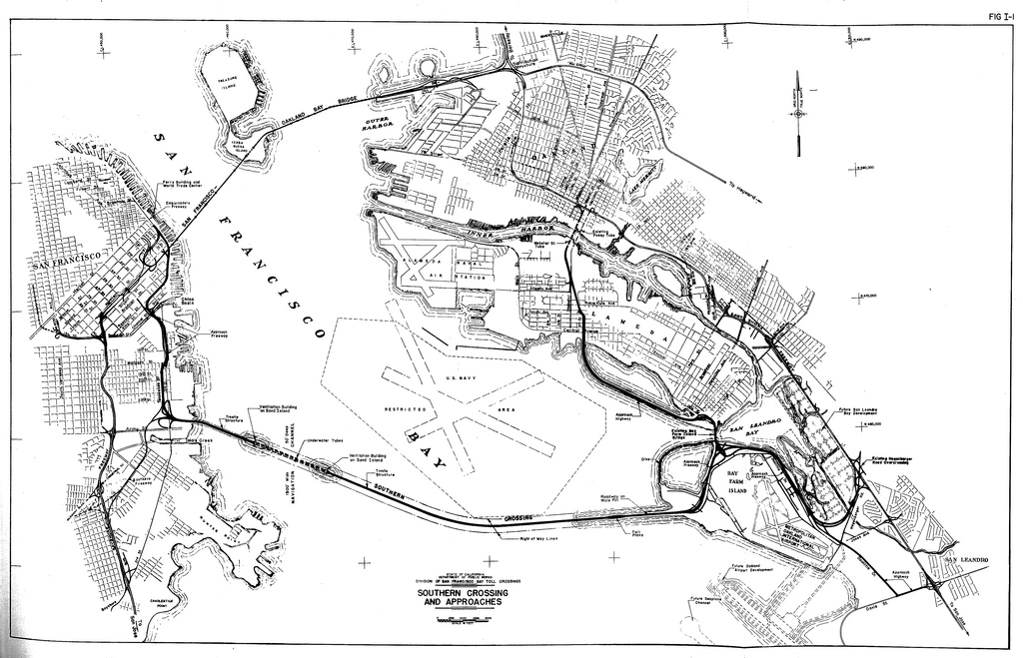
Doris Sloan
Brian Atwater

Slide 16
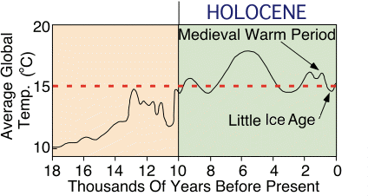
Previous ice age
interglacial
Notes:
Time period covered in book. Global climate changes from glacial max to interglacial.

Slide 17
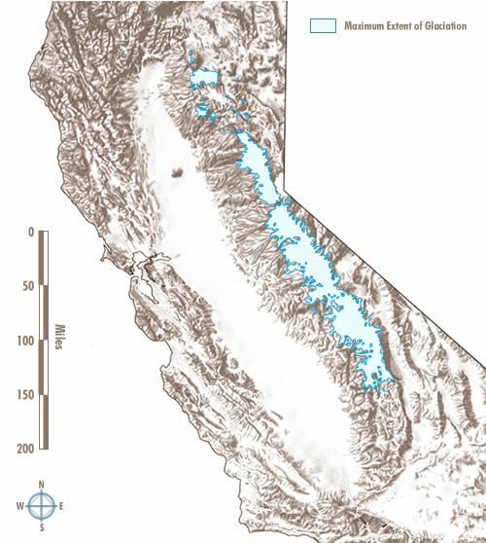

Slide 18
18,000: sea level 120 meters lower, shoreline 19 miles out

Slide 19
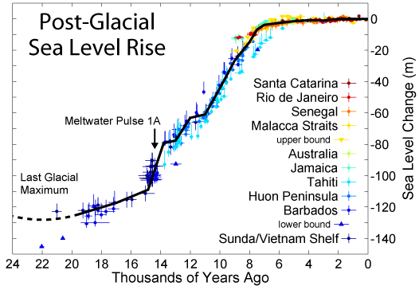
Sea level rise: 18,000 years - present (120 meters)
Notes:
This slide shows the rise of sea level over the last 18,000 years. Note that sea level rise slowed dramatically during the last 6,000 years, an important point for the S.F. estuary marshes which will be discussed soon.

Slide 20
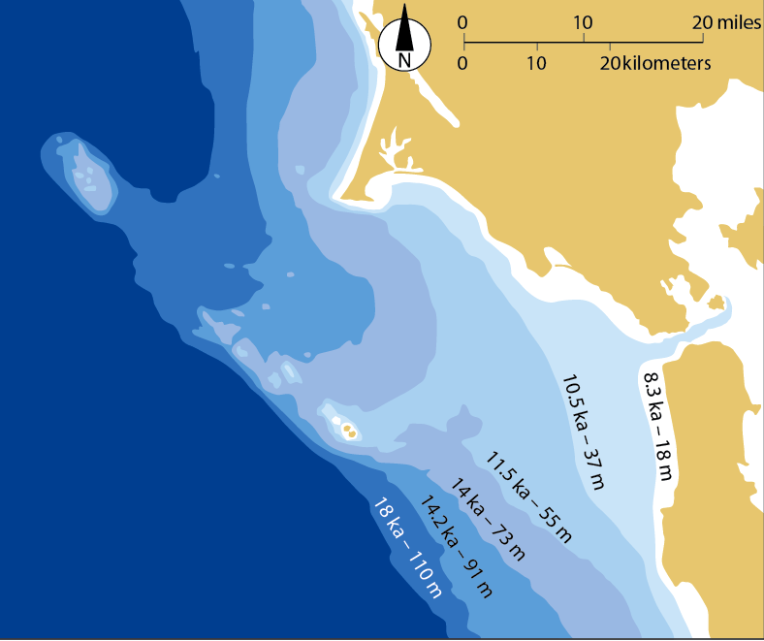

Slide 21
San Francisco Bay: filled to present level 5000 years ago

Slide 22
California droughts:
How frequent and severe were past droughts?

Slide 23
Notes:
Time period covered in book. Global climate changes from glacial max to interglacial.

Slide 24
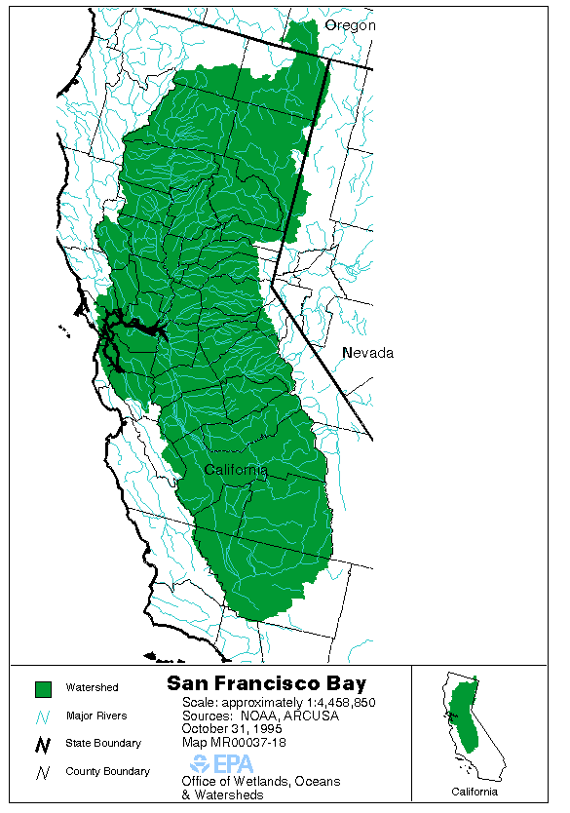
San Francisco Bay watershed
40% area of California
Precipitation and runoff drain through San Francisco Bay

Slide 25
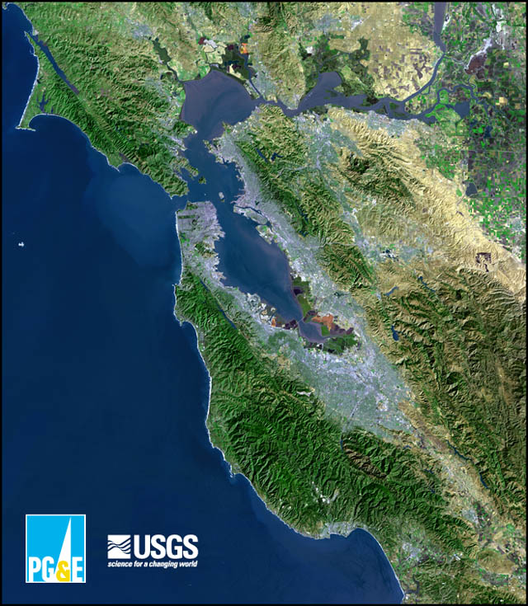
Salinity in SF Bay reflects precipitation and runoff over the drainage basin
Freshwater
Saltwater

Slide 26
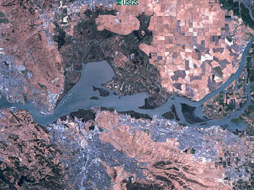
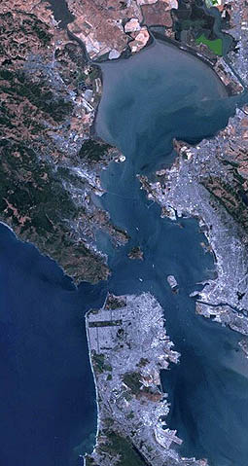
Coring locations in SF Bay
San Pablo
Bay
Suisun
Bay
Central
Bay

Slide 27
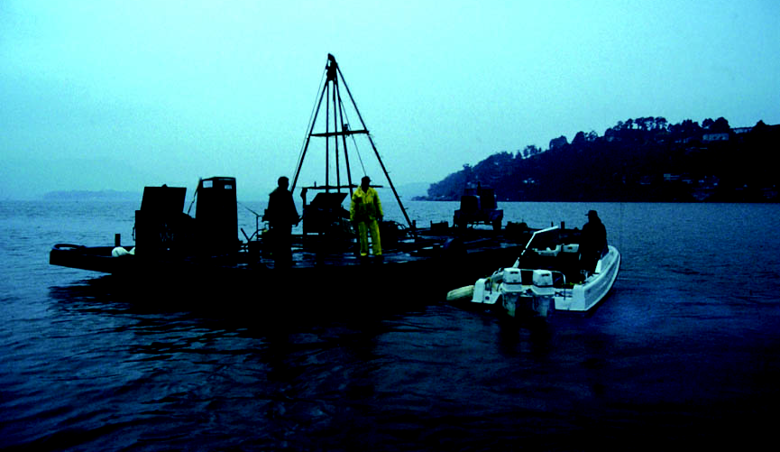
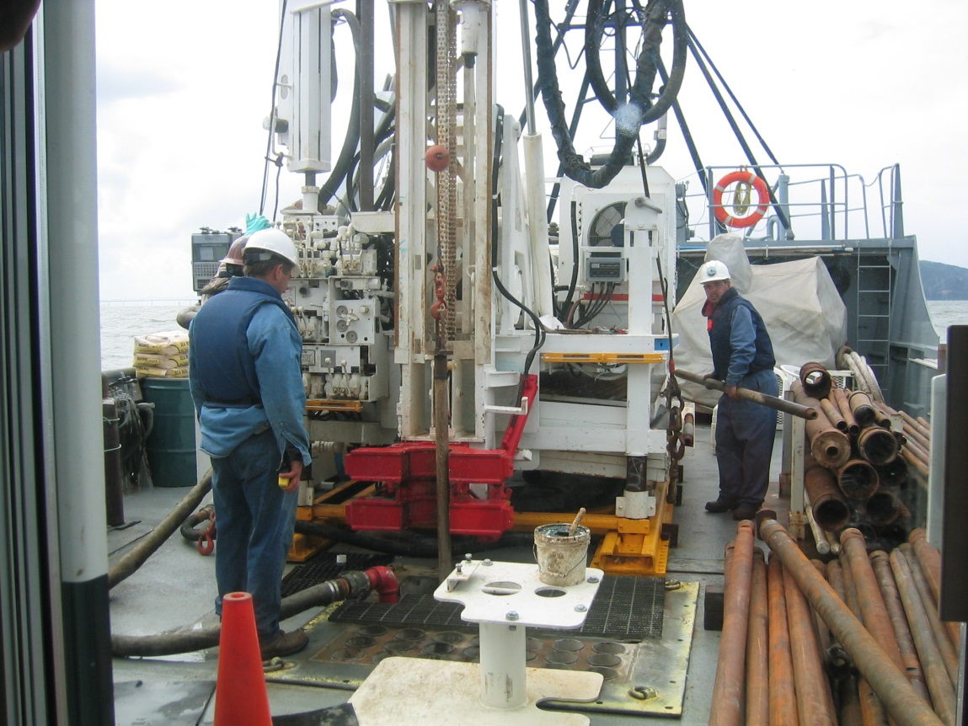
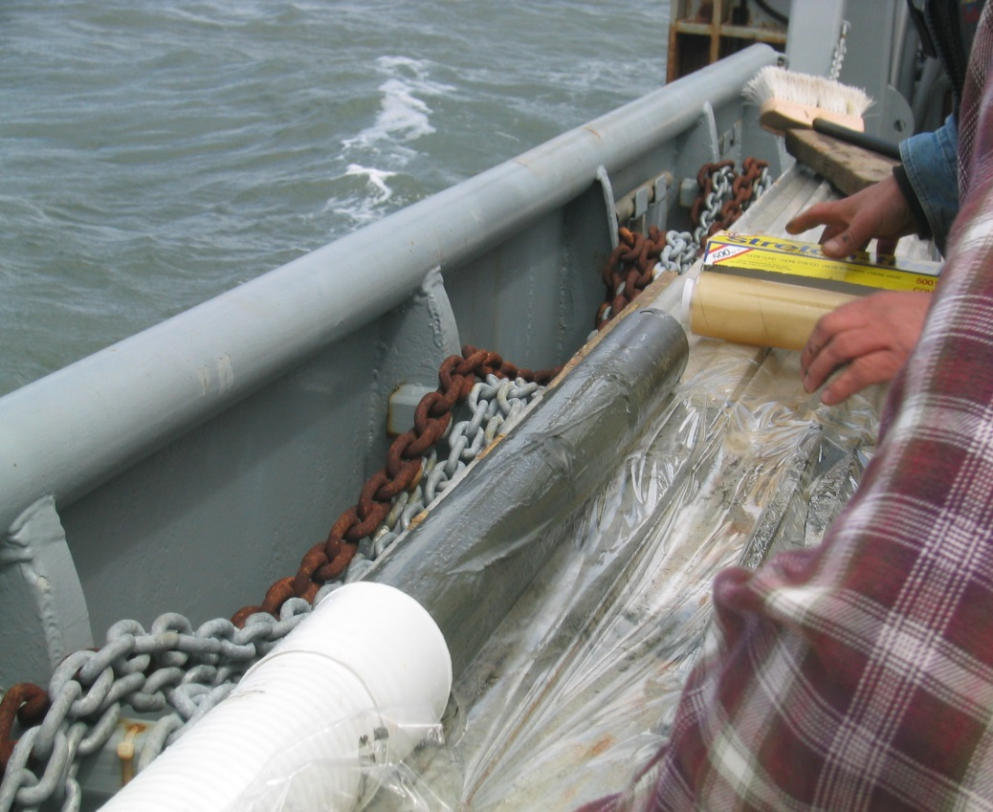
Sediment coring in San Francisco Bay

Slide 28
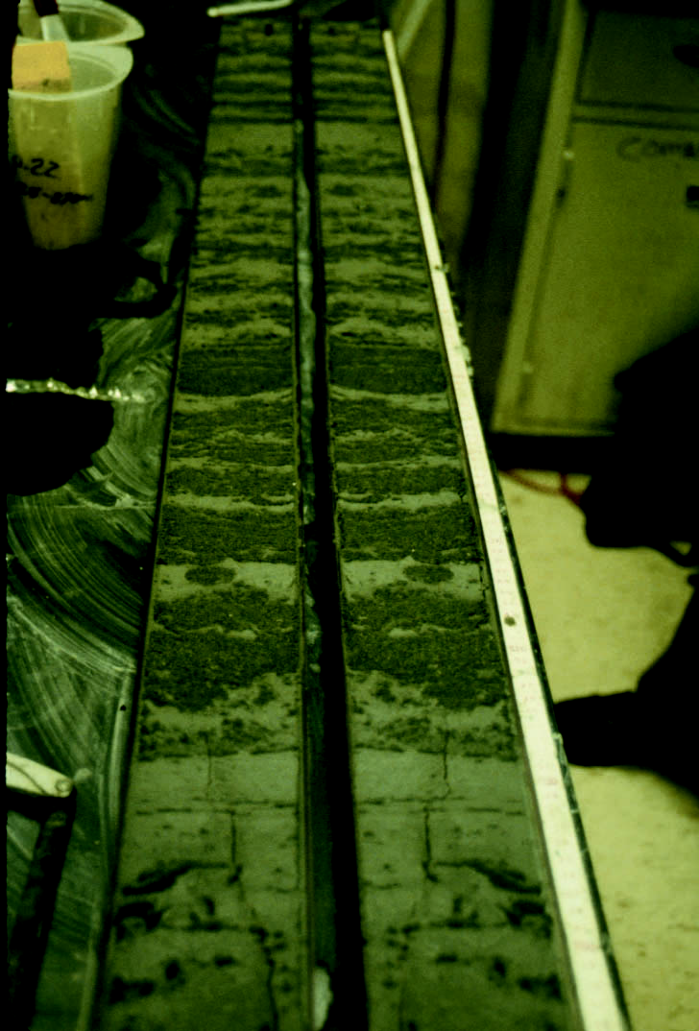
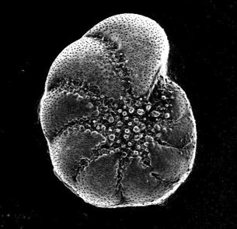
SF Bay sediment core
date with 14C
Separate fossil shells
Shell chemistry reflects salinity
Notes:
Cores collected from the Bay and its surrounding marshes contain environmental proxy records that can be analyzed to produce a history of climate-related change in environmental conditions. These proxies include the core stratigraphy (including the TOC, changes in mineral content, and grain size), in the bay cores there are a number of carbonate organisms that are preserved in the sediments, in the marshes remains of plants and pollen are preserved. And in both cores diatoms can provide information and there is a lot of work to be done in that category.
DIFF BETWEEN MARSH CORESAND BAY CORES

Slide 29
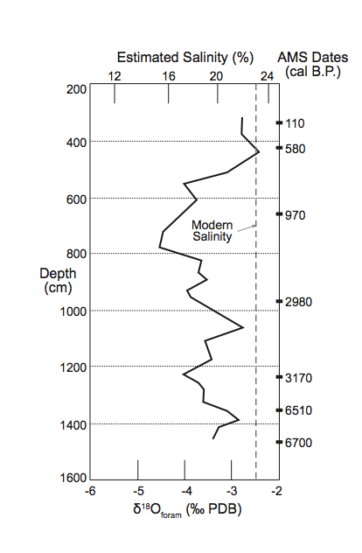
Lower runoff into Bay
Medieval Warm
Period (dry)
Notes:
Note the period approx. 1000 years ago and lasting for a few hundred years

Slide 30
Marsh core sites
China
Camp
St. Park
Roe
Island
Brown’s
Island
Benicia
St. Park

Slide 31
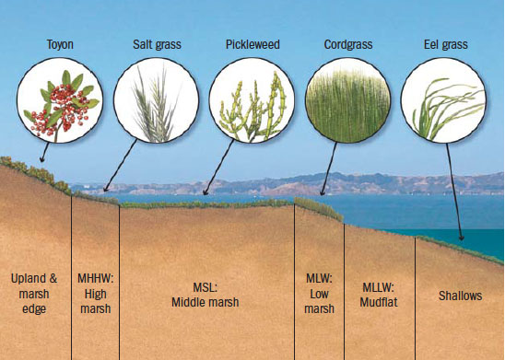
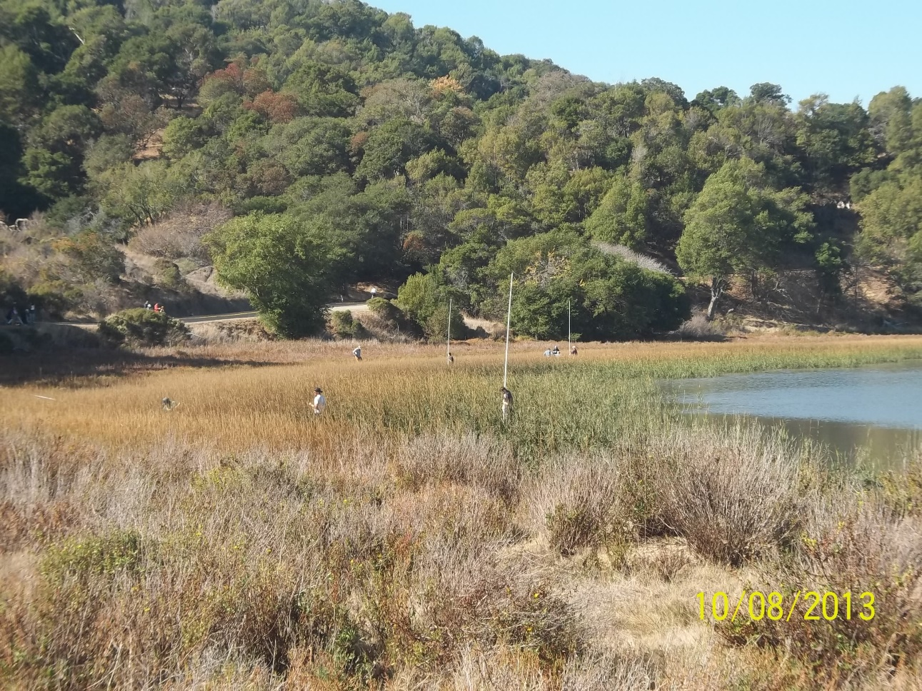
Salt Marsh plant zonation

Slide 32
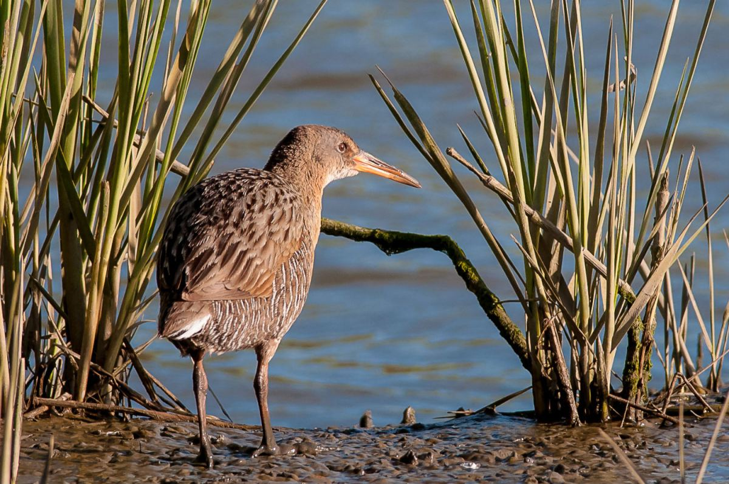
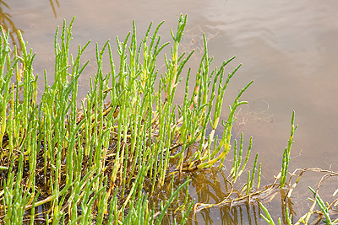
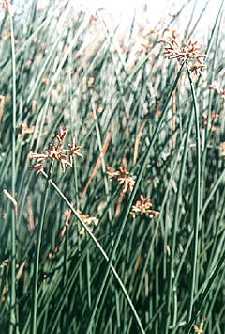
Zonation along the Bay estuary
Based on salinity gradient
Freshwater
plants
Salt marsh
plants

Slide 33
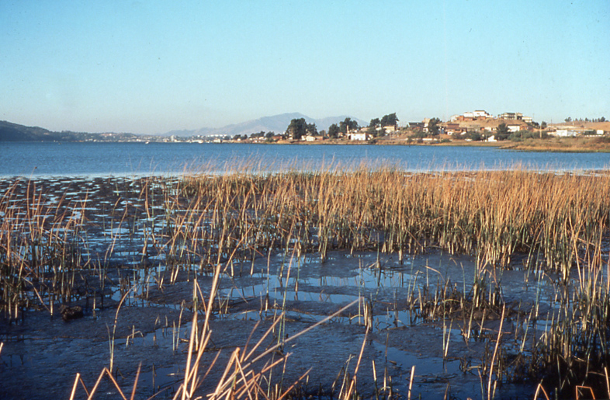
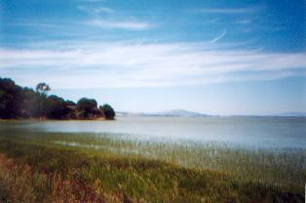
Marshes: vegetation changes with salinity
During droughts, more salt adapted plants grow (saltgrass, cordgrass, etc)
During wetter periods, more fresh adapted plants (tule, etc)

Slide 34
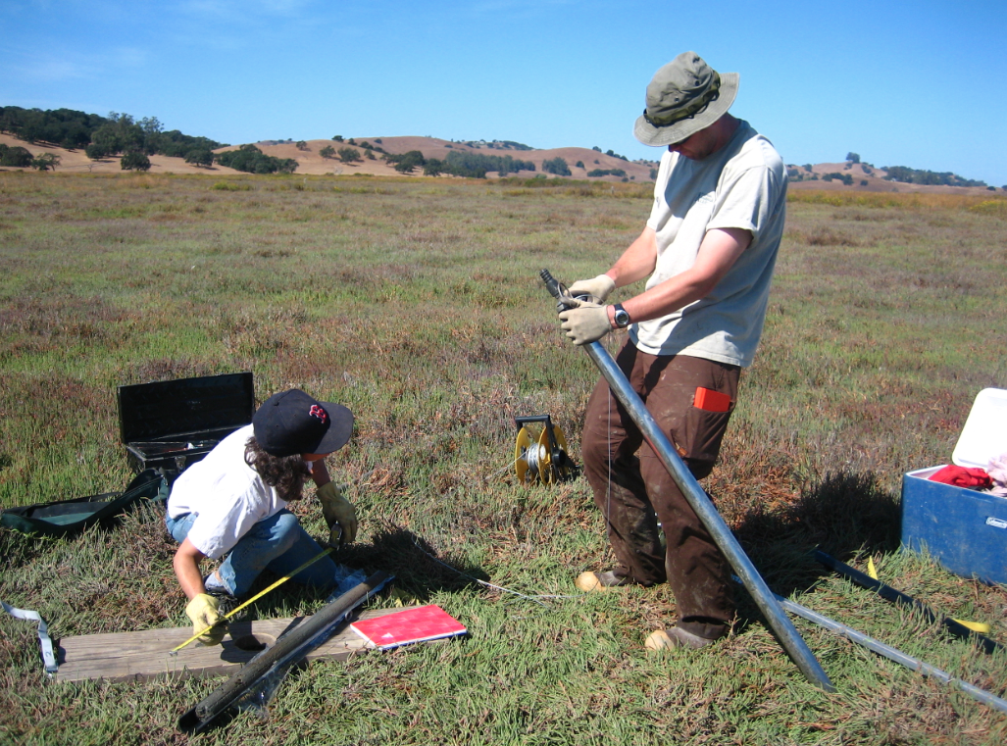
Marsh coring

Slide 35
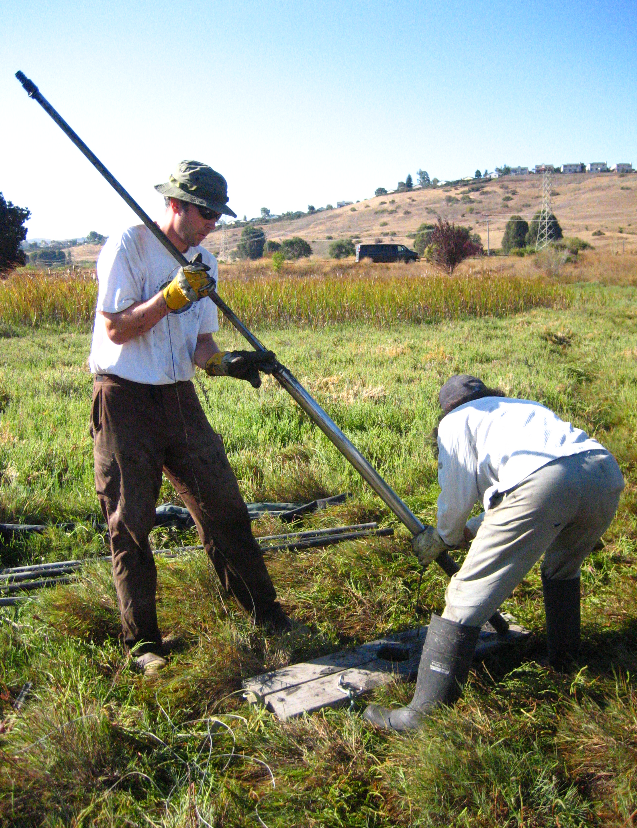
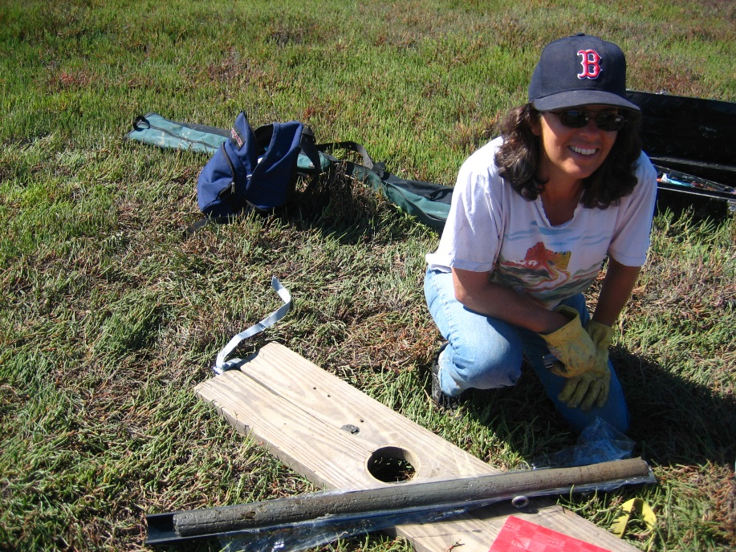
Marsh coring

Slide 37
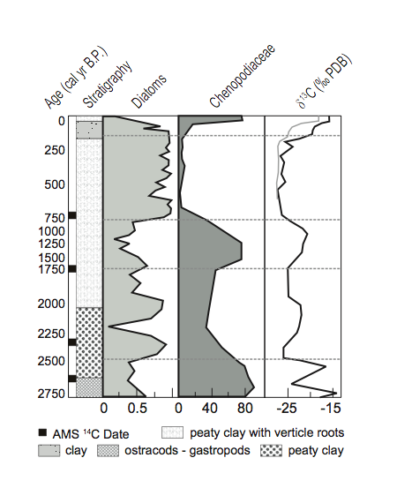
Human impact (dams and
diversions)
Little Ice Age (cooler and wetter)
Increased salt-adapted vegetation (saltgrass and cordgrass) very dry during Medieval Warm Period
Megadrought!
Notes:
Same period of drier conditions shows up in the marsh records. Sed rate much lower during this time and possibly compaction

Slide 38
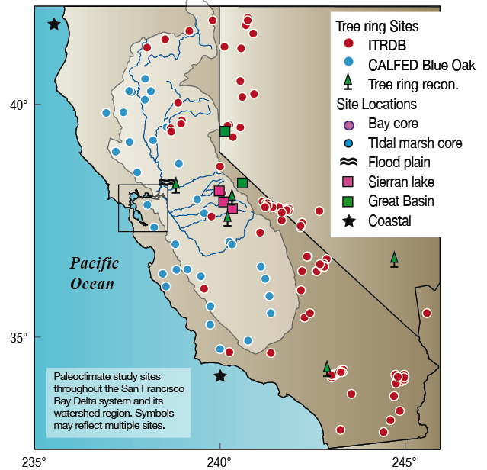
Climate records
Beyond the
San Francisco
Bay

Slide 39
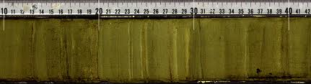



Lake sediment core
Charcoal (fires) pollen (vegetation) fossils (climate)

Slide 40

Megadrought in CA and southwest – 3 decades long

Slide 41


Submerged tree-stumps
A.D. 900-1100
A.D. 1200-1350
“Medieval megadroughts”
Stine (Nature, 1994)

Slide 42

Prolonged droughts (40% drier)
(Medieval Warm Period)
Wetter (20th century wet)
Little Ice Age

Slide 43


Giant Sequoia fire scars – 30% increase in fires during Medieval drought
(from Swetnam et al., 2008)

Slide 44



Anasazi collapse in 4 corners during Medieval drought
Mesa Verde, SW Colorado
Montezuma Castle,
central Arizona

Slide 45


California coastal shellmound sites (including in SF Bay) abandoned at the same time
(Evidence of conflict and violence, infant mortality, starvation)

Slide 46

California megafloods

Slide 47

California flood vulnerability
Central Valley bathtub
Delta/SF Bay drain
Natural floodplain/wetlands
Today 6 million people
42 billion agricultural industry

Slide 48


Worst historic flood in the West
Rained for 43 days (late Dec to early Feb)
Precipitation in 1861-62 was 3 to 4 times normal

Slide 49
Sacramento Flooding:
    10 ft of water flooded city: a “frontier Venice”
    houses swept away/ floating in the streets
    Legislature moved to SF for 6 months
    CA went bankrupt

Slide 50

Cause of flooding: Atmospheric Rivers
1000s of km long (across ocean basins), 100s of km wide
Carry warm water vapor from tropics to mid-latitudes
equivalent of up to 10 Mississippi Rivers

Slide 51

Vapor condenses as it rises over Coast Ranges and Sierra Nevada, forming rain that rapidly runs off

Slide 52

Did megafloods of 1861 magnitude occur in the past? (and at what frequency?)
Sacramento Valley floodplain sediments
CA Coast:
Santa Barbara Basin
Notes:
Sacramento flood sediments from R. Byrne’s research

Slide 53

Sediment cores:
Annual layers
Unusually thick sediment layers from megafloods
Thickness of layer proportional to size of flood
“megafloods” occurred every 100-200 years

Slide 54


Coring oxbow lake (Sacramento River valley)
Flood sediment layers
(similar to 1861-62 or larger)
- every 100-200 years

Slide 55

We need to begin preparing now for…
a warmer and drier future with rising sea level
more frequent intense flood events
longer, more intense dry seasons

