Slide 1

Genome Project Solutions
Partnering for Discovery
What If We Could Sequence Everything?
Jeffrey Boore
CEO, Genome Project Solutions, Inc.
Adjunct Professor, UC Berkeley
http://GenomeProjectSolutions.com

Slide 2
Outline
A little about us at Genome Project Solutions
The basics of genomics
History of genome sequencing and technology
Areas that have been invigorated
Evolution as the guiding framework
http://GenomeProjectSolutions.com

Slide 3
Outline
A little about us at Genome Project Solutions
The basics of genomics?
History of genome sequencing and technology
Areas that have been invigorated
Evolution as the guiding framework
http://GenomeProjectSolutions.com

Slide 4
What is Genome Project Solutions?
Non-profit independent research group
Conduct genomics research, especially regarding the evolution of genes, gene families, and genomes
Facilitate researchers’ interface with high-throughput genomics techniques
Develop and implement software and web tools for analyzing and presenting genomes
Educate scientists and the public about genome science and evolutionary genomics
http://GenomeProjectSolutions.com

Slide 6
Outline
A little about us at Genome Project Solutions
The basics of genomics
History of genome sequencing and technology
Areas that have been invigorated
Evolution as the guiding framework
http://GenomeProjectSolutions.com

Slide 10
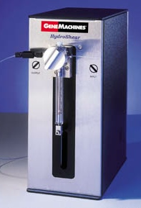
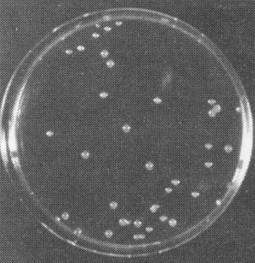
Large DNA fragment
Sheared randomly into small pieces
Clone

Slide 11
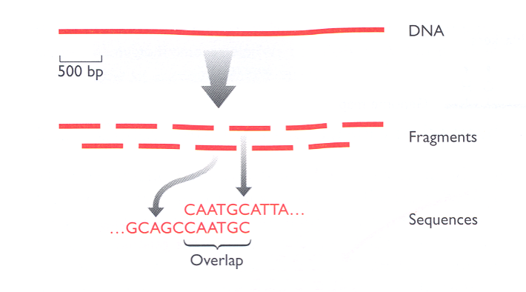
Genome Project Solutions
Partnering for Discovery

Slide 12
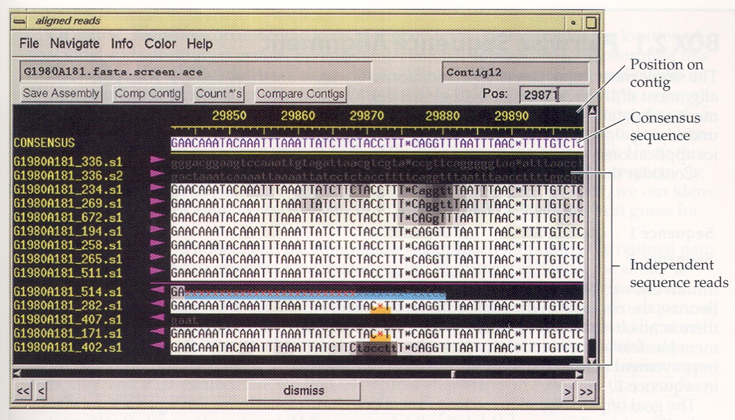

Slide 13
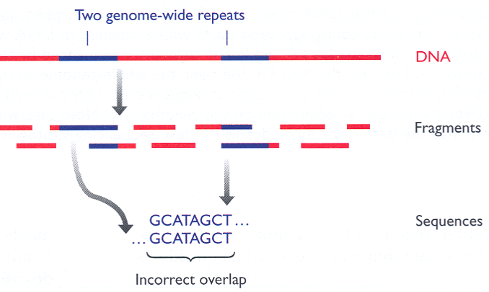

Slide 14
Genome Project Solutions
Partnering for Discovery
Short
paired-end
reads
Medium
paired-end
reads
Long
paired-end
reads

Slide 15
Outline
A little about us at Genome Project Solutions
The basics of genomics
History of genome sequencing and technology
Areas that have been invigorated
Evolution as the guiding framework
http://GenomeProjectSolutions.com

Slide 16
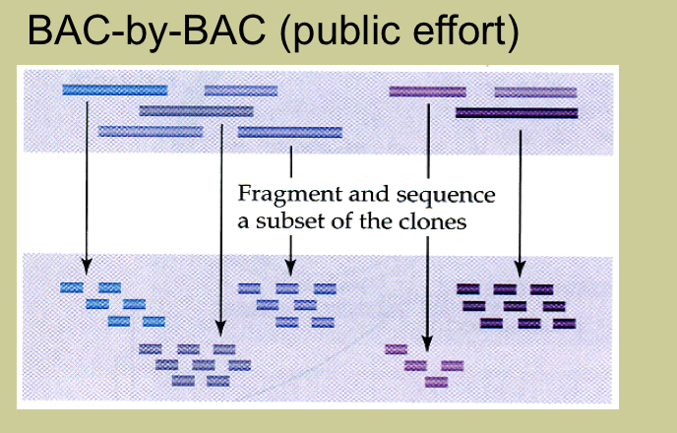
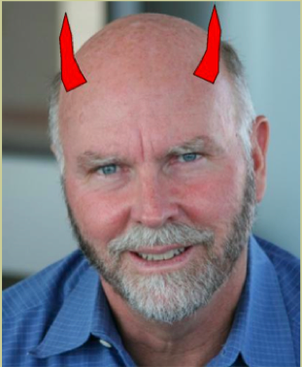
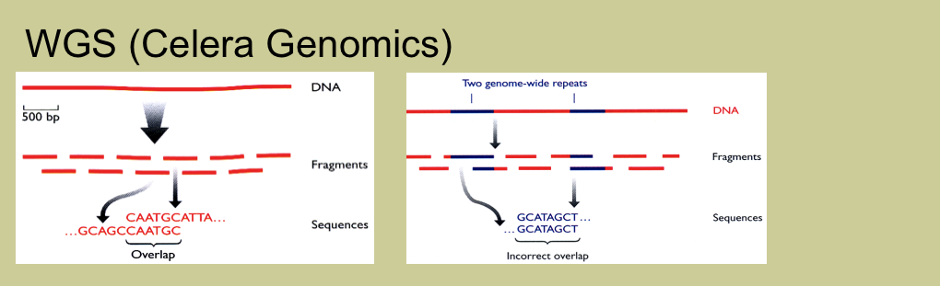

Slide 17
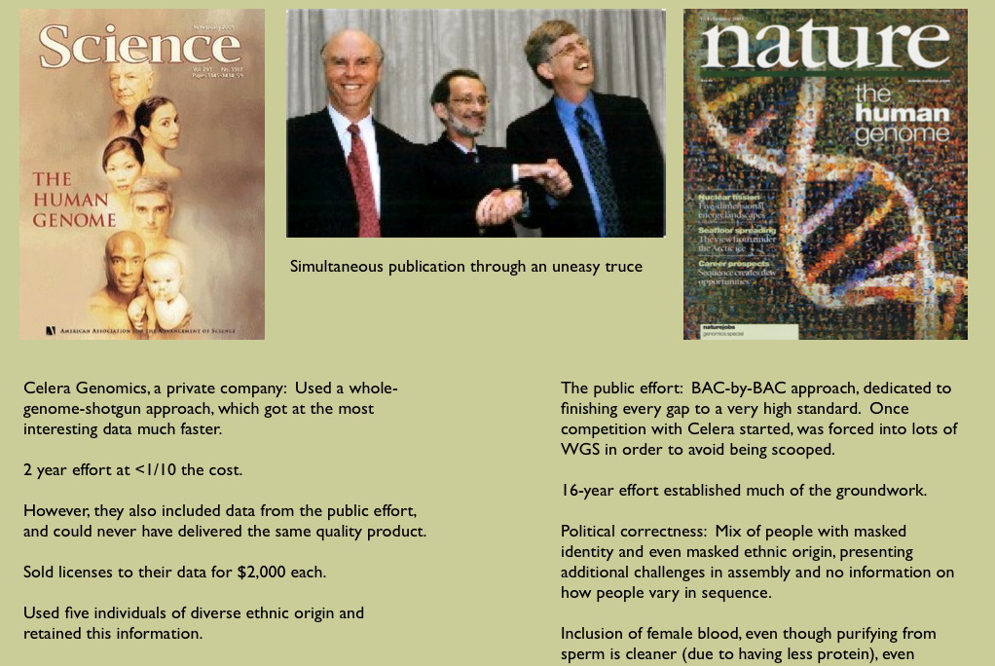

Slide 18
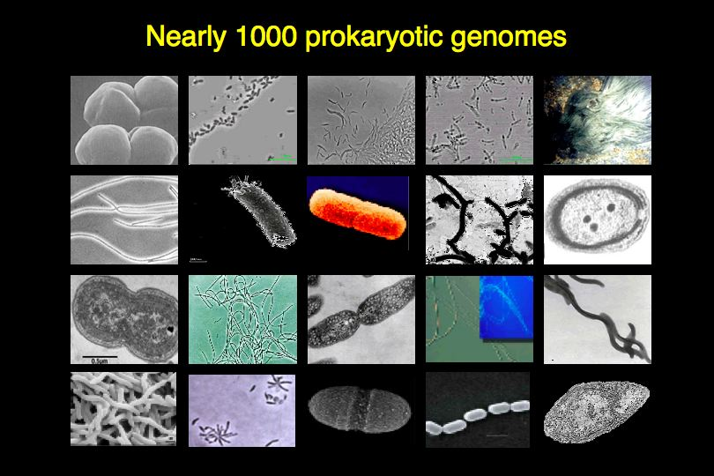
Over 1000 prokaryotic genomes

Slide 19
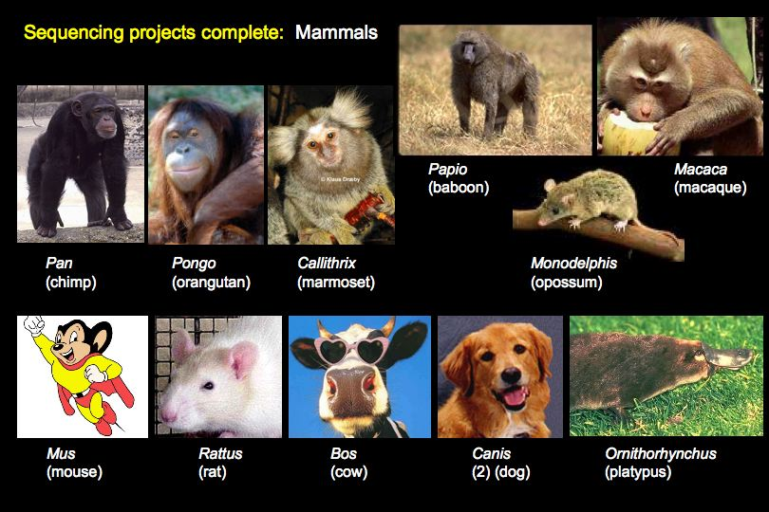

Slide 20
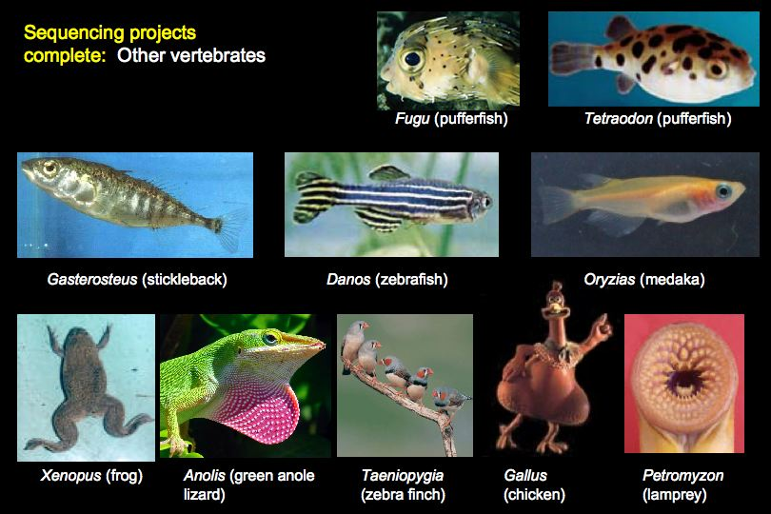

Slide 21
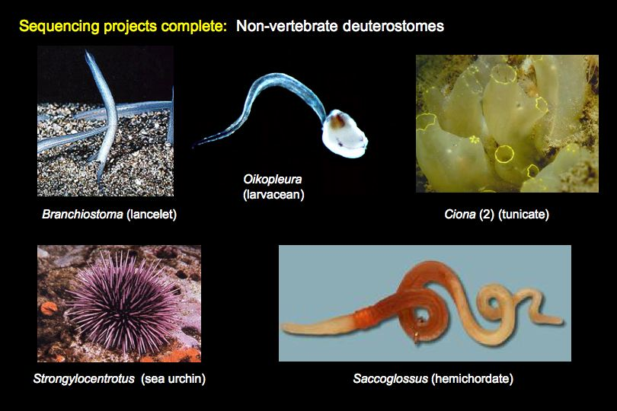

Slide 22
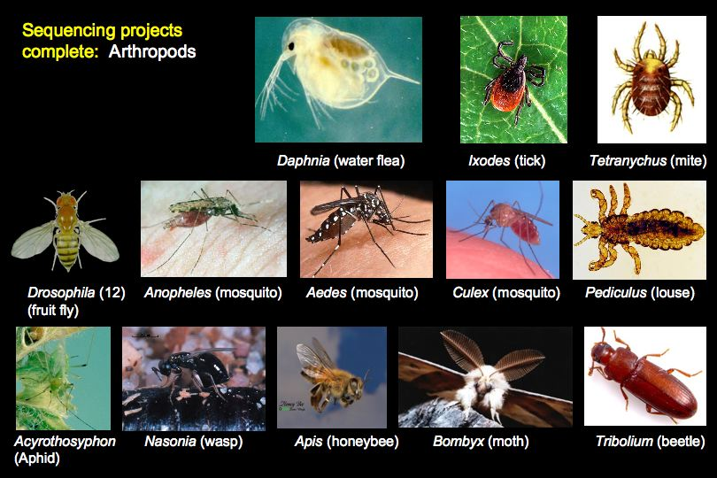

Slide 23
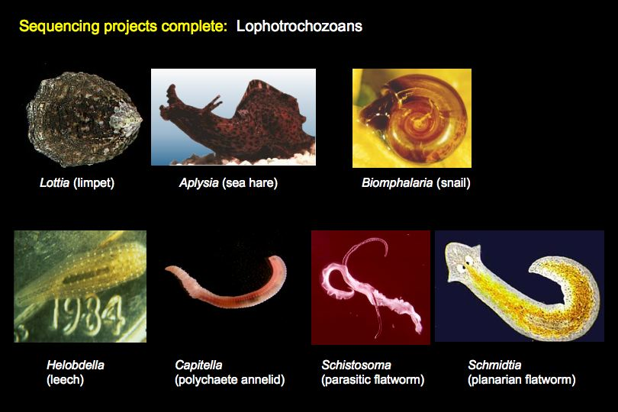

Slide 24
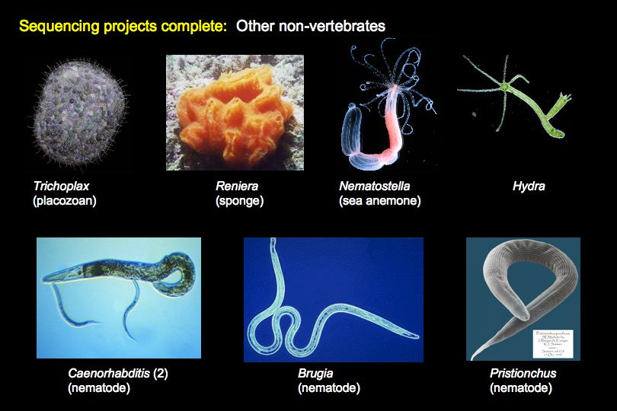

Slide 25
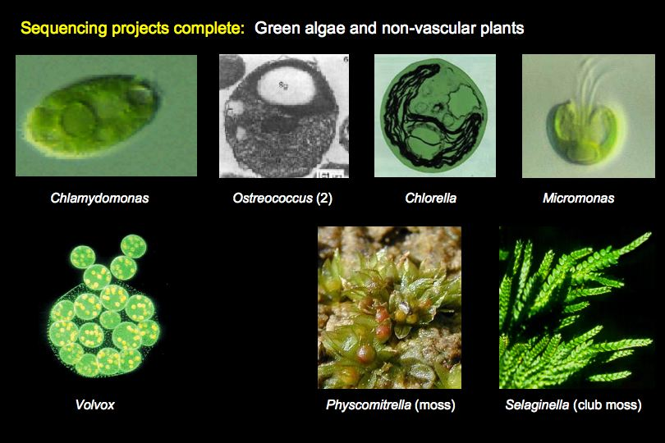

Slide 26
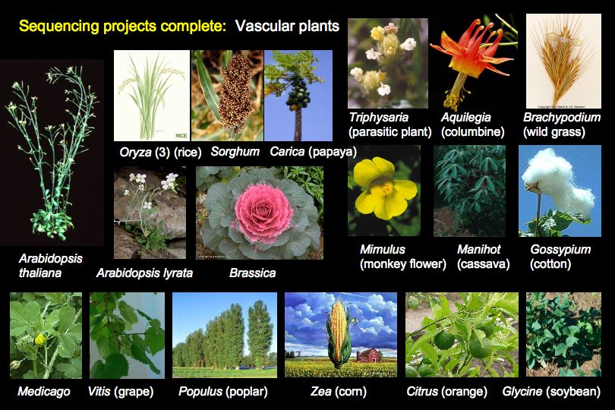

Slide 27
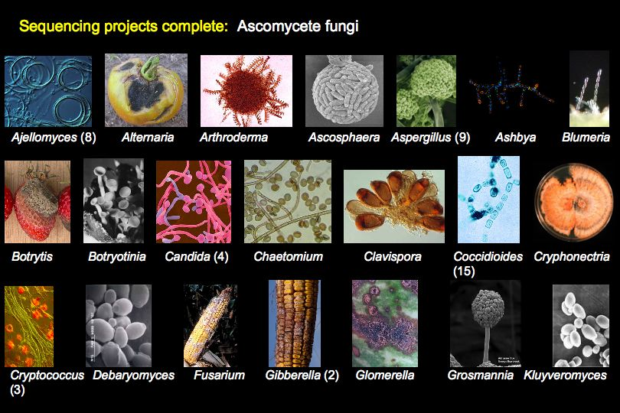

Slide 28
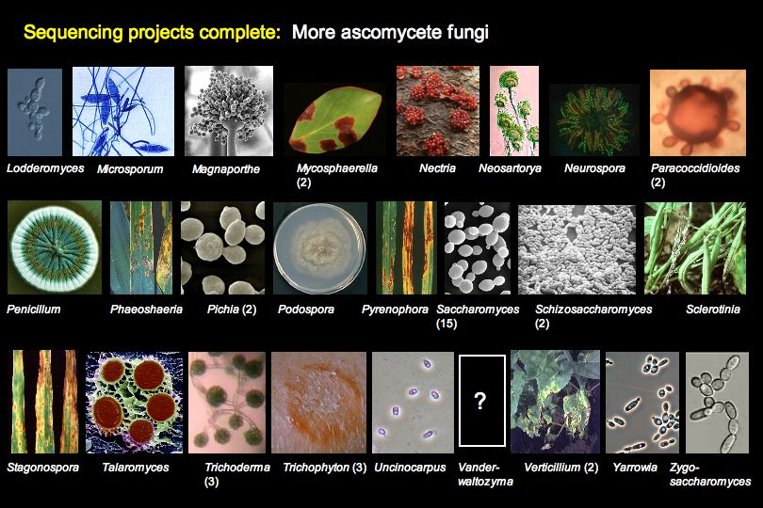

Slide 29
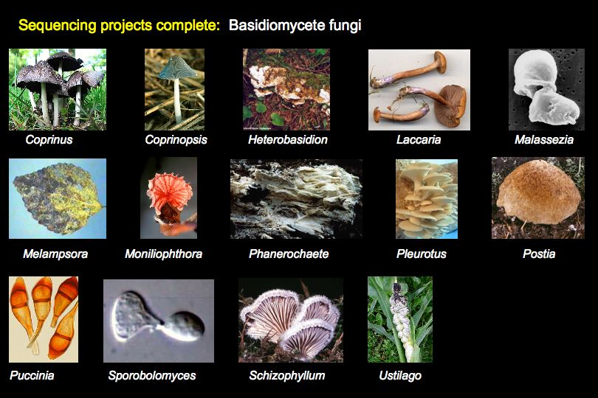

Slide 30
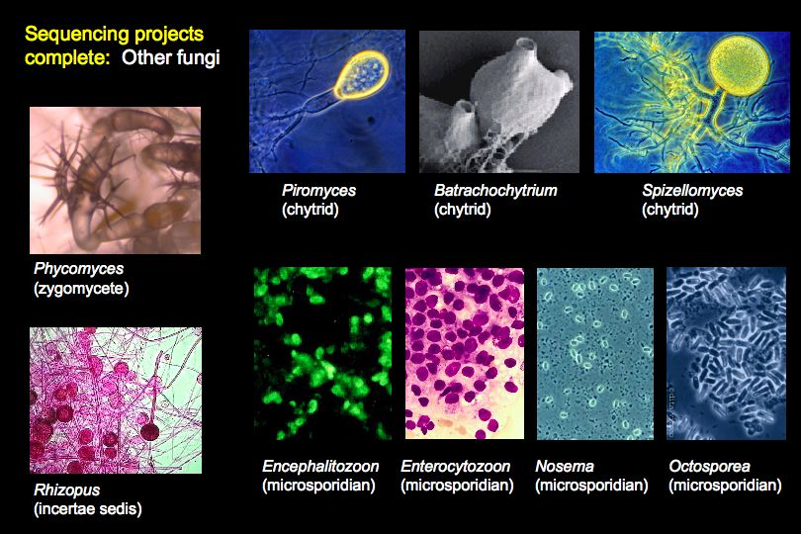

Slide 31
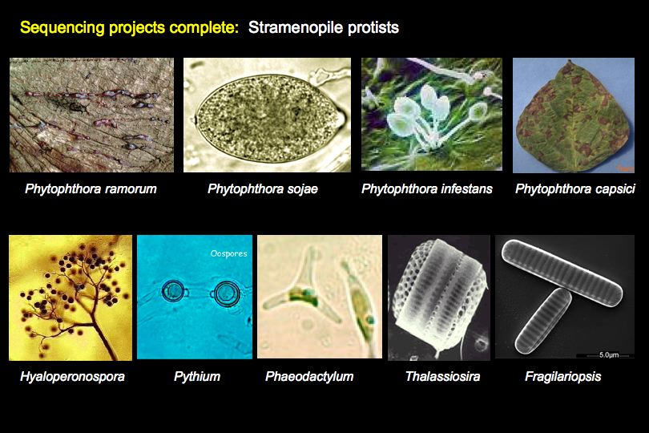

Slide 32
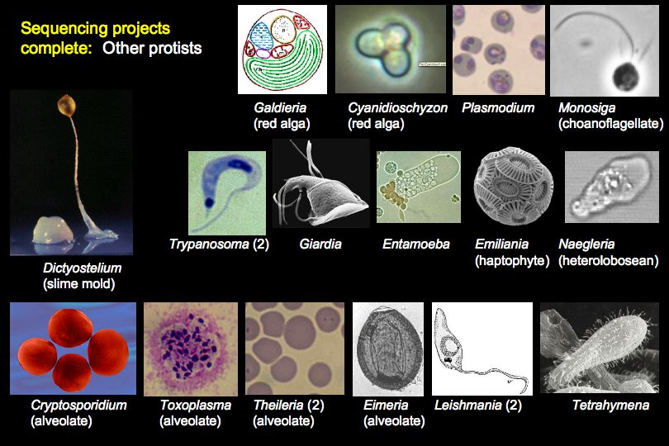

Slide 33
Genome Project Solutions
Partnering for Discovery
Approach | Nt / run | Cost / Mb
Capillary electrophoresis | 240,000 | $1,200
Roche (454) | 500,000,000 | $25
Illumina | 250,000,000,000 | $1
http://GenomeProjectSolutions.com

Slide 34
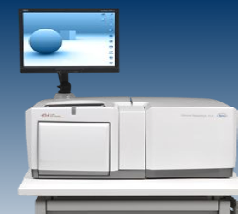
Changes in genome sequencing
Cost of sequencing a genome itself has dropped >20-fold in the last 3 years
Consolidation for the Human Genome Project (late 90s) was necessary because of technology and bioinformatics development and economy of scale for robotics, etc., leading to the creation of major genome centers.
We would not do this today
Today, an individual lab with a modern instrument can
produce DNA sequence 300x faster than all of these
centers could do, combined, in 2005.
Urgent need for bioinformatics to assemble reads,
find genes and regulatory elements, conduct measures
and comparisons of various genome features, and -
the step hardest to automate - find insights into the
biological processes that these sequences give rise to.

Slide 35
“Threshold effect”
The drop in cost creates a
“threshold effect” for individual researchers
For draft sequence of a 500 million nucleotide genome
(not counting costs for analysis)
Using 8x capillary electrophoreses ~ $5,000,000
Using 50x Illumina sequencing ~ $25,000
http://GenomeProjectSolutions.com

Slide 36
Outline
A little about us at Genome Project Solutions
The basics of genomics
History of genome sequencing and technology
Areas that have been invigorated
Evolution as the guiding framework
http://GenomeProjectSolutions.com

Slide 37
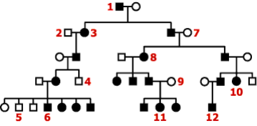
Candidate Gene Approaches
Before genomics:
Pedigree including affected individuals
Find physical “markers” in the genome
Track co-segregation
Sequence DNA clones corresponding to markers
“Walk” out from this sequence, find additional markers
Repeat MANY times until a candidate gene is found
Now: Identify a set of candidate genes and see if they vary between affected and unaffected people
(not necessarily related), potentially reducing decades of work to months

Slide 38
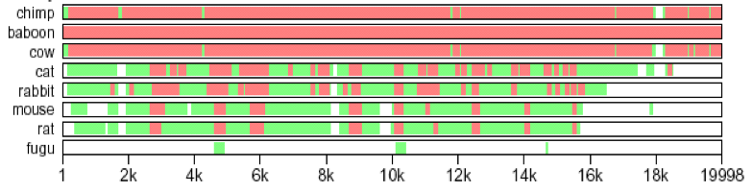
Identifying Regulatory Elements
Phylogenetic “shadowing”
No one evolutionary distance is always optimum

Slide 39
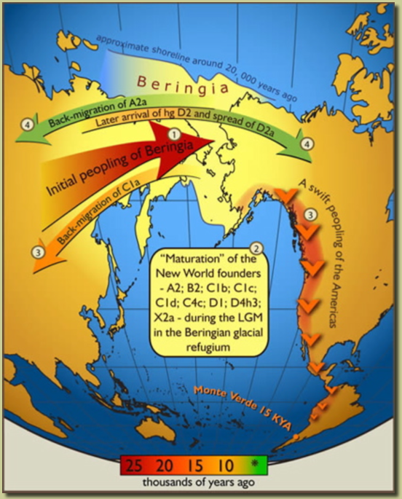
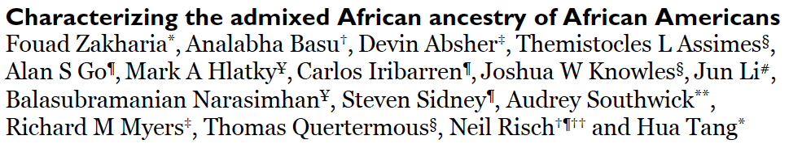
“Peopling” of the Earth
The patterns of migration, degree of admixture, and history of alleles
Humans as a model species for understanding genome evolution
and the “population genomics” of many species.

Slide 40
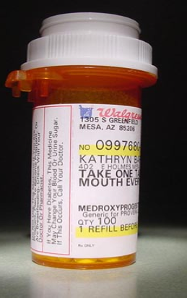
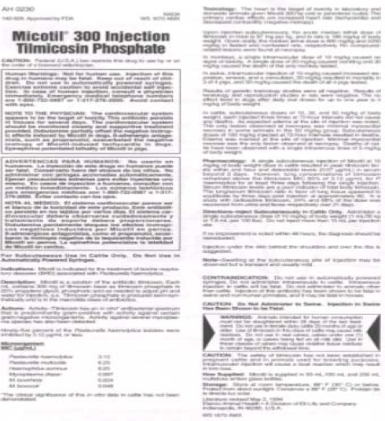
Genome-wide Association Studies
“Resequence” the whole genome of various individuals and correlate variation accumulated during our evolution with differences in drug response, disease susceptibility, and other traits, leading to “personalized medicine”.

Slide 41
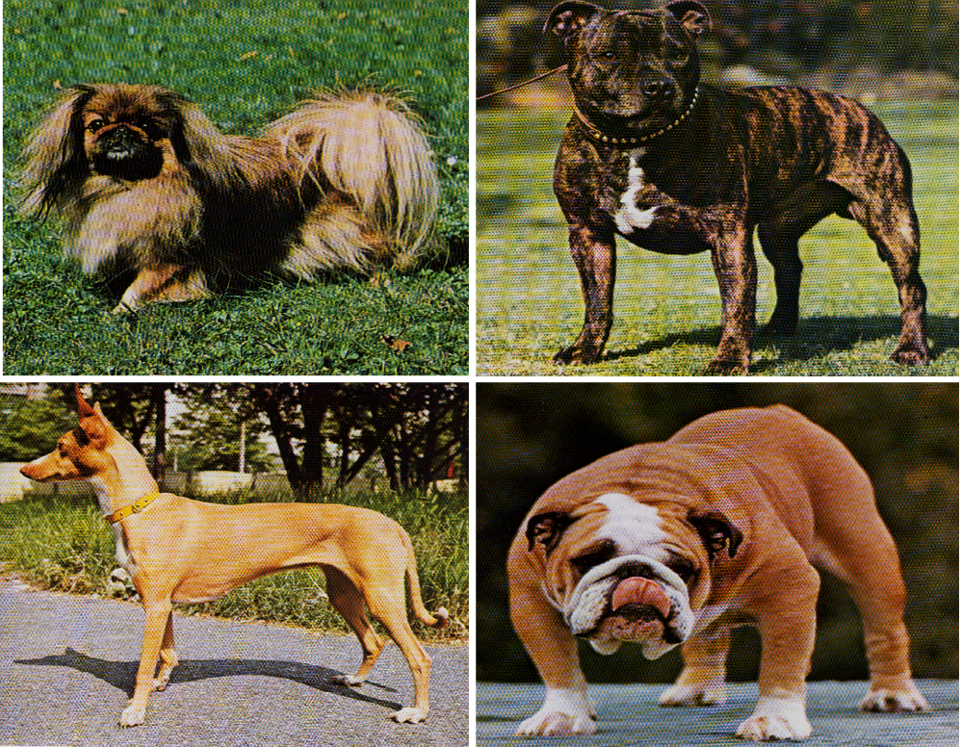
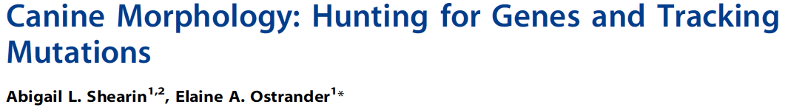

Candidate Gene Approaches for Other Organisms
Correlate novel genomic features with novel traits (morphological, physiological, behavioral, etc.)

Slide 42
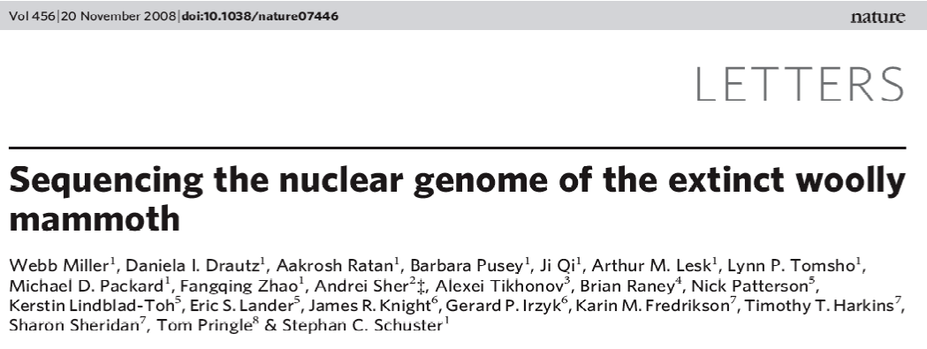
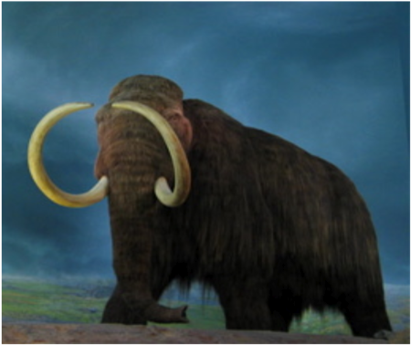
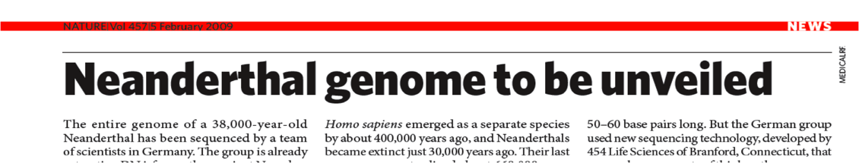
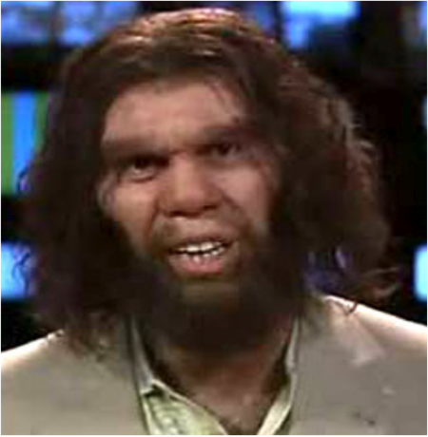
Understanding the Genomes of Extinct Organisms

Slide 43
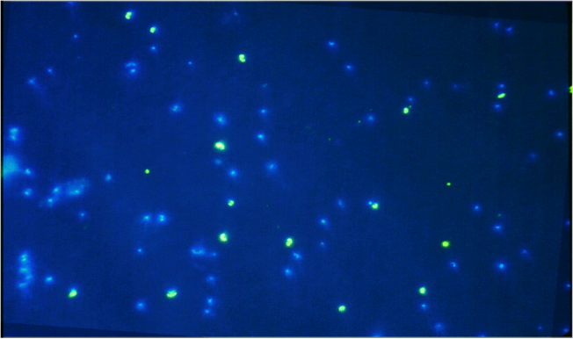
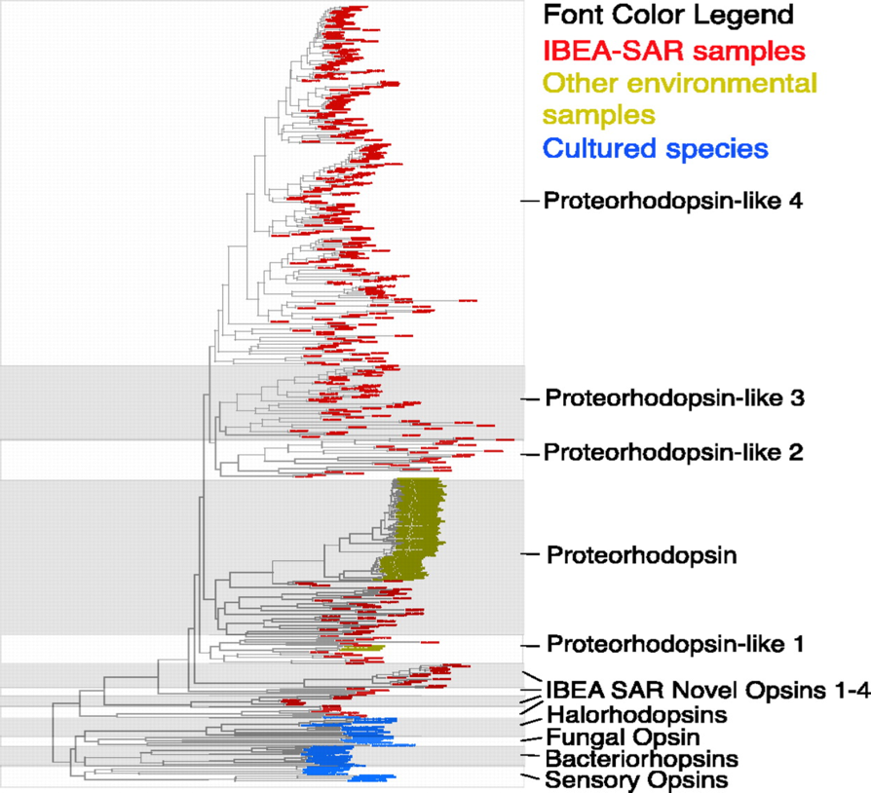
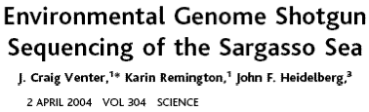
Metagenomics
99%+ of Earth’s microbiota cannot be grown in culture
Found in all ocean waters, soils, and lakes
rRNA in situ hybridizations of
Oceanic Sample from
Monterey Bay, CA
Green = Archaea
Blue = Bacteria

Slide 44
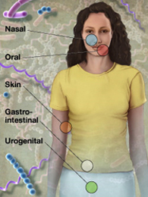
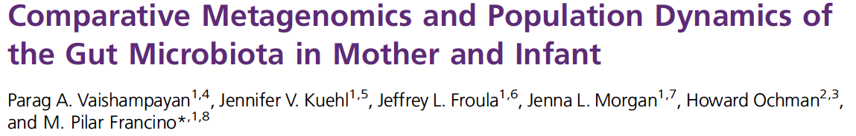

Metagenomics
The “other” human genome
Microbial cells outnumber human cells by >10:1, and total number of different genes by 200:1
Largely uncharacterized and unculturable
Some disorders with a bacterial aspect: ulcers (H. pylori), cardiovascular disease, Crohn’s disease, kidney stones
NIH Human Microbiome Project aims:
Characterize the microbiome (1,000 bacterial genomes)
Understand whether changes in the microbiome correlates with changes in human health by SSU-rRNA surveys

Slide 45
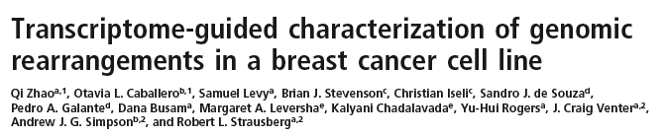
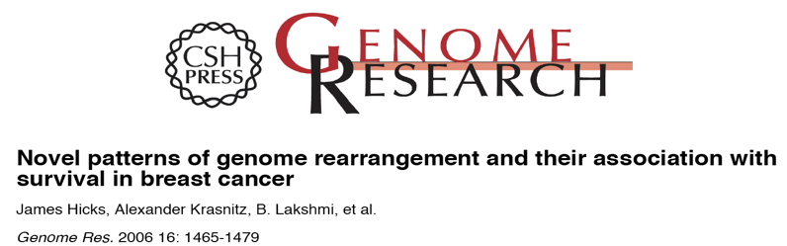
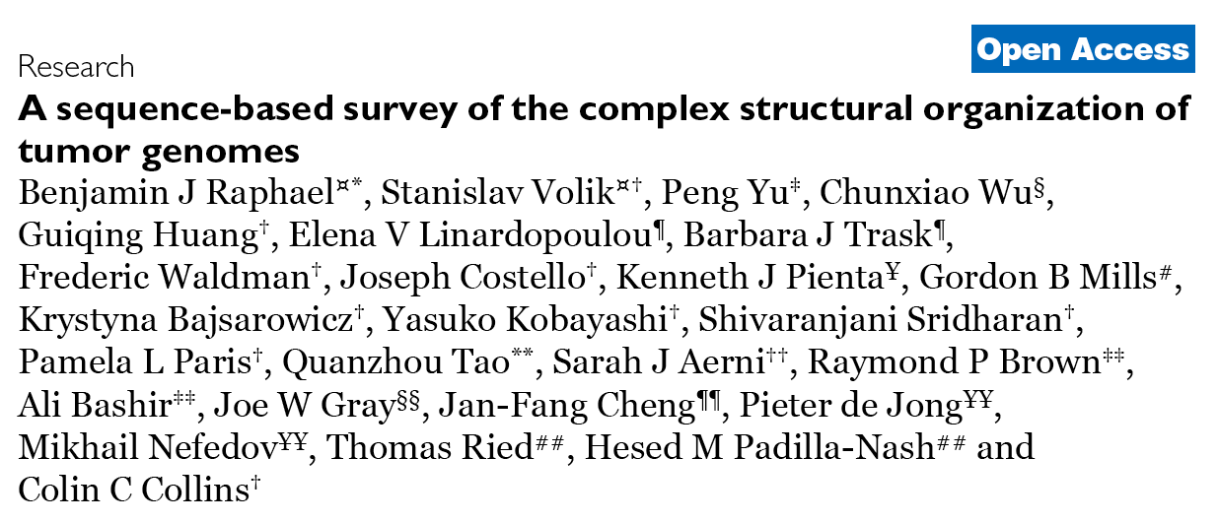
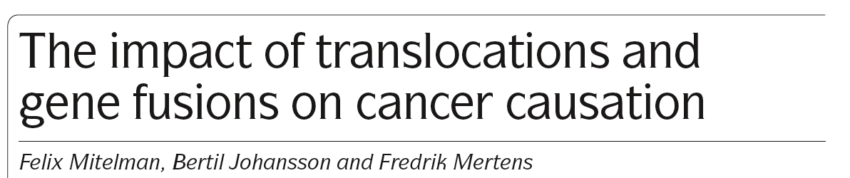
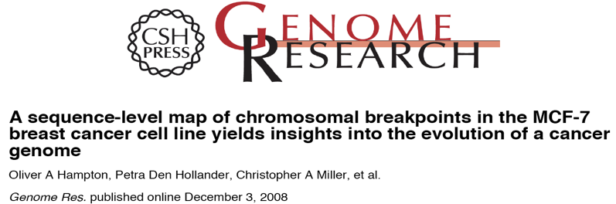
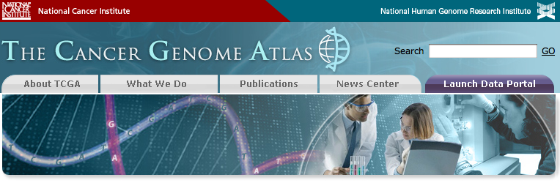
The “Cancer Genome”

Slide 46
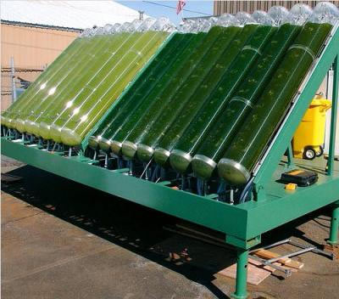
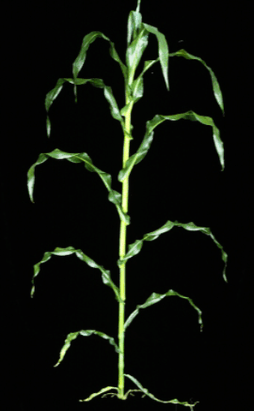

Modifying Microorganisms
For example, making better algae to produce biodiesel, making crops that make drugs, or making bacteria that can digest cellulose as part of making ethanol

Slide 47

Understanding Gene Expression
Isolate mRNA from various stages, tissues, challenge conditions, etc.
Use short read technology (e.g. Illumina) to generate a large number of reads and compare computationally to see which genes are turned on or off

Slide 48

Understanding the Evolution of Genome Size
What constitutes the large amounts of non-functional DNA in very large genomes?
What processes cause genomes to become larger or smaller?
Is genome size determined primarily by selection for the optimum size or, alternatively, by equilibrating to the mutational biases, with some causing DNA gain and others DNA loss?

Slide 49

Understanding the Role of Duplications
Outside cell
Inside cell
Drosophila
Notch
receptor
protein
4 human
Notch
receptor
proteins

Slide 50
Understanding the Role of Duplications
Multigene families have sequence similarity because they derive from a common ancestral gene.
The Beta globin gene family in primates contains genes that are differentially expressed, with highest O₂ binding in embryonic (Epsilon), then fetal (Gamma), then adult (Beta and Delta) stages.
Beta globin gene cluster
Human chromosome 11
G A
Epsilon Gamma Delta Beta

Slide 51
Understanding the Role of Duplications
Some multigene families are stable over long periods of time (e.g. Hemoglobins, rRNAs)
Human beta hemoglobin
beta
Orang beta hemoglobin
Baboon beta hemoglobin
Human delta hemoglobin
delta
Orang delta hemoglobin
Baboon delta hemoglobin
G A
Epsilon Gamma Delta Beta

Slide 52
Understanding the Role of Duplications
. . . while others are rapidly changing in composition (e.g. zinc finger transcription factors)
mouse
human

Slide 53






Phylogeny Using Genome-Level Characters
Chimpanzee
Lemur, Loris
Baboon
Squirrel monkey
Prosimians Tarsiers NWM OWM Apes
Alu-C7
Alu-C9
Alu-C12
Schmitz, Ohme, and Zischler, 2001 Genetics 157:777-784
PCR survey of 118 intronic SINE element positions

Slide 54
Outline
A little about us at Genome Project Solutions
The basics of genomics
History of genome sequencing and technology
Areas that have been invigorated
Evolution as the guiding framework
http://GenomeProjectSolutions.com

Slide 55






The way that life is NOT arranged

Slide 56

The way that life IS arranged

Slide 57
A
B
C
A
B
C
Derived state
(apomorphy)
Modification
Ancestral state
(plesiomorphy)

Slide 58



Biological interpretations hinge on knowing phylogenetic relationships
+
For example:
+ / —
for knuckle walking
+
Homo lost knuckle walking here
+
+
—
+
+
—
+
Other apes gained knuckle walking here
—
Homo never did knuckle walking

Slide 59




How many times has flight evolved?

Slide 60

Genome Project Solutions
Partnering for Discovery

Slide 61




Why is it imperative that we are guided by the principles of evolutionary biology?
We must employ the same principles to:
Biochemical pathways
Gene rearrangements
Gene transfers
Domain shuffling

