Slide 1
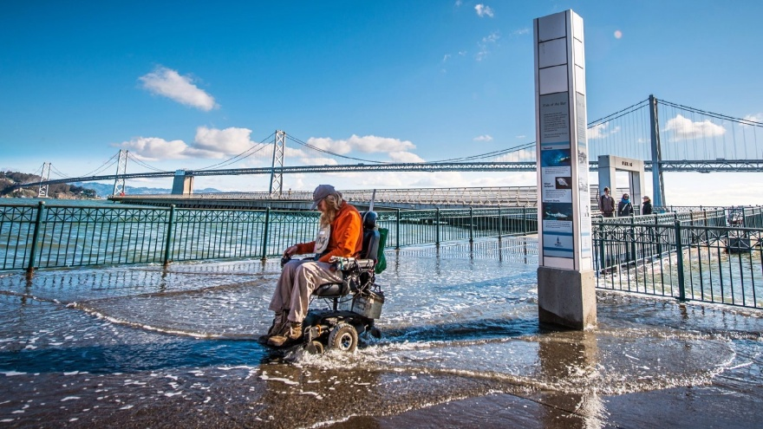
Out of the Pan, Into the Fire: Restoring the Estuary’s Tidal Wetlands in the Face of Rapid Climate Change
King Tide, Embarcadero
Michael Vasey, Ph.D., Director
San Francisco Bay National Estuarine Research Reserve
February 27, 2016

Slide 2
Outline
Profile of the Historic San Francisco Estuary
Degradation of Tidal Wetland Landscapes (Into the Pan)
Restoration of Tidal Wetlands (Out of the Pan)
Emergence of Rapid Climate Change (Into the Fire)
Coastal Resilience, Environmental Intelligence, Place-Based Conservation (Out of the Fire?)

Slide 3
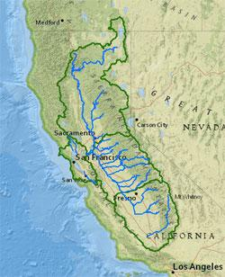
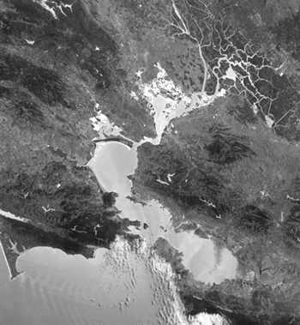
San Francisco Estuary
Watershed drains ~40% of California
Tidal Influence ~1600 sq. mi

Slide 4
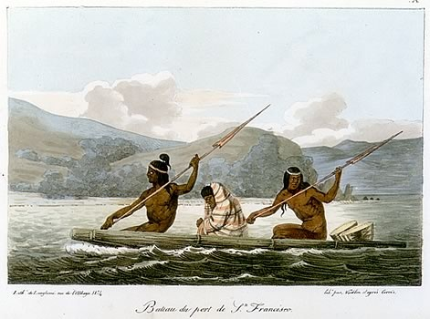
One of largest concentrations of Native Americans anywhere on our continent

Slide 5
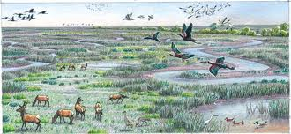
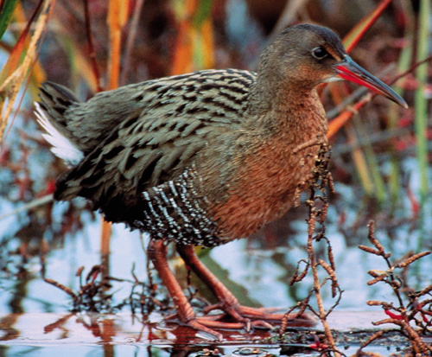
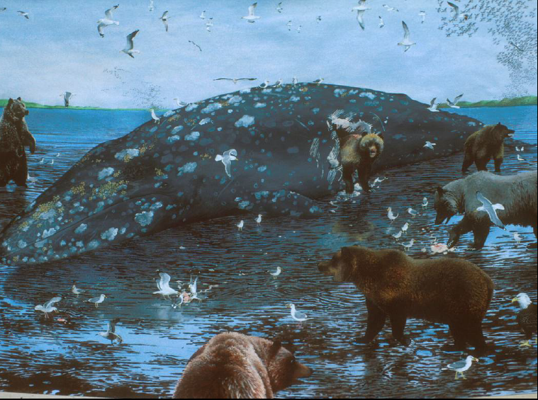
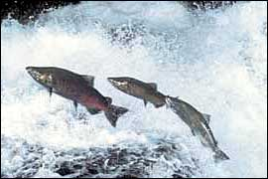
Extraordinarily rich concentration of wildlife

Slide 6
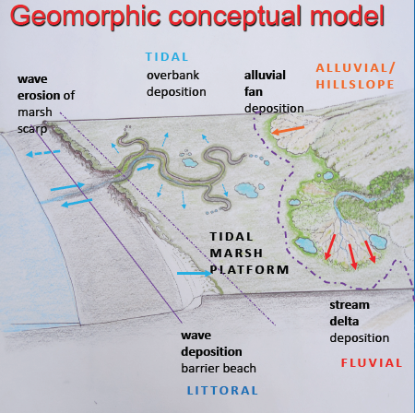
Highly heterogeneous landscape patterns and processes
Peter Baye

Slide 7
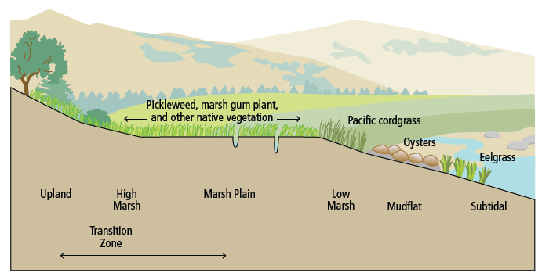
Vertical zonation of habitats
Vertical Zonation of Tidal Communities

Slide 8
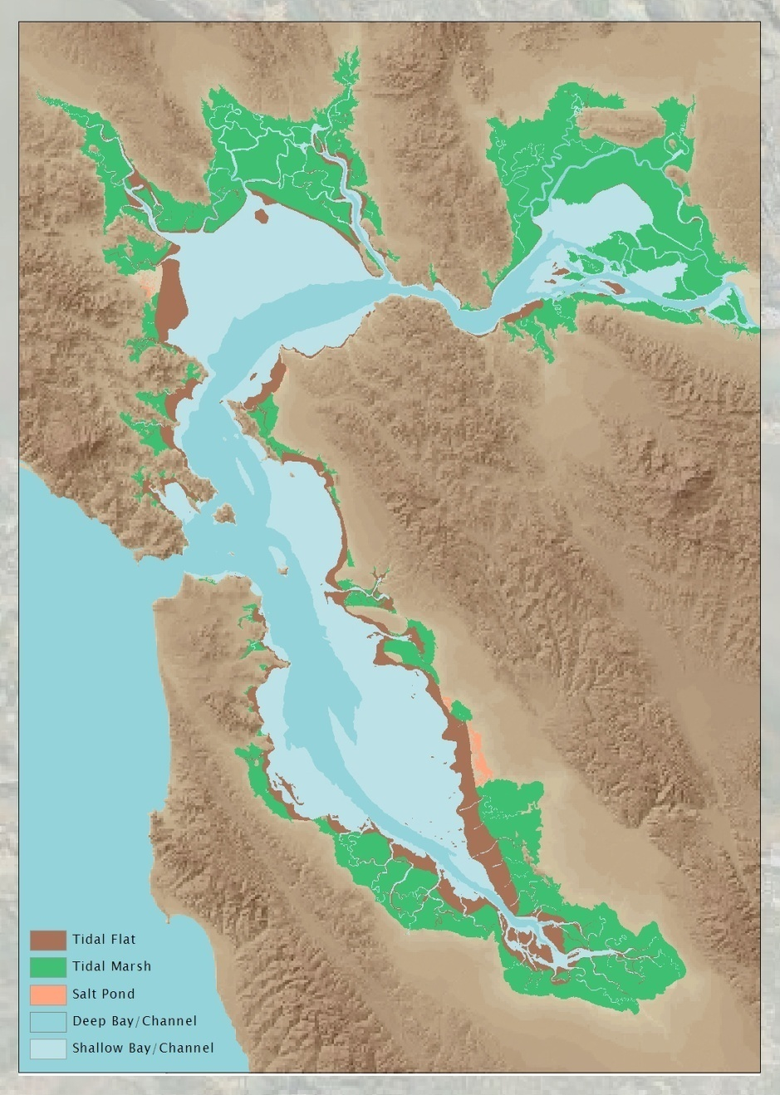
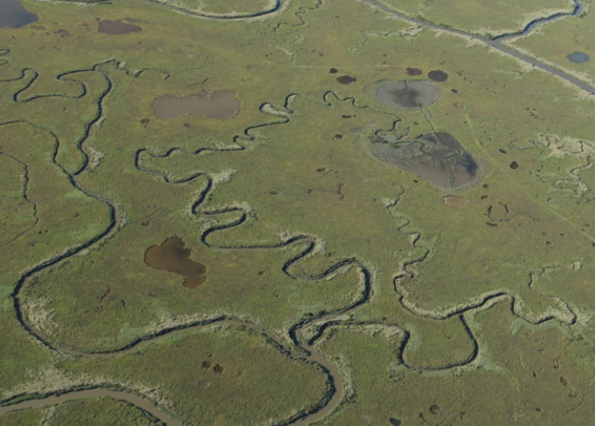
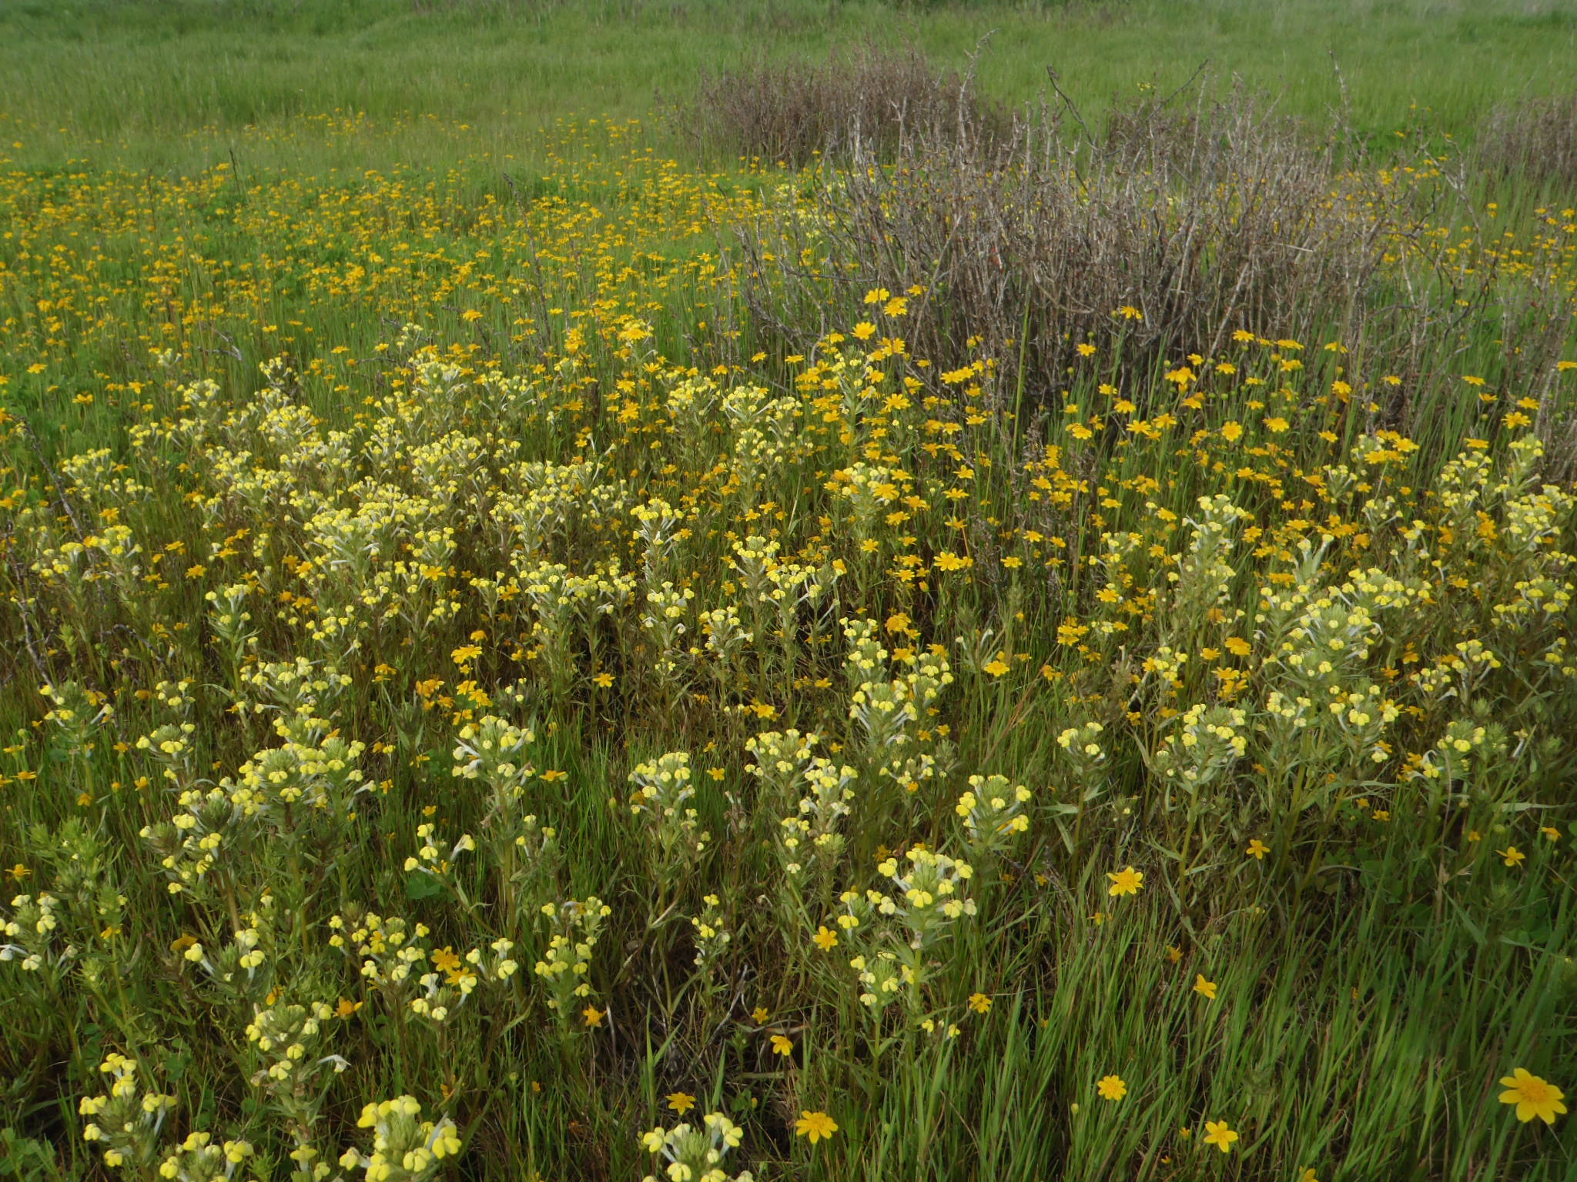
Extensive tidal wetlands (~200,000 acres) and diverse vascular plant flora
Marc Holmes
Peter Baye

Slide 9
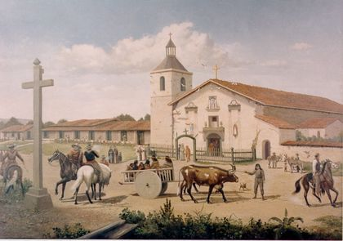
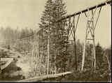
Historical Changes to the Bay
Colonization of Spanish (1769-1849)
Intensive grazing
Gold mining in the Sierras (1849-1898)
Flumes and water diversions

Slide 10
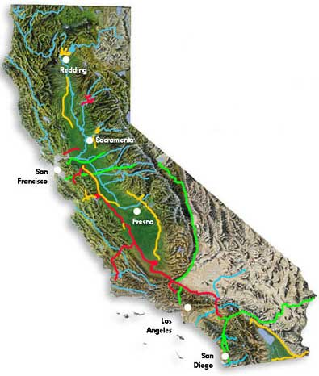
Dredging and bay fill
Diking and hay farming
Network of large and small dams
California water projects

Slide 11
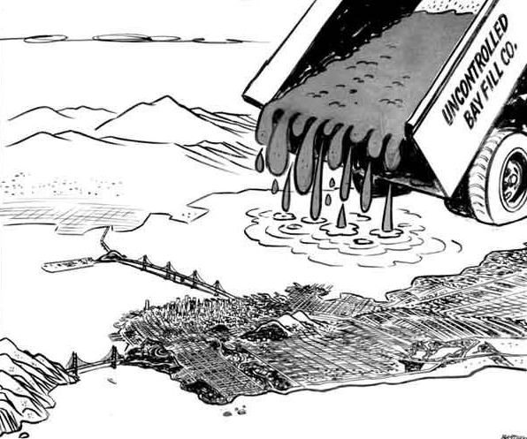
Bay fill for development
Duck hunting clubs
Salt ponds

Slide 12
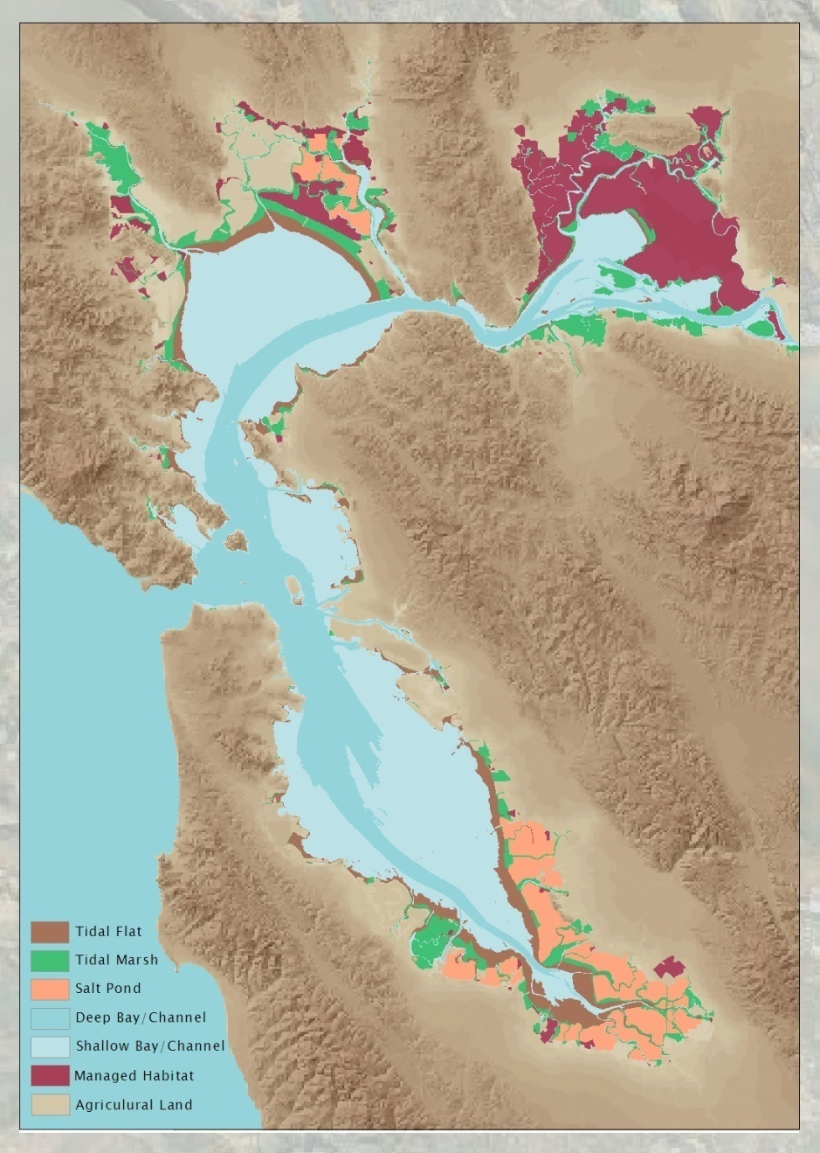
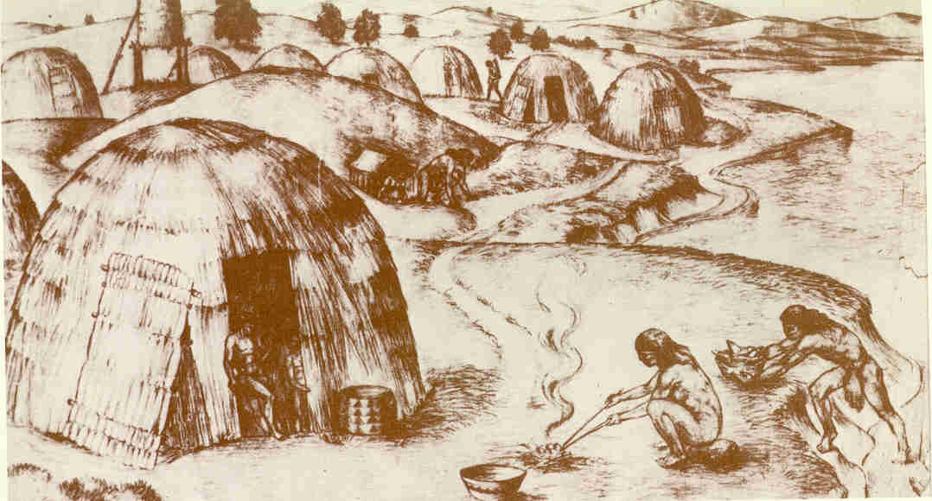
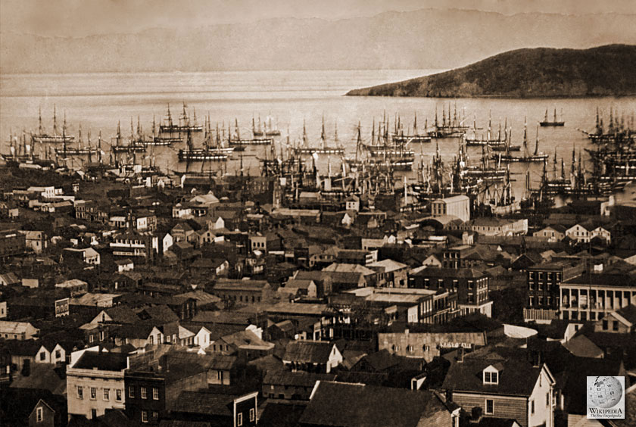
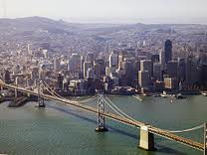
Evolution of the “Urbanized Estuary”

Slide 13
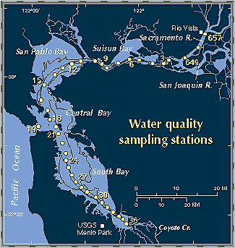
1993 SFEP Comprehensive Conservation Management Plan

Slide 14
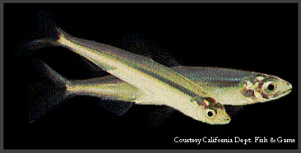
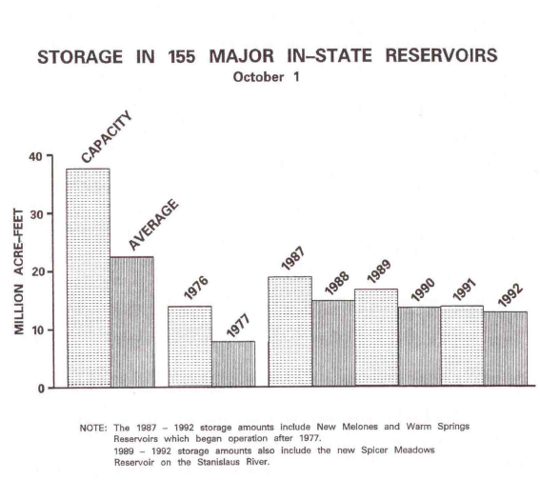
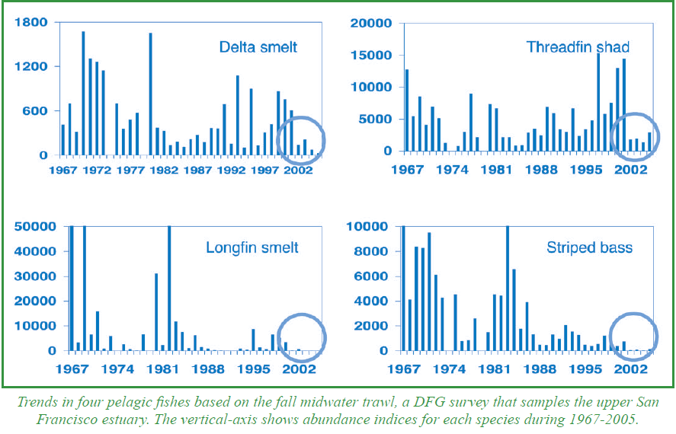
Extreme drought in
The late 1980’s –
Early 1990’s
Delta Smelt

Slide 15
Loss of Tidal Wetlands in the SF Estuary
Tidal wetlands have declined by over 90%

Slide 16
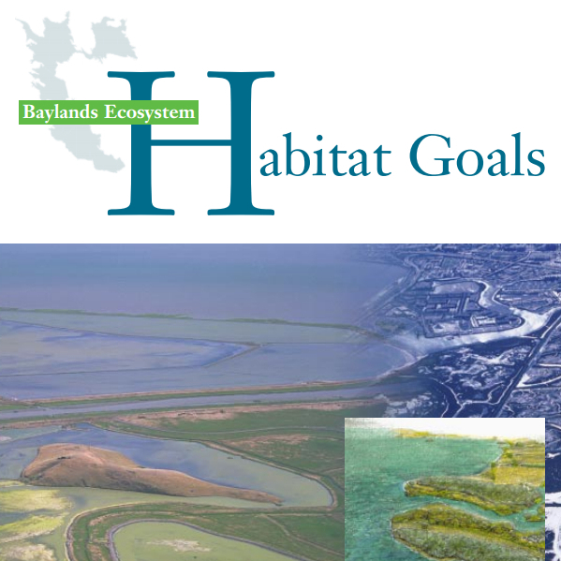
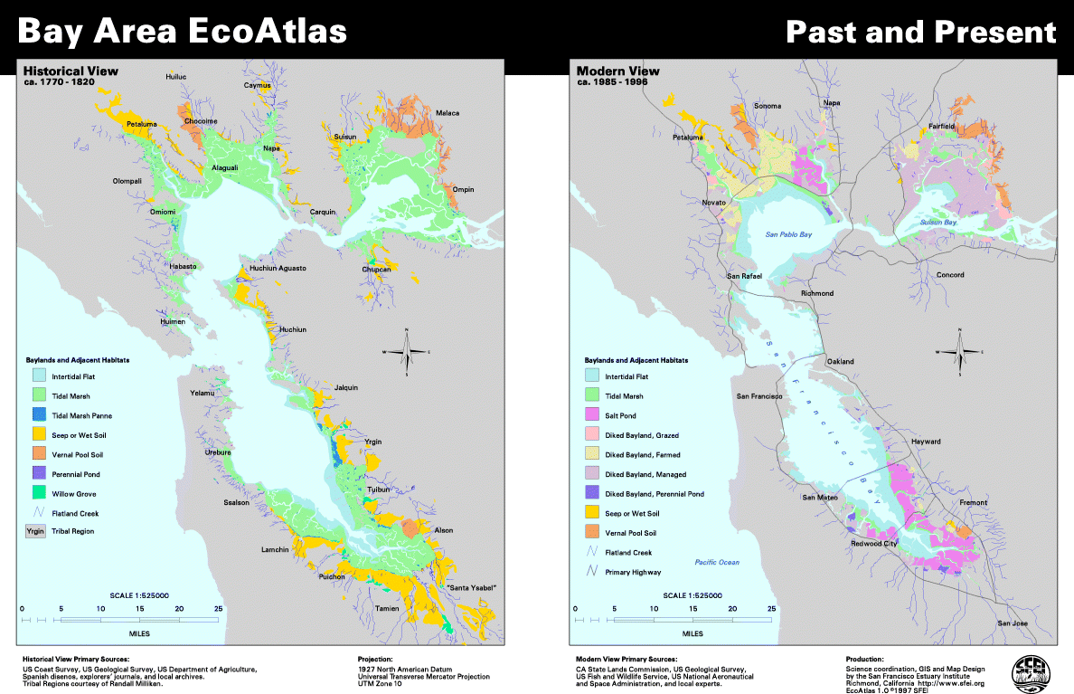
This recognition led to the
Bayland Ecosystem Habitat
Goals Project whose focus was
on tidal wetland restoration

Slide 17
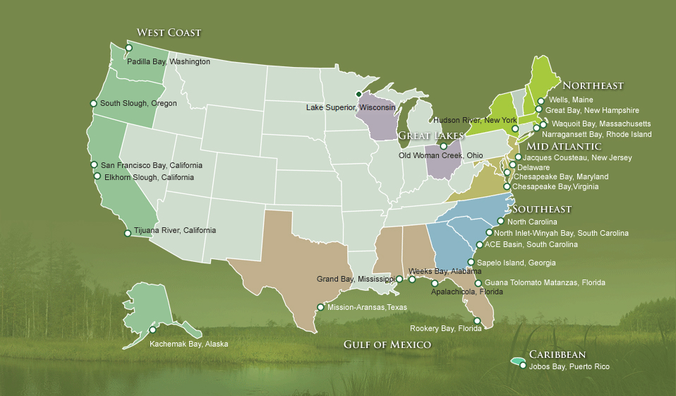
Created by the Coastal Zone
Management Act - 1972
The Reserve System mission is to practice and
promote the stewardship of coasts and estuaries
through innovative research, education, and
training using a place-based system of protected
areas. As a representative system, each reserve
serves as a place-based living laboratory and
classroom where research methods and
management approaches can be piloted and
applied to issues of local, regional, and national
importance.
SFSU got a
“predesignation”
grant from NOAA
in 1990 -
Acting Manager
in 1991

Slide 18
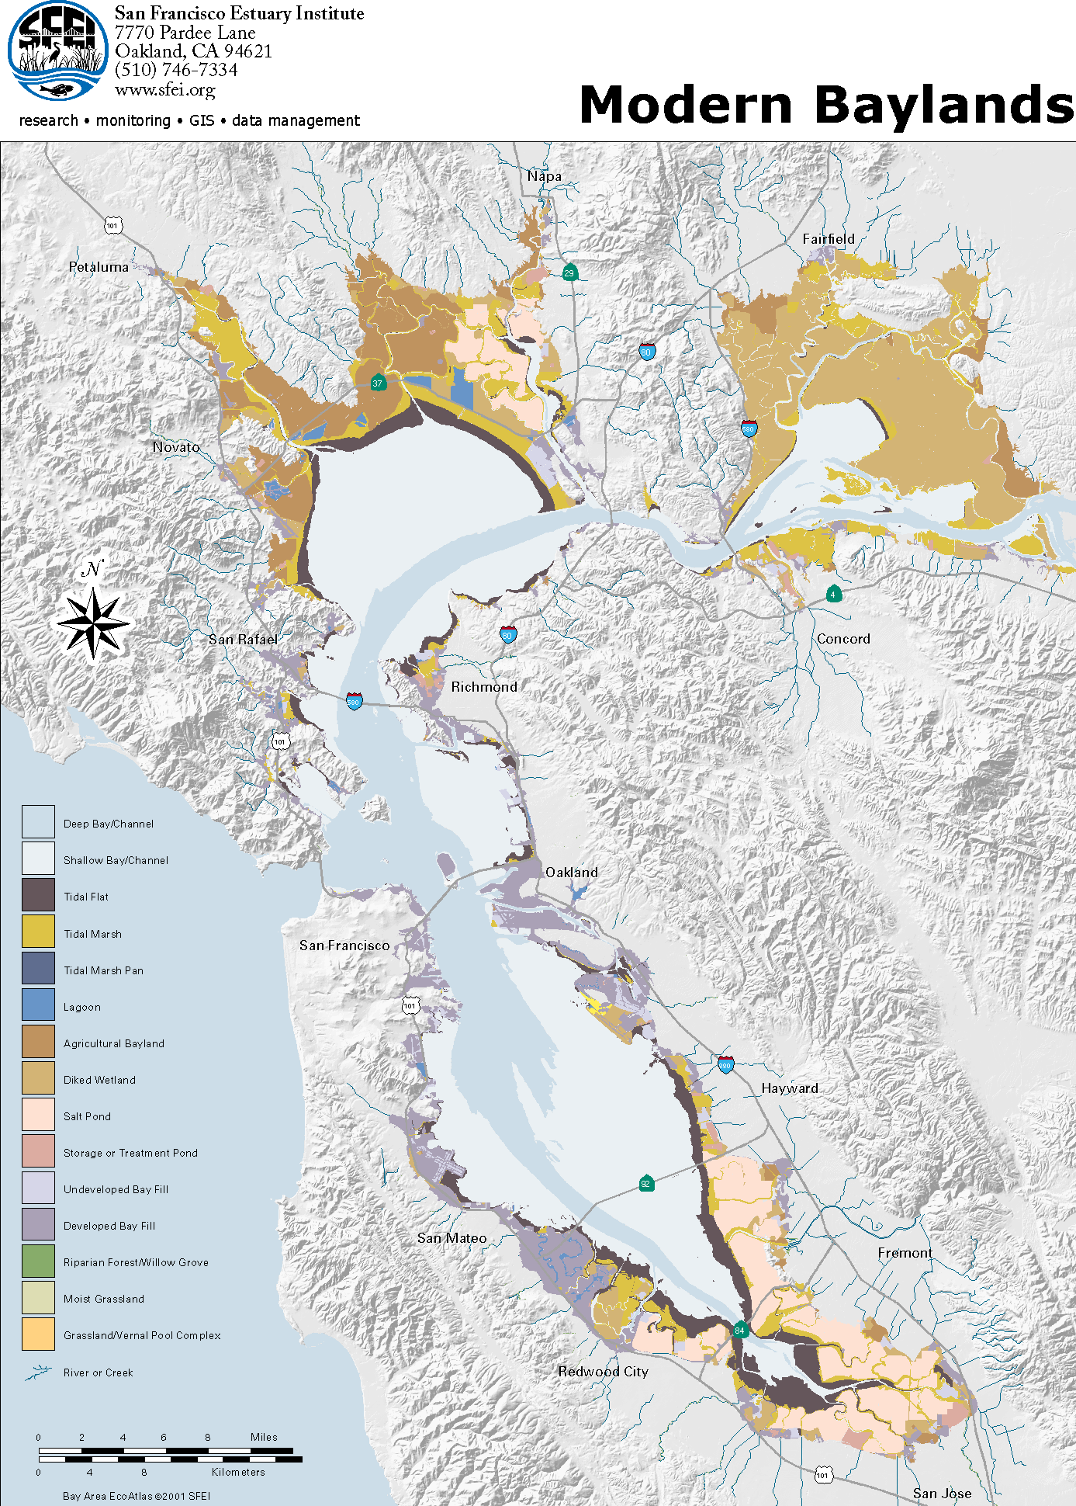
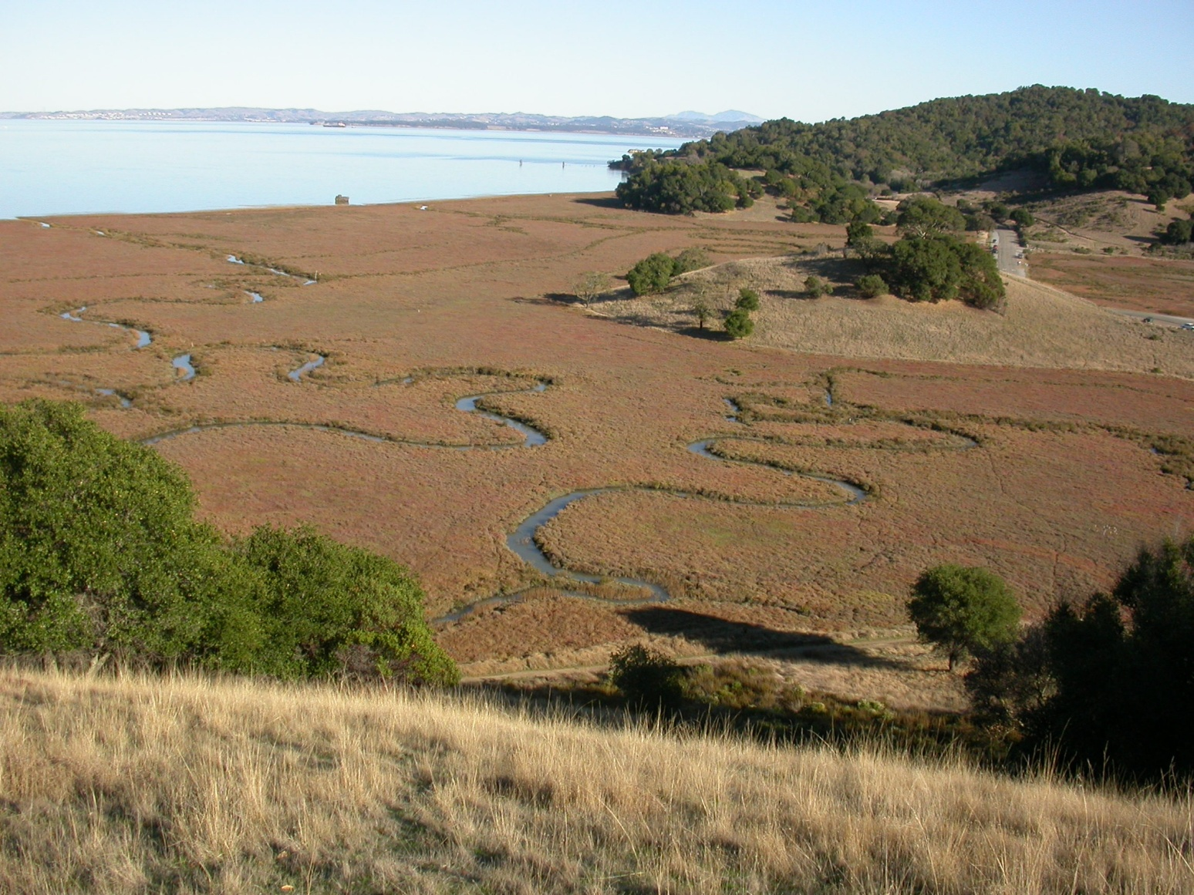
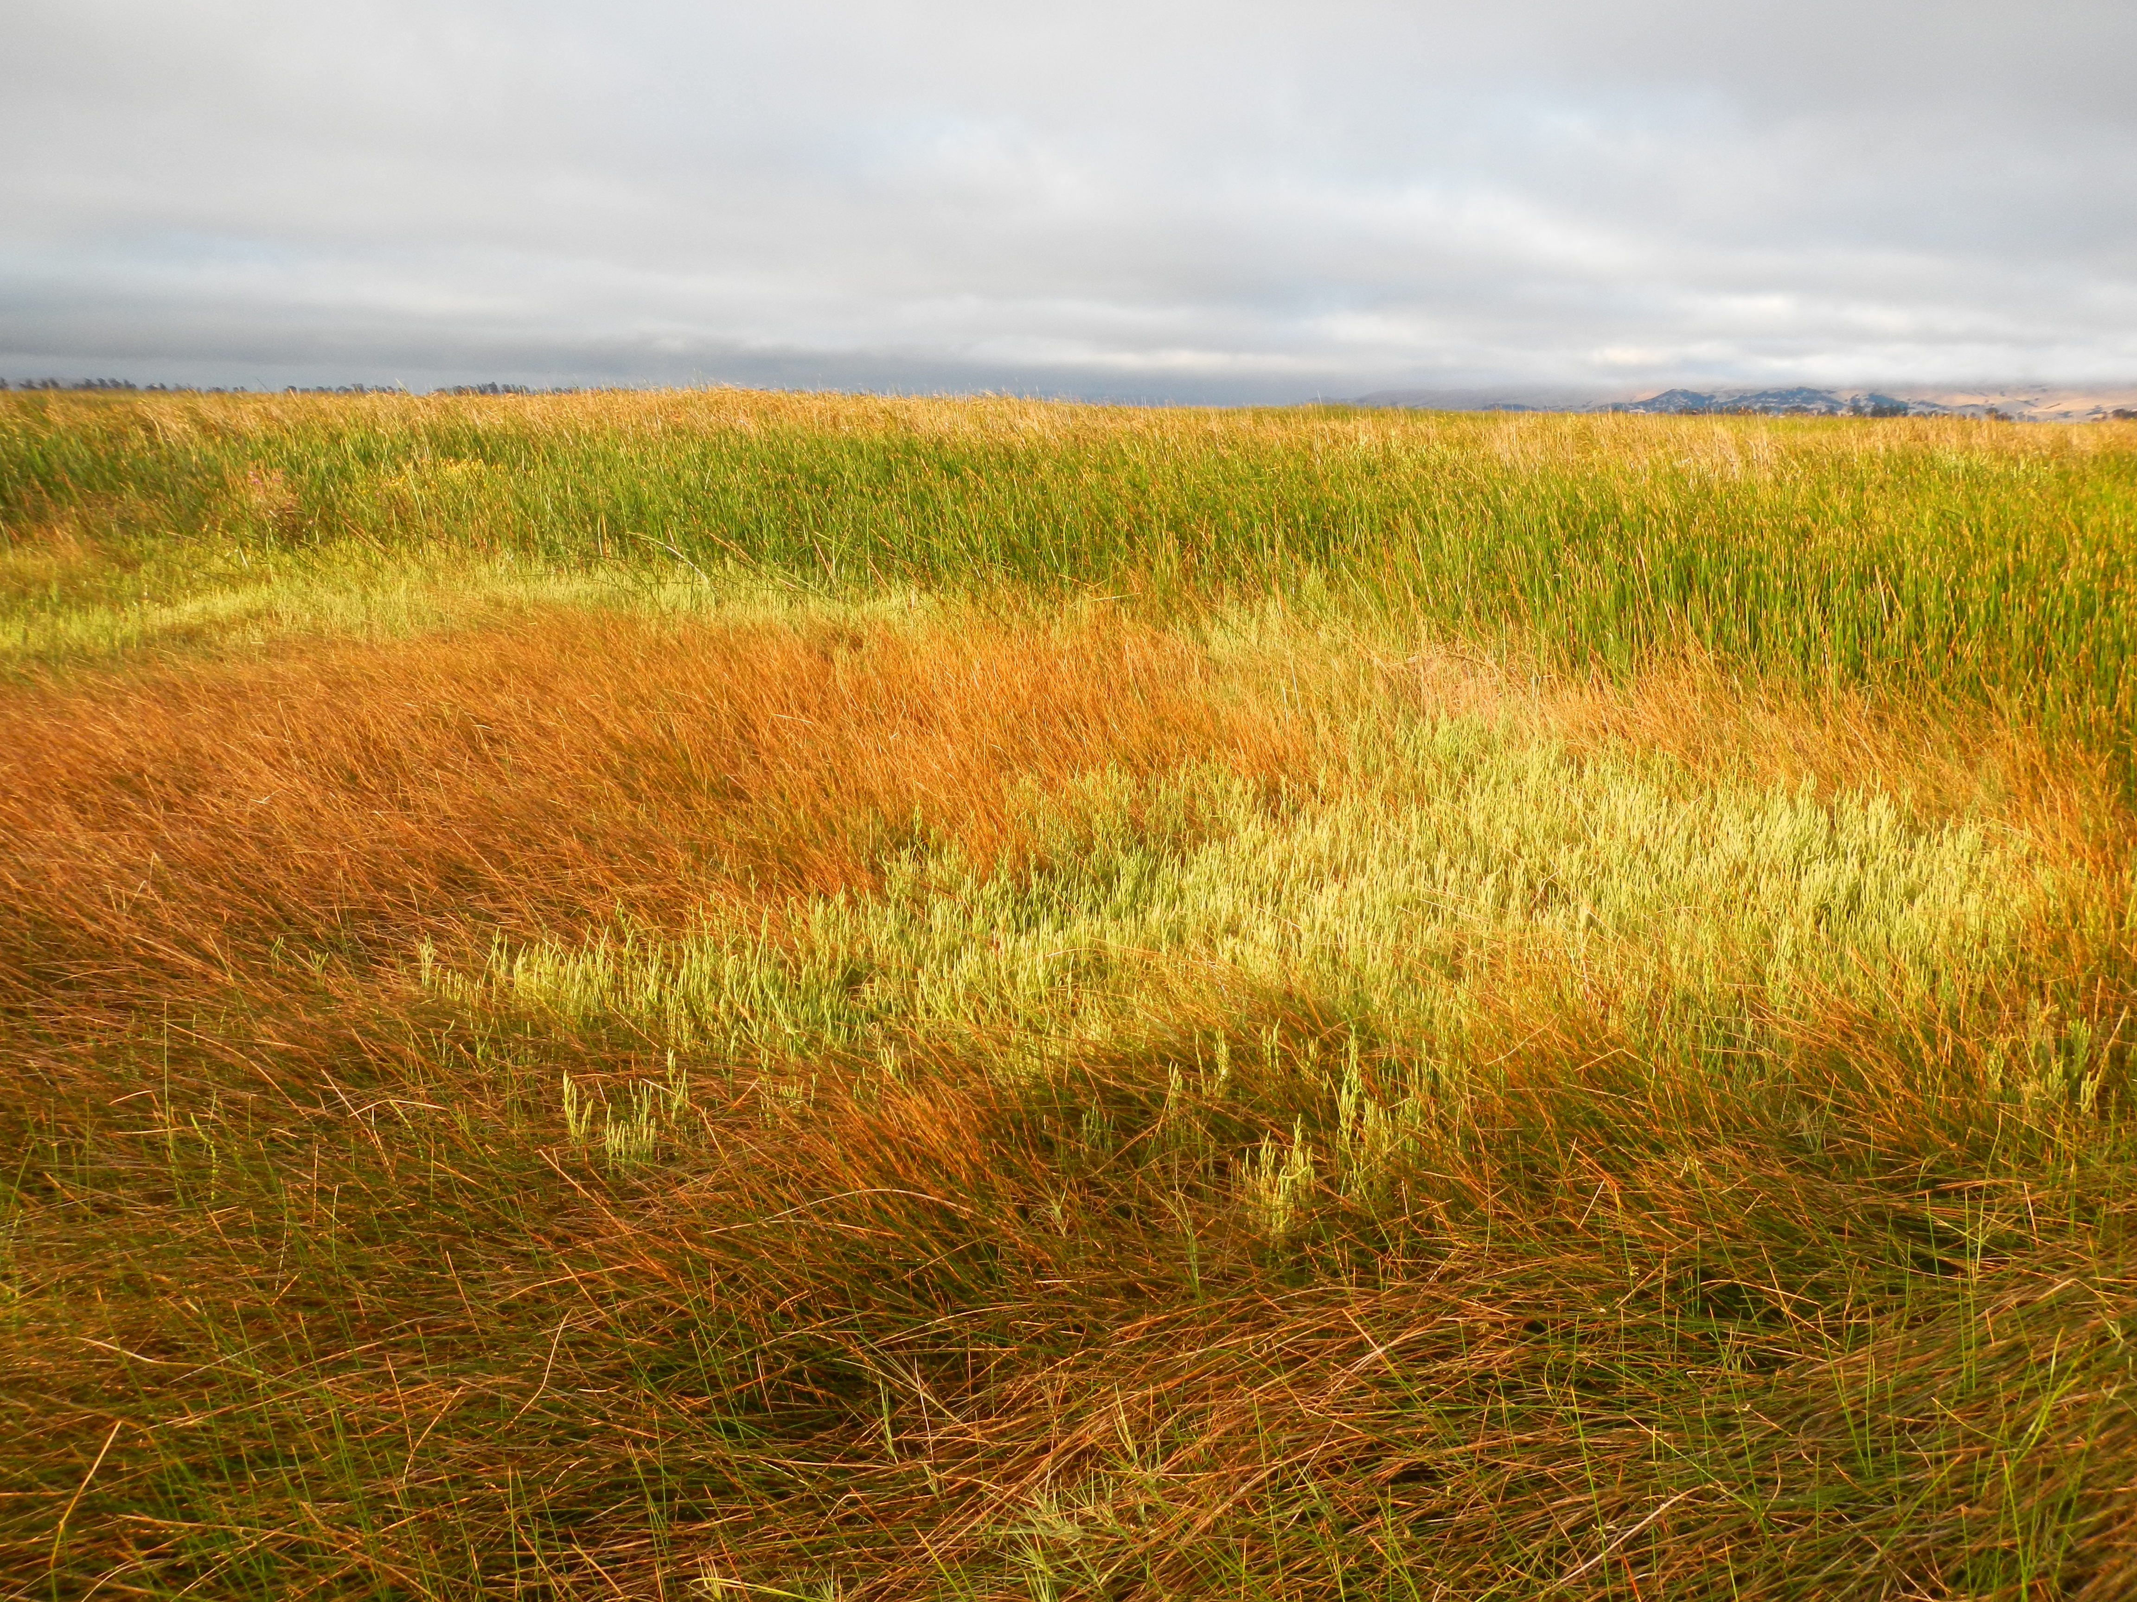
SF Bay NERR
Reserve designated in 2003
‘Upper Estuary’
Rush Ranch
‘Lower Estuary’
China Camp
China Camp State Park
NERR HQ
at RTC
Rush Ranch Open Space Preserve

Slide 19
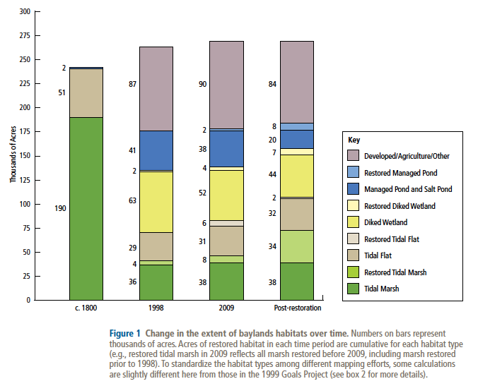
Early phase of tidal wetland restoration (Pre-1998)

Slide 20
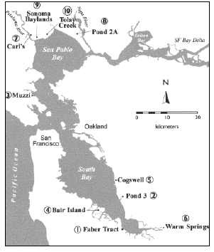
Restoration projects < 1999
X
X
PWA & Faber 2001

Slide 21
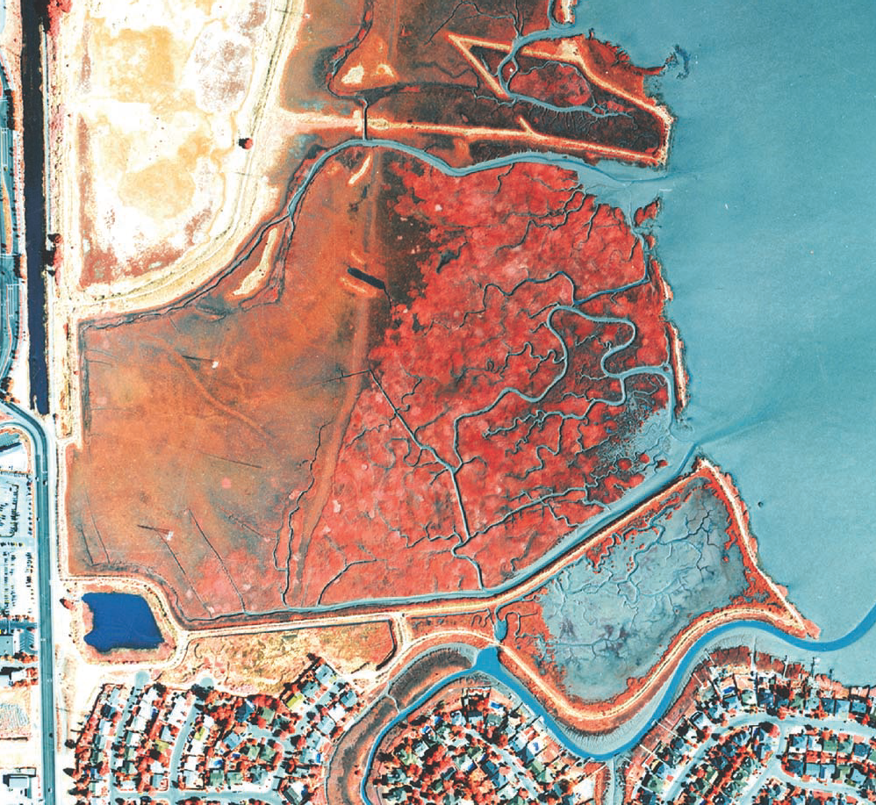
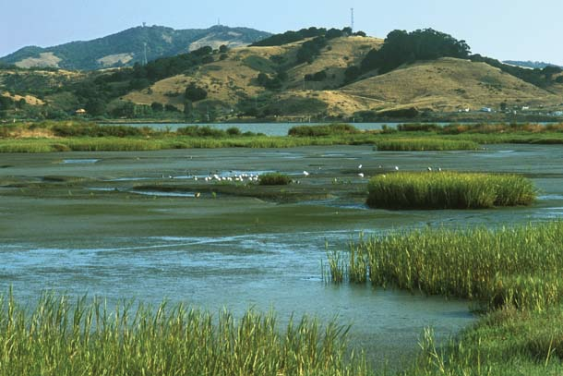
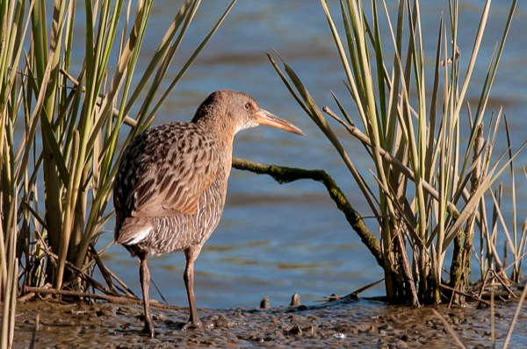
Muzzi Marsh Restoration 1.0
200 acre marsh restored for mitigation in 1976
Historic
marsh
Sediment
fill
Dredge
fill
http://www.wrmp.org/design/

Slide 22
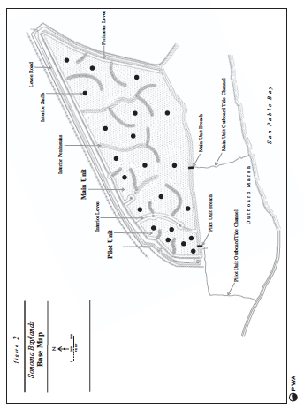
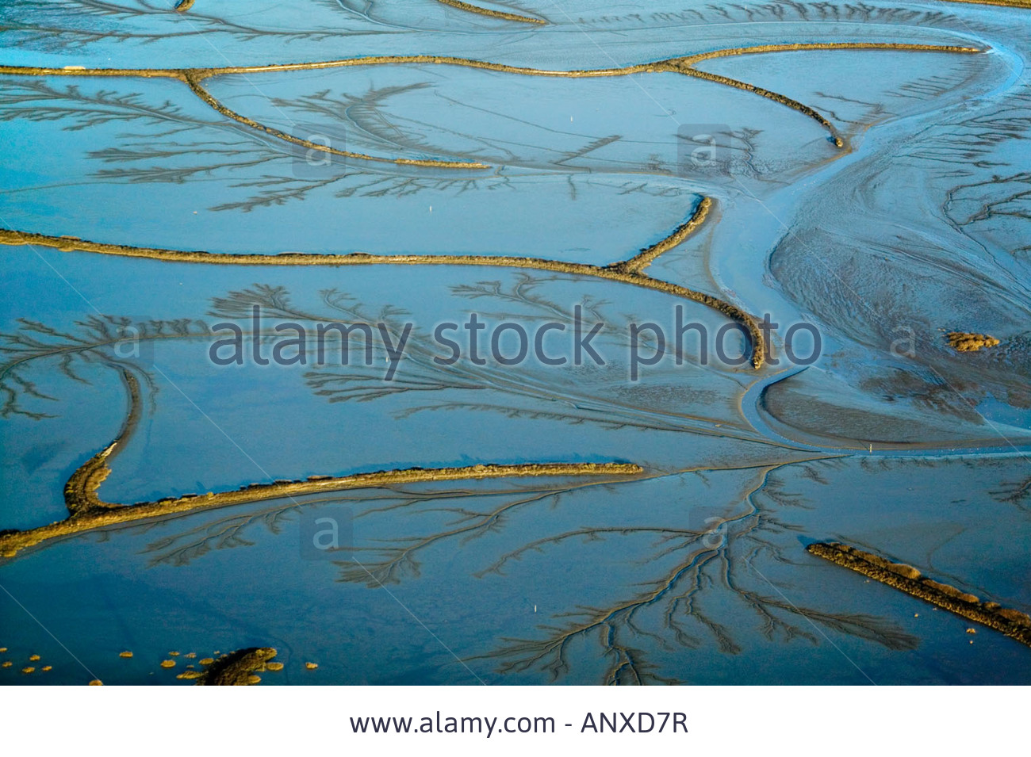
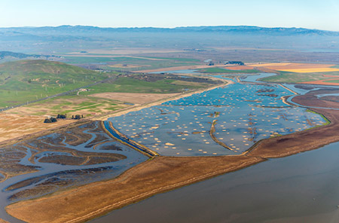
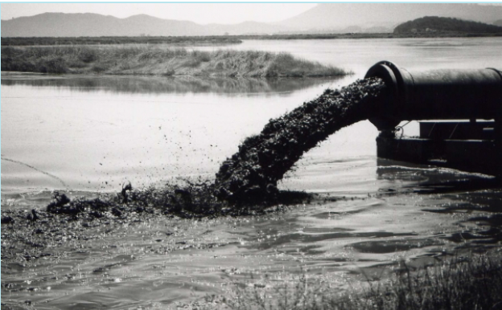
Sonoma Baylands 2.0
~ 320 acre pioneering dredge spoil restoration 1994
2007
2015

Slide 23
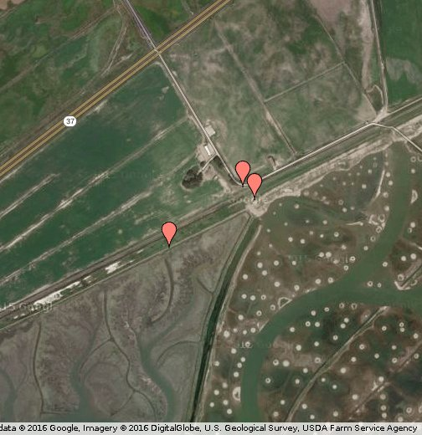
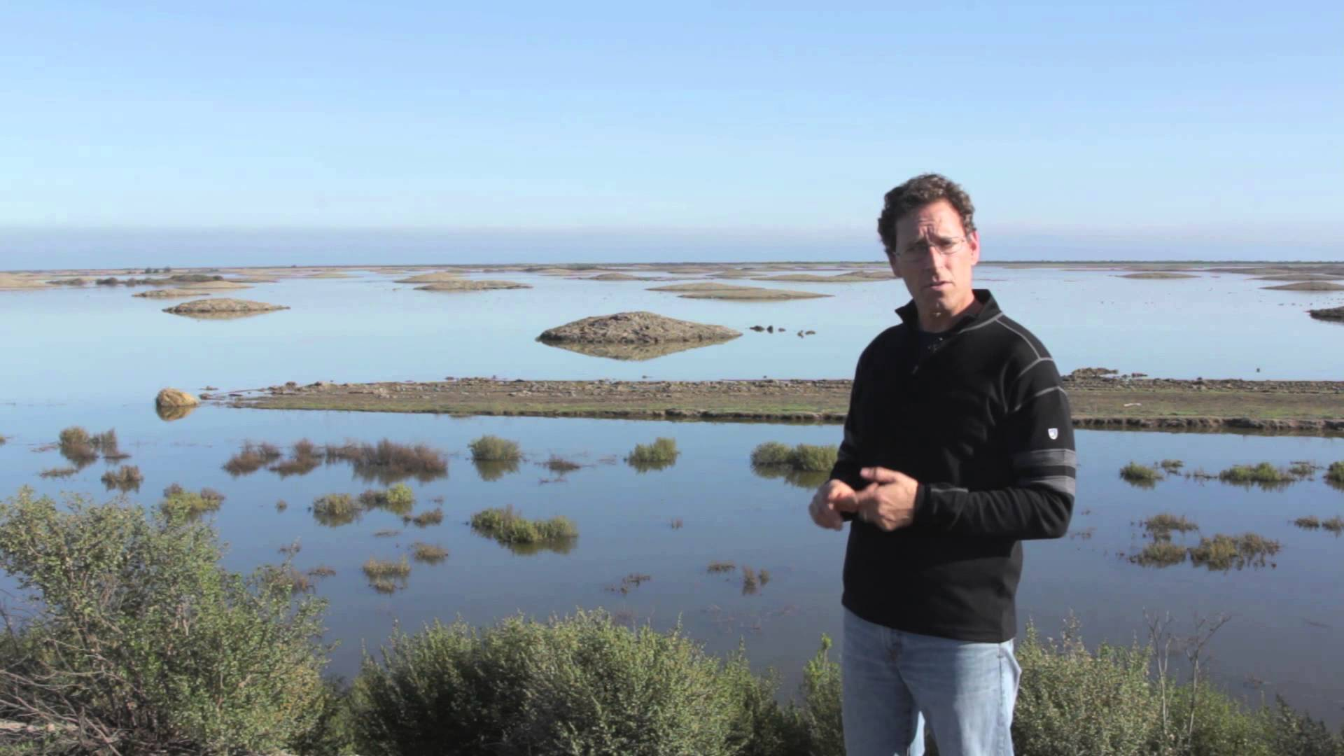
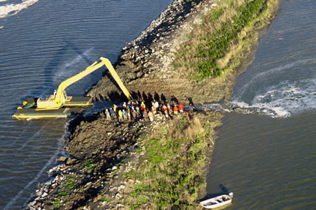
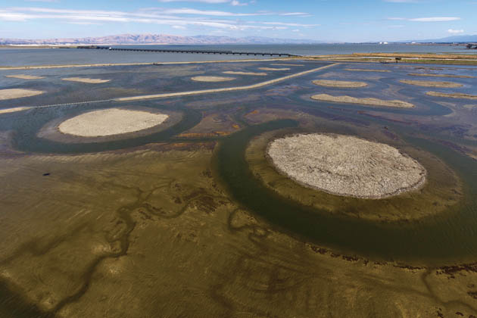
Sears Point Restoration 3.0
~ 1,000 acres, 10 years of planning, $18 million, 2015
Sonoma
Baylands
Sears
Point
Julian Meisler, Sonoma Land Trust

Slide 24
Baylands and Climate Change Baylands Habitat Goals Update 2015

Slide 25
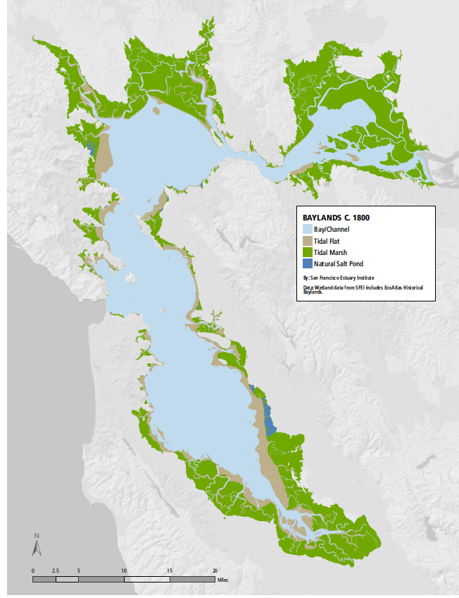
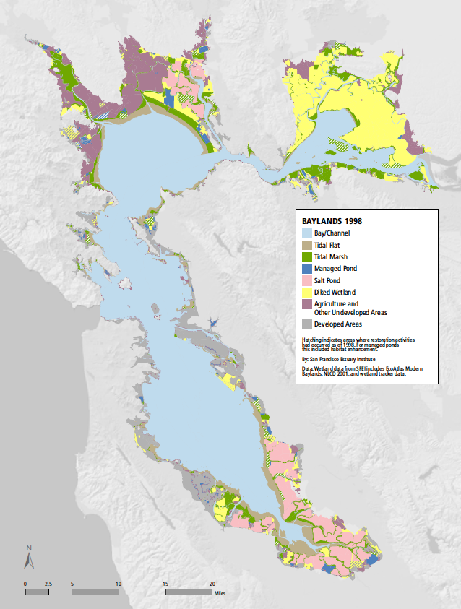
Deteriation of tidal wetlands – Into the Pan!

Slide 26
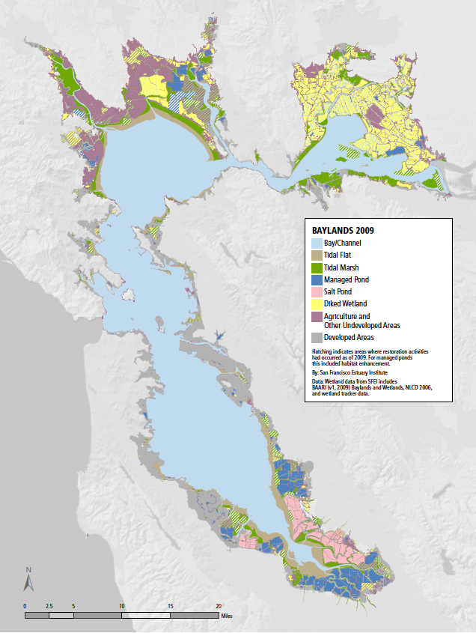
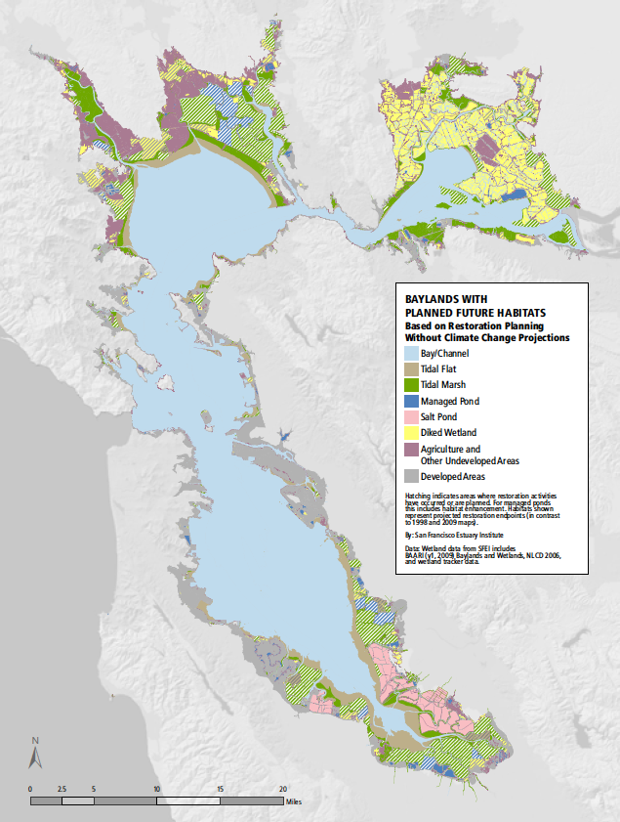
Restoration of tidal wetlands – Out of the pan!

Slide 27
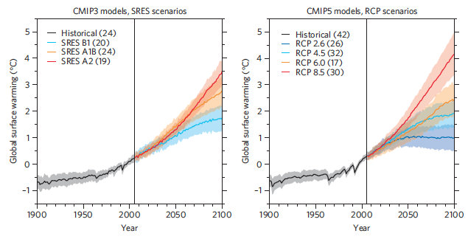
But … then there is Climate Change Plus!
IPCC 2014

Slide 28
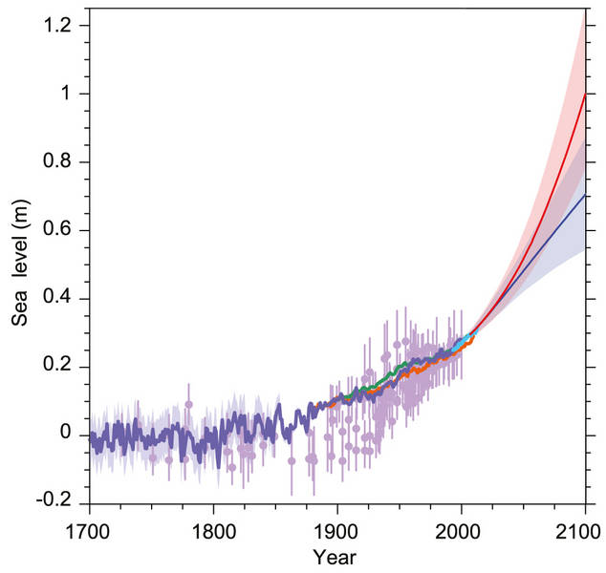
Increased rate of sea-level rise (SLR), reduced sediment supply, and extreme weather events (drought and flood)
IPCC 2014
Schoellhamer 2011

Slide 29
Key to marshes keeping up with SLR is relatively simple
Rate of accretion must
keep pace with rate of
water level increase (SLR)
Rate of accretion is a
function of biomass
accumulation and sediment
supply
If rate of accretion lags
behind SLR increase, marsh
will “drown”
Accretion
USGS Open-File Report 2013–1081

Slide 30
Tidal marsh fate for China Camp under different SLR and sediment supply scenarios
Schile et al. 2014

Slide 31
Tidal marsh fate for China Camp under different SLR and sediment supply scenarios
Schile et al. 2014

Slide 32
Need for tidal marsh migration space
China Camp
county road
bisecting tidal
marsh and
separating I from
flood plain

Slide 33
Extreme flood events

Slide 34
Despite the promise of restoring key components of the Estuary, we now must come to grips with what it takes to become resilient
Beller et al. 2015 Landscape Resilience Framework SFEI

Slide 35
Concept of “Living Shorelines”
Horizontal levee – A nature-based solution

Slide 36
Bringing back water to the wetlands The Oro Loma Project

Slide 37
Living shoreline designs to reduce wave erosion and effects of SLR
Integrating marshes, eelgrass, oysters, and other
living components to enhance shorline protection and
promote ecological resilience

Slide 38
Assess vulnerability (models), adapt to changing conditions and uncertainty, and promote resilience over time
BEHGU 2015

Slide 39
Need for ‘Coastal Intelligence’
Network of high resolution observational data ‘nodes’
that can help to forcast trends and allow timely management response

Slide 40
Integration of public engagement

Slide 41
Dawn spider web, China Camp State Park

Slide 42
Need to think out of the box!

Slide 43
Rapid climate changes reminds us that nature must be flexible to survive

Slide 44
We need to learn, adapt, and create our future!
Researcher John Callaway, China Camp State Park

Slide 45
Thanks!

