Slide 1
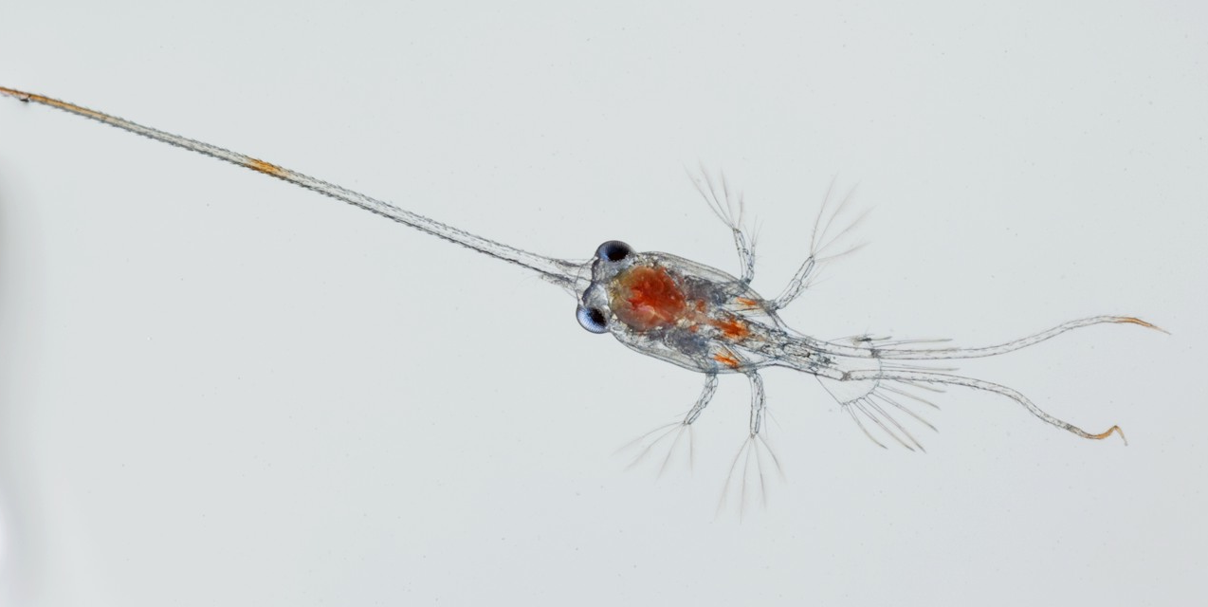
Hot and Sour Crab: A taste of how global change is impacting coastal crabs
Jonathon Stillman
Romberg Tiburon Center, SF State Univ
Integrative Biology, Berkeley
online.sfsu.edu/~stillmaj

Slide 2
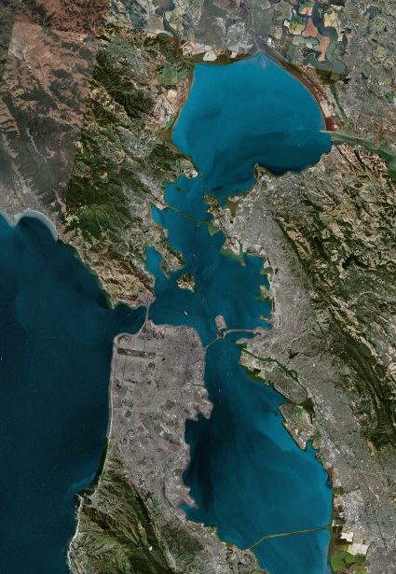
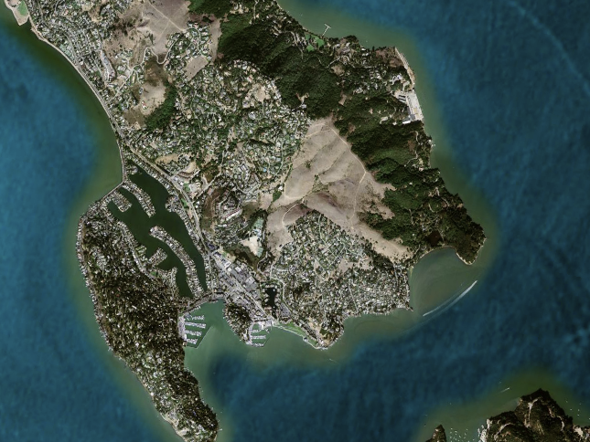
Romberg Tiburon Center rtc.sfsu.edu
RTC

Slide 3
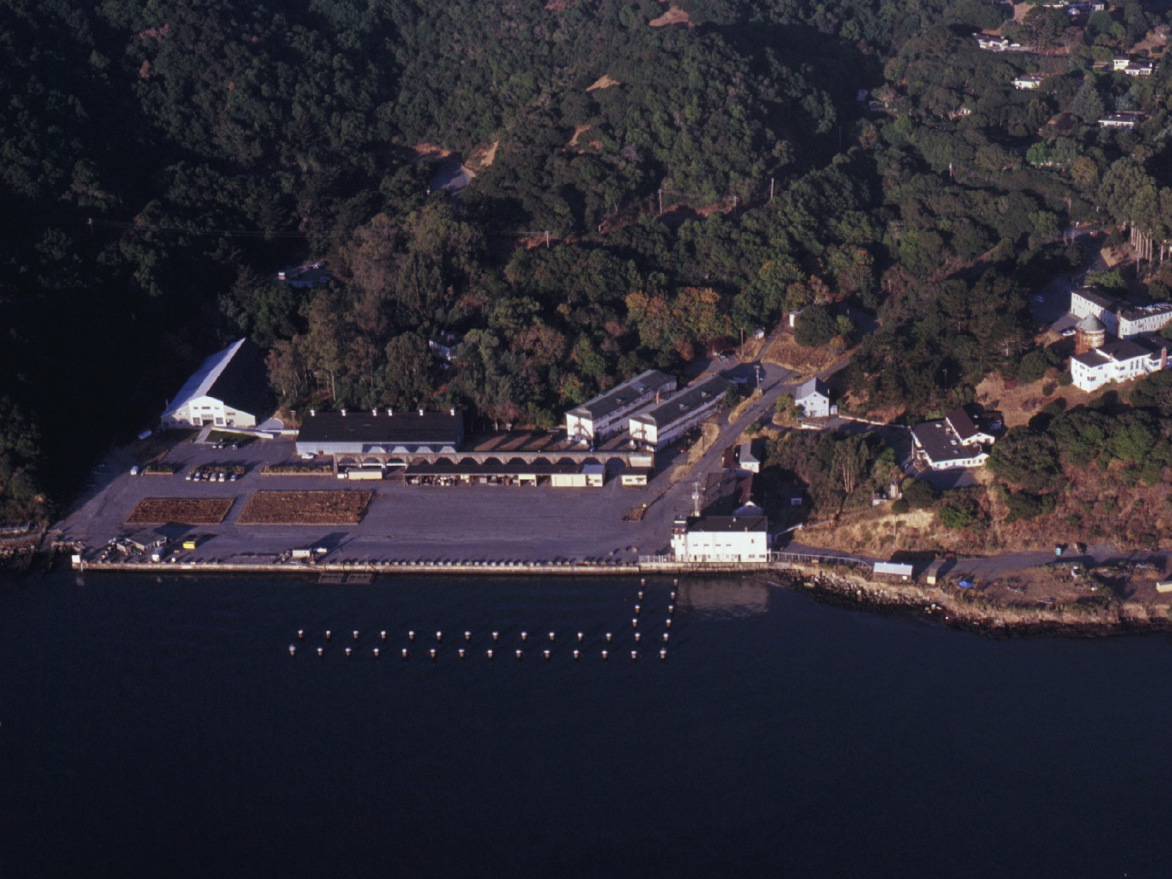

Slide 4
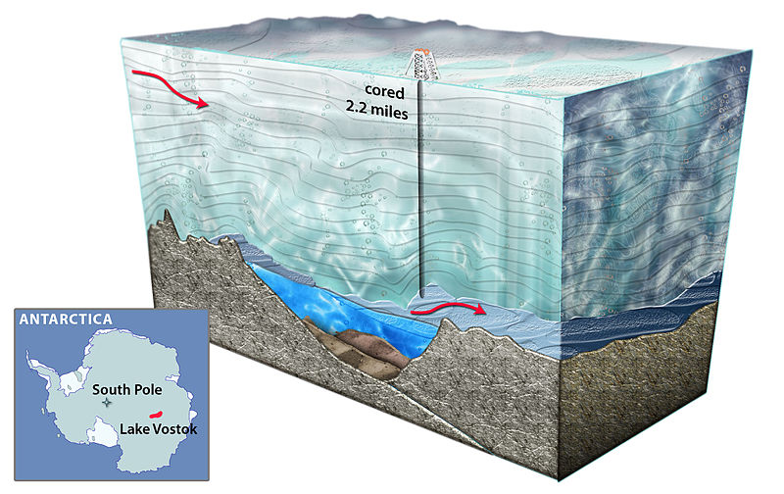
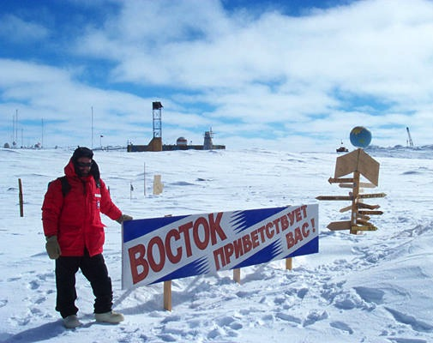
Lake Vostok, Antarctica
Notes:
Let’s start our adventure as polar explorers – in Antarctica.
If you can read Russian, correct me, but I think it says “Voskok – it’s damn cold here!”

Slide 5
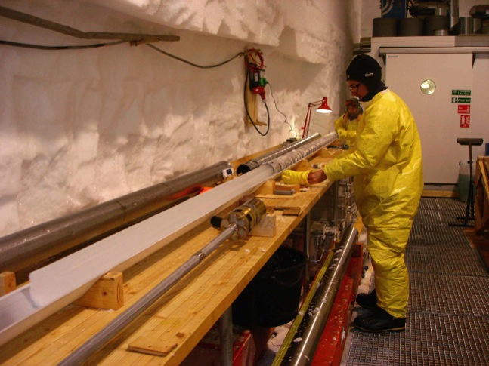
Gas bubbles in ice are trapped air
Vostok Ice Core
Petit, J. R. et al. (1999) Climate and atmospheric history of the past 420,000 years from the Vostok ice core, Antarctica. Nature 399, 429-436.
2100
800
2050
550
400
20
15
10
Temperature change (°C)
CO₂ Concentration (ppmv)
5
200
0
-5
-10
0
450
400
350
300
250
200
150
100
50
0
Thousands of years ago
Notes:
The atmospheric concentration of CO2 is now higher than it has been for at least the past 650,000 years and possibly for the last 10 million years
Can measure CO2 in gas bubbles trapped in ice core
Measure deuterium (or heavy hydrogen, H2 – one proton & one neutron) content of the ice (a proxy of local temperature change)

Slide 6
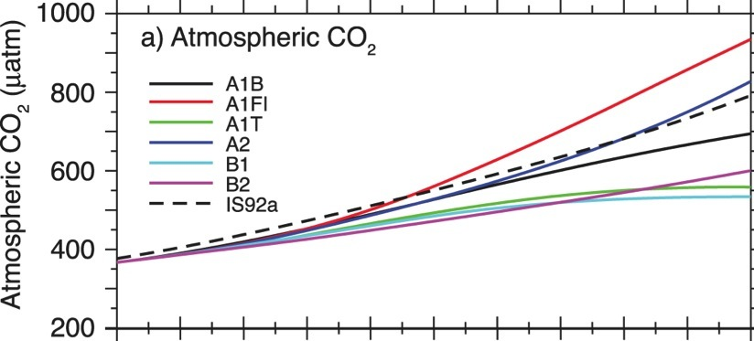
CO₂ ⬆ regardless of future changes in fossil fuel use
B1: Committed climate change scenario
550 ppm CO₂ by 2100,
+1.8°C increase in temperature
A1FI: Business as usual scenario
950 ppm CO₂ by 2100,
+4°C increase in temperature
Intergovernmental Panel on Climate Change (IPCC). 2007 – WGI – Fig. 10.24
The IPCC is the leading scientific and intergovernmental body for assessment of climate change, established by the United Nations Environment Programme and the World Meteorological Organization to provide the world with the current state of climate change and its potential environmental and socio-economic consequences.
Notes:
The first panel is based on the predictions of the Intergovernmental Panel of Climate Change and illustrates the projection scenarios through the year 2100 with A1FI (solid red) as the most severe and B1 (light blue) as the most conservative. Experts agree that we are committed to B1 even if everyone started biking as of this minute and A1FI is considering the predicted industriallization of developing nations etc.

Slide 7
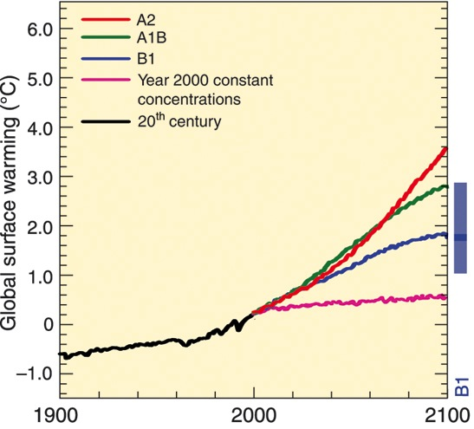
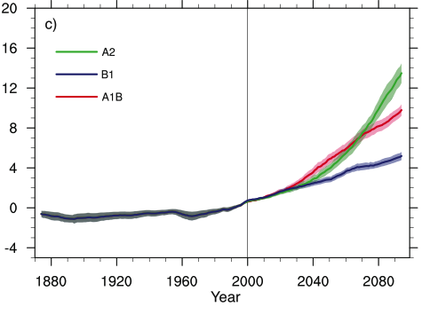
More CO₂ = A warmer more variable Earth
Global Surface Warming (°C)
Thermal variability (°C)
IPCC AR4 Synthesis, 2007

Slide 8
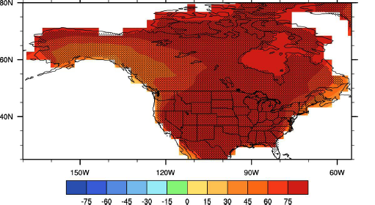
Heat waves all summer
A2 Climate Scenario
# days @
> 5°C above normal for ≥ 5 consecutive days
°C increases
Courtesy Bill Collins, LBL
Notes:
The future is going to be warmer. In the A2 climate change scenario

Slide 9
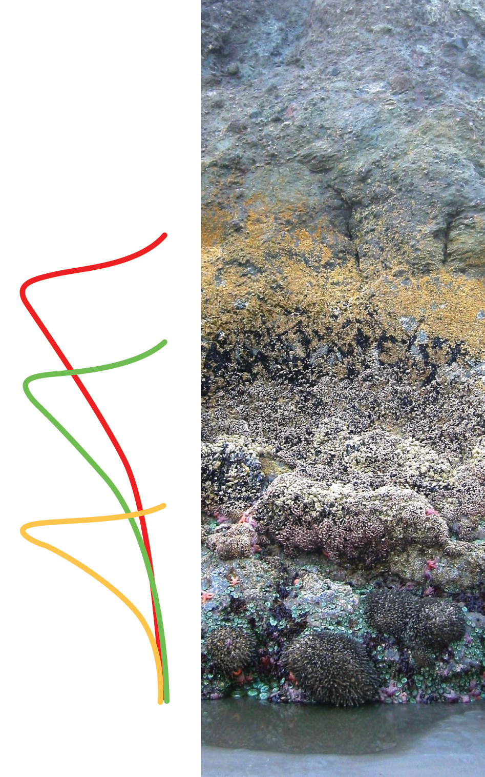
Heat waves define intertidal zonations

Slide 10
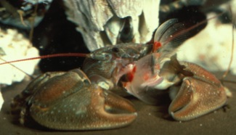
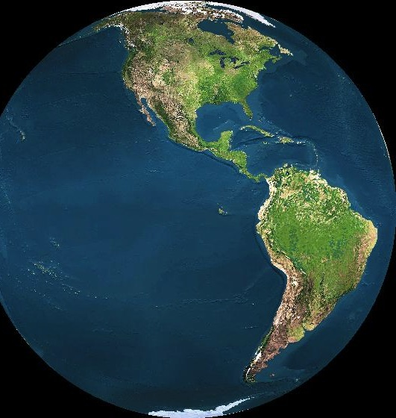
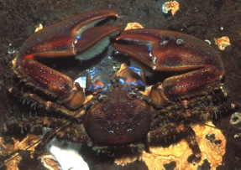
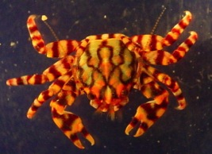
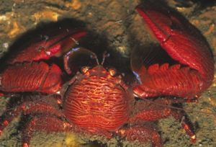
Porcelain Crabs: A model system for the intertidal zone
HIGH
SUBTIDAL
5
7
24
HIGH
SUBTIDAL
HIGH
SUBTIDAL
11
HIGH
SUBTIDAL

Slide 11
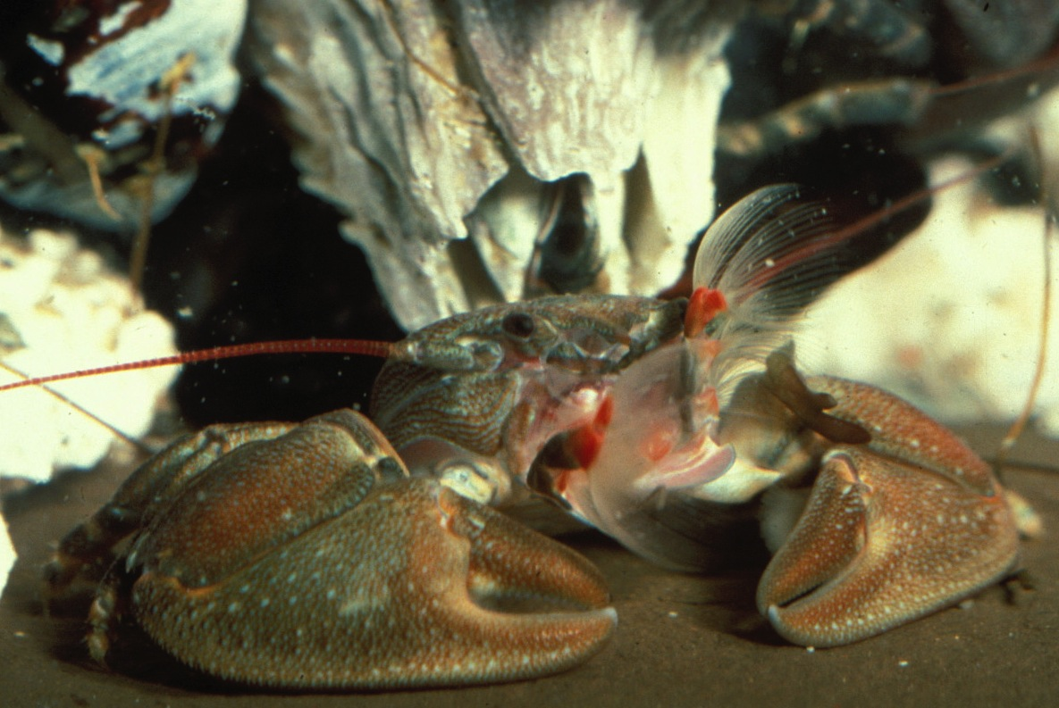
Petrolisthes cinctipes

Slide 12
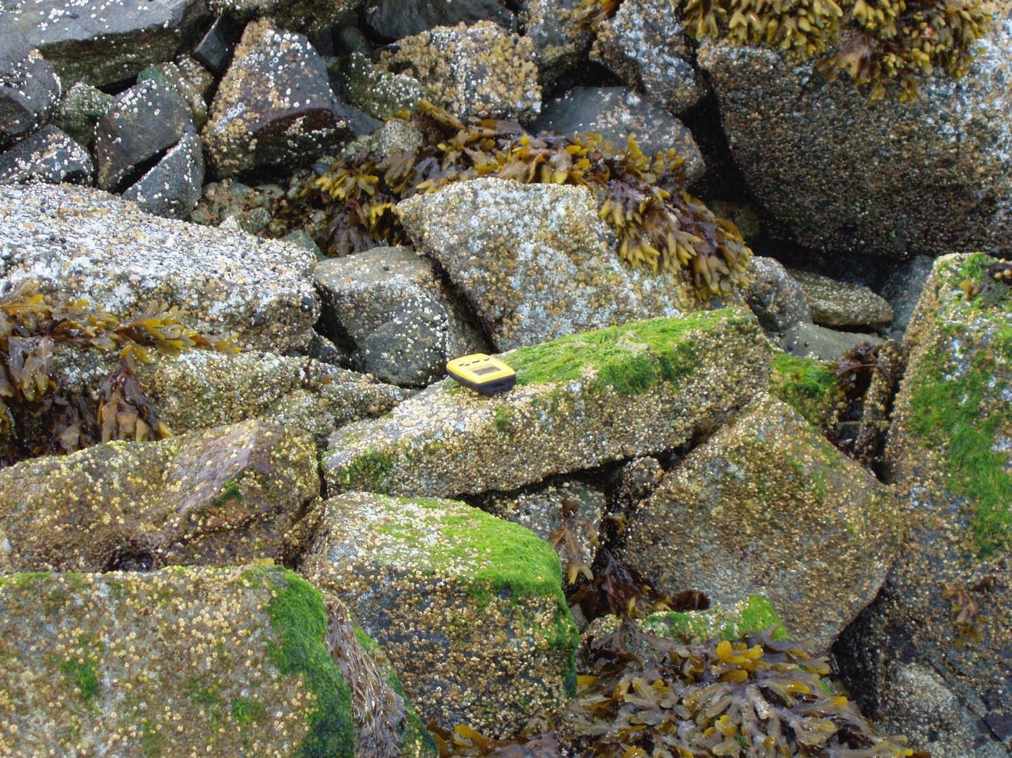


Slide 13
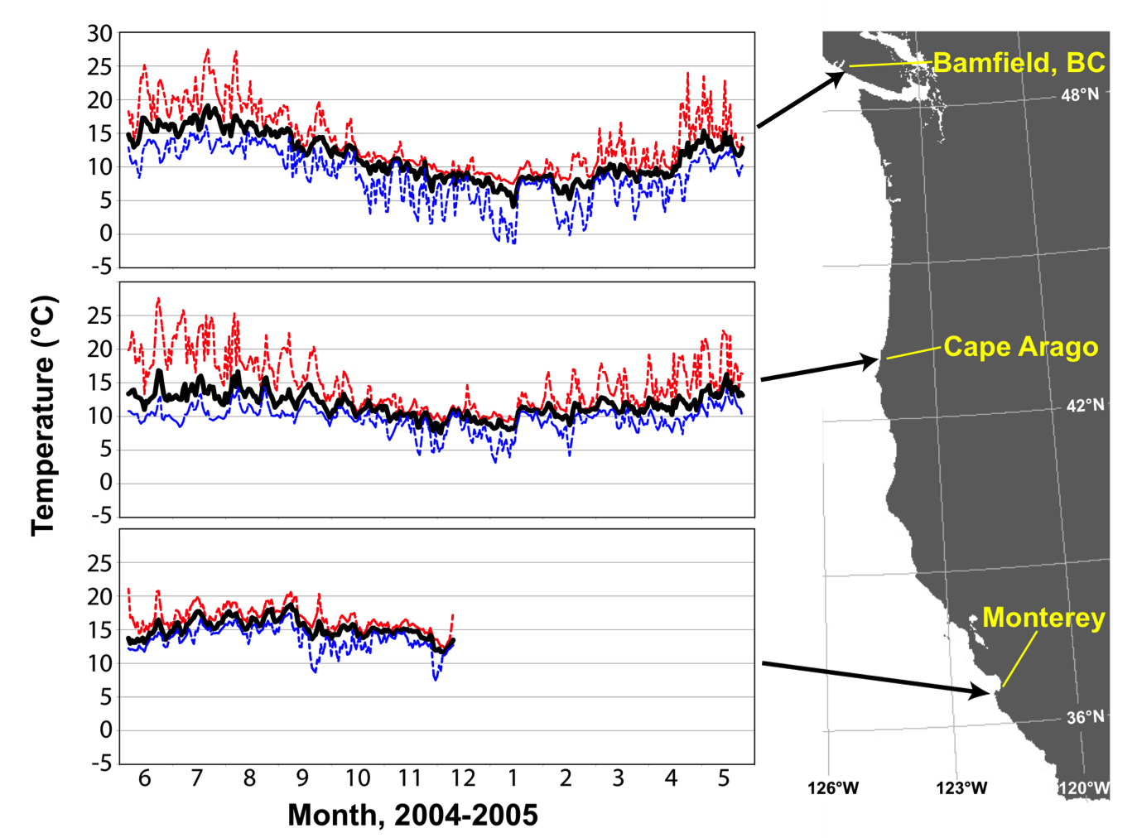
P. cinctipes habitat temperatures

Slide 14
Heat Waves ≠ Warmer Averages
Days > 30°C for 0.5h
Hours > 25°C
Helmuth et al 2010. JEB

Slide 15
Thermal tolerance of porcelain crabs: small safety margins
42
40
R²=0.88
California
Chile
N. Gulf of California
Panama
38
)
36
C
°
(
Heat Tolerance (CTmax,°C)
0
34
5
T
L
32
30
Safety margin
28
26
10
15
20
25
30
35
40
45
Maximal habitat temperature (°C)
(Stillman and Somero 2000 PBZ)

Slide 16
Porcelain Crab Plasticity-Tolerance Tradeoff
7
P. gracilis
P. hirtipes
P. cinctipes
P. eriomerus
6
5
Cold Tol.
4
Plasticity
3
2
1
Heat Tol.
0
15
20
25
30
35
40
45
Maximal Habitat Temperature (°C)
(Stillman 2003 Science)

Slide 17
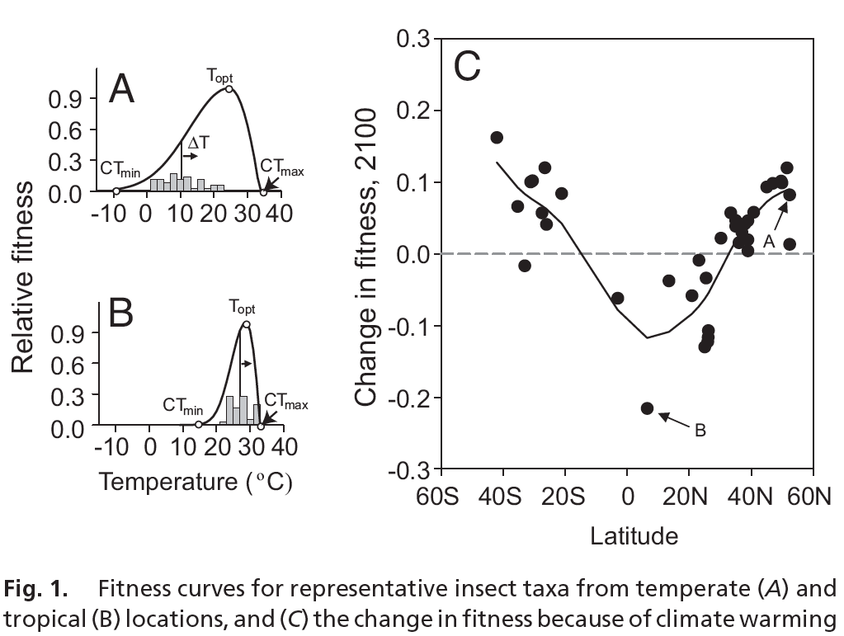
Tropical insects most susceptible to global warming
Deutsch et al 2008 PNAS

Slide 18
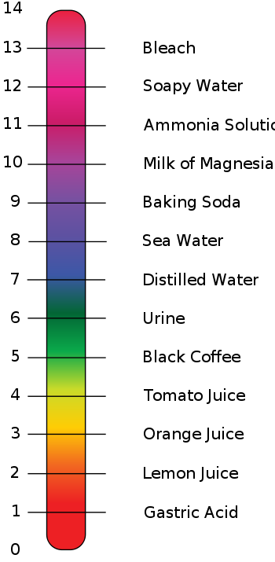
CO₂ acidifies seawater
AIR
CO₂
WATER
H₂CO₃
CO₂ + H₂O
Carbonic acid
pH Scale
HCO₃⁻ + H⁺
CO₃²⁻ + H⁺
Hydrogen ion
Bicarbonate ion
Hydrogen ion
Carbonate ion
pH = log(1/[H⁺]) = -log [H⁺]
More hydrogen ions = lower pH
Less hydrogen ions = higher pH

Slide 19
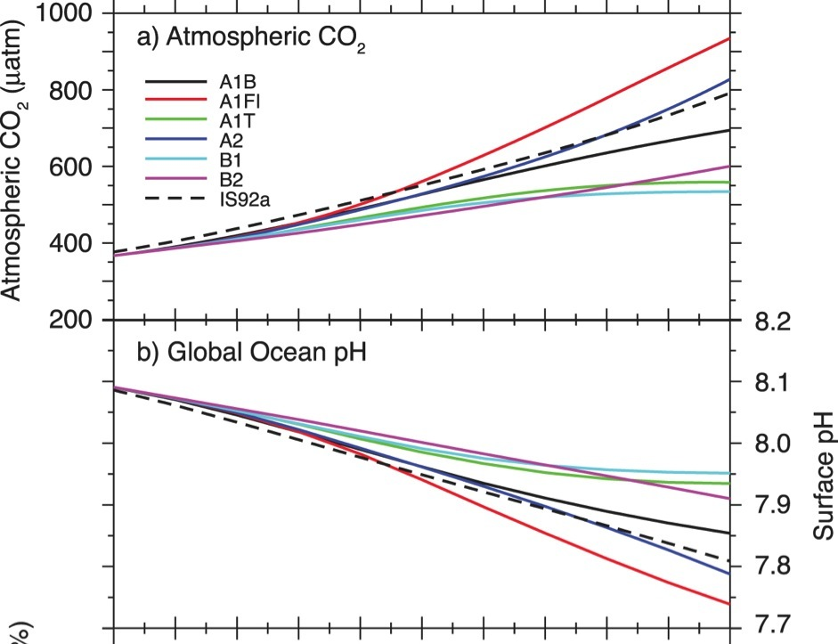
CO₂ ⬆ + pH ⬇ regardless of Intergovernmental Panel of Climate Change (IPCC) Scenarios
B1: Committed climate change scenario
  550 ppm CO₂ by 2100
  +1.8°C increase in temperature
  -0.14 unit decrease in pH
A1FI: Business as usual scenario
  950 ppm CO₂ by 2100
  +4°C increase in temperature
  -0.35 unit decrease in pH
IPCC 2007 – WGI – Fig. 10.24
Notes:
The first panel is based on the predictions of the Intergovernmental Panel of Climate Change and illustrates the projection scenarios through the year 2100 with A1FI (solid red) as the most severe and B1 (light blue) as the most conservative. Experts agree that we are committed to B1 even if everyone started biking as of this minute and A1FI is considering the predicted industriallization of developing nations etc.

Slide 20
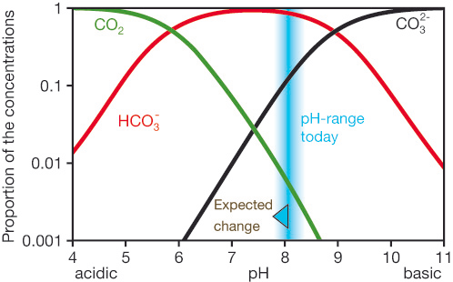
Reduced pH → Reduced Carbonate Ion
H₂CO₃
Carbonic acid
CO₂ + H₂O
HCO₃⁻ + H⁺
CO₃²⁻ + H⁺
Hydrogen ion
Bicarbonate ion
Hydrogen ion
Carbonate ion
pH = log(1/[H⁺]) = -log [H⁺]

Slide 21
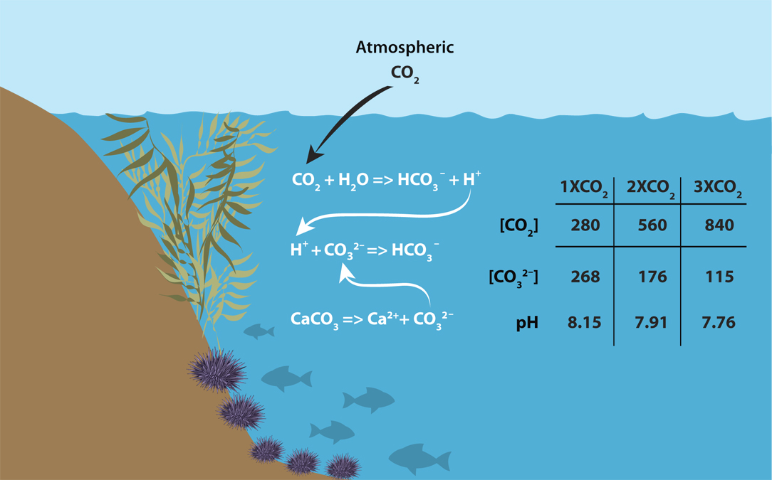
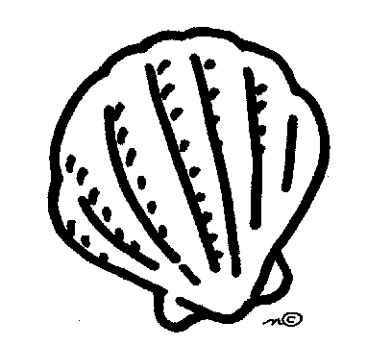
Why reduced carbonate ion matters:
Pre-Industrial [CO₂] = 280 ppm Present [CO₂] = ~390 ppm
ppm
Shells: CaCO₃
Calcium Carbonate
µmol kg⁻¹
Notes:
This reduction of carbonate ions may have deleterious effects on organisms that produce CaCO3 shells and skeletons. The extent to which they will be affected depends on the CaCO3 saturation state. The continual increase in CO2 in the atmosphere will decrease carbonate ions and continue to decrease the Calcium carbonate saturation levels.
The two types of calcium carbonate secreted by marine organisms are calcite and aragonite, and the saturation state of both of these is projected to decrease significantly by 2100. The big question then is how will organisms that rely on carbonate ions to build their skeletons fare under conditions of calcite and aragonite saturations which are roughly half of what they were before the industrial revolution?
Ksp = apparent stoichiometric solubility product for either aragonite or calcite
The factors which affect K'_{SP} are examined. These factors are temperature, salinity, pressure, crystal structure, mineral composition,

Slide 22
Carbonate saturation + temperature = double whammy for coral reefs
Hoegh-Guldberg, et al.
Science 318, 1737 (2007)

Slide 23
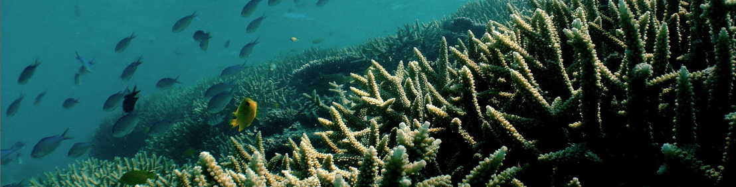
Growing concern for marine organisms as well as marine ecosystems
IPCC (2001): "Coral reefs would be negatively affected by bleaching and by reduced calcification rates due to higher CO₂ levels (medium confidence).”
IPCC (2007): “Major impacts are very likely for coral reefs, particularly the Great Barrier Reef”
Notes:
25% of marine species

Slide 24
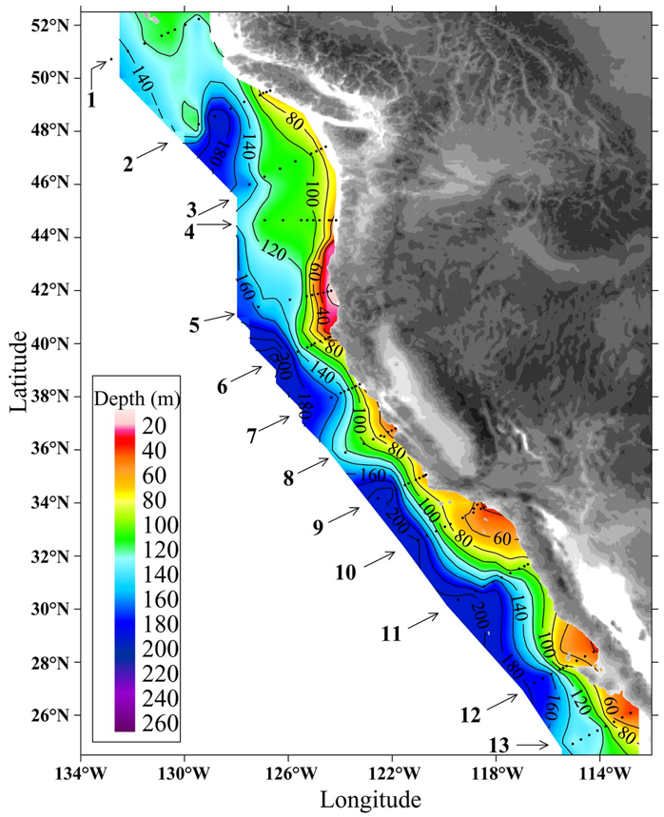
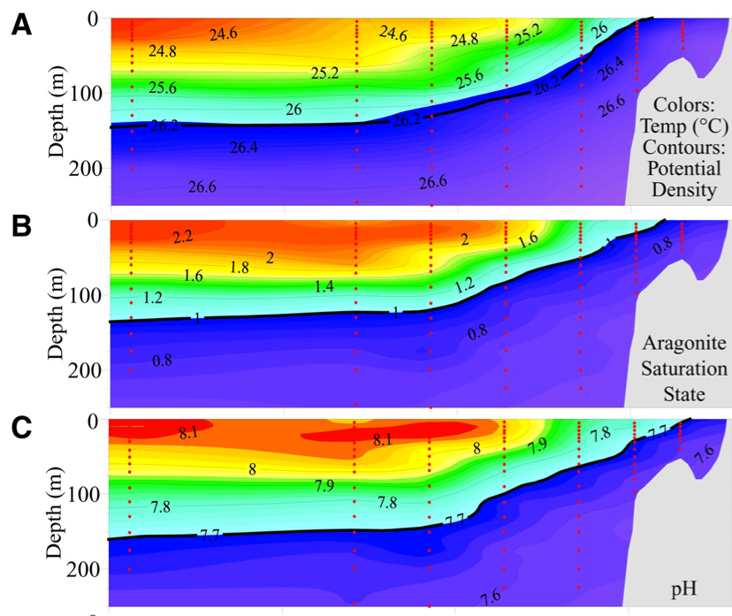
Coastal pH: Shoaling of Corrosive Water off California Coast
Transect line 5 - Pt. George CA
Feely et al (2008) Science
Notes:
strengthening of the northwesterly winds (13, 14). These winds drive net surface-water Ekman transport offshore, which induces the upwelling of CO2-rich, intermediate- depth (100 to 200 m) offshore waters onto the continental shelf. The upwelling lasts until late summer or fall, when winter storms return.
In regions where Warag or Wcal is > 1.0, the formation of shells and skeletons is favored. Below a value of 1.0, the water is corrosive and dissolution of pure aragonite and unprotected aragonite shells will begin to occur (12).
Although much of the corrosive character of these waters is the natural result of respiration processes at intermediate depths below the euphotic zone. The uptake of anthropogenic CO2 has caused these horizons to shoal by 50 to 100 m since preindustrial times so that they are within the density layers that are currently being upwelled along the west coast of North America.
The uptake of anthropogenic CO2 has caused these horizons to shoal by 50 to 100 m since preindustrial times so that they are within the density layers that are currently being upwelled along the west coast of North America. Also, no undersaturated waters would reach the surface without the anthropogenic impact. therefore, the upwelling processes will expose coastal organisms living in the water column or at the sea floor to less saturated waters, exacerbat- ing the biological impacts of ocean acidification.

Slide 25
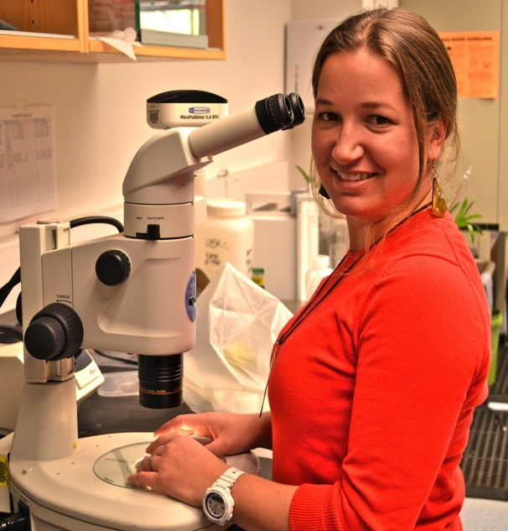
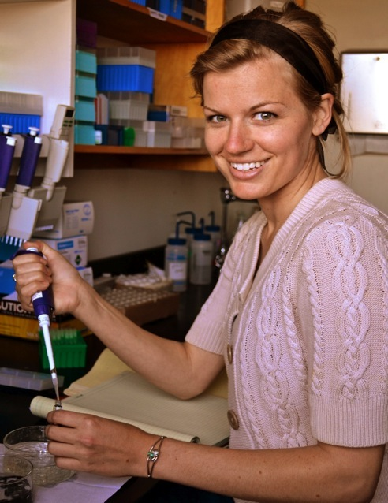


How do coastal crabs respond to OA?
Lina Ceballos
Hayley Carter
Ceballos, L.O. et al. 2013 J. Exp. Biol. 216: 1405-1411 Carter H.A. et al. 2013. J. Exp. Biol. 216: 1412-1422

Slide 26
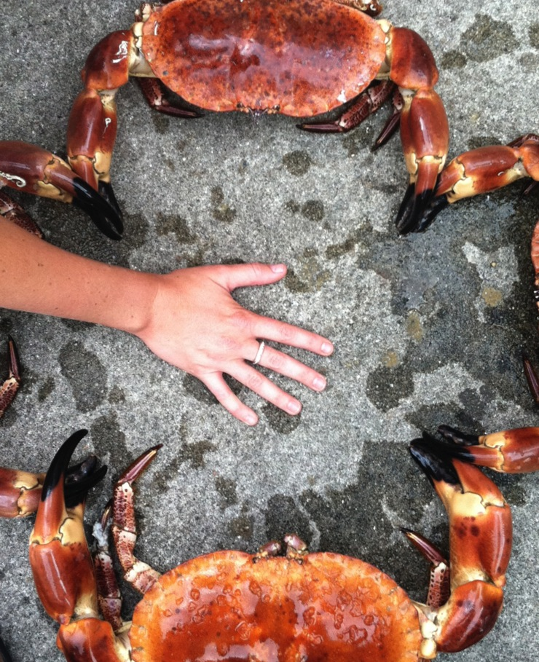
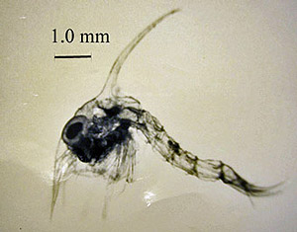
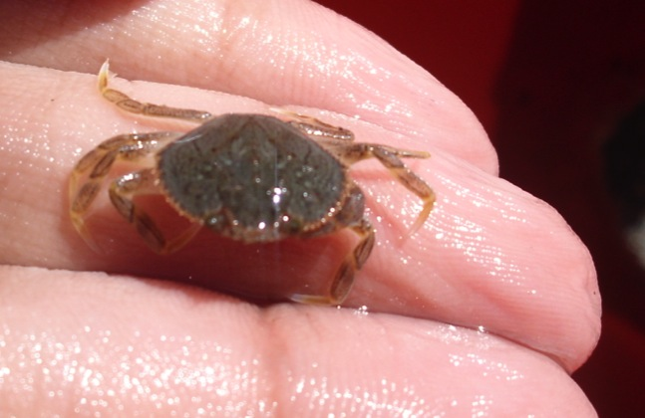

Slide 27
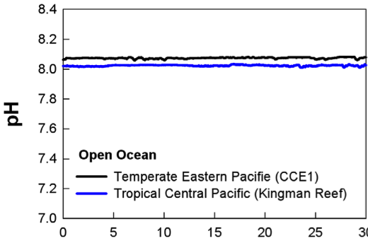
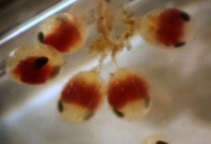

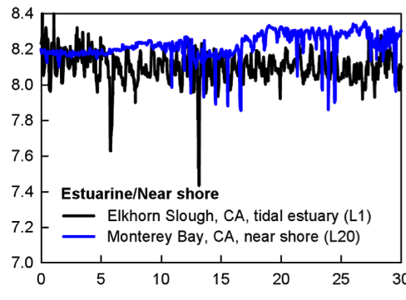
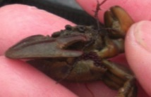
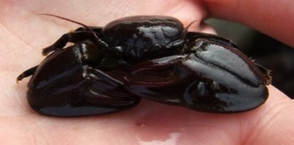
Same animal, different pH environments
Zoea I, II
Offshore
Megalope
Embryos
Juvenile
Intertidal
days
Adult
Hofmann et al. 2011

Slide 28
Life history variation in OA response?
Survival ?
Growth ?
Energetics ?
Rates ?

Slide 29
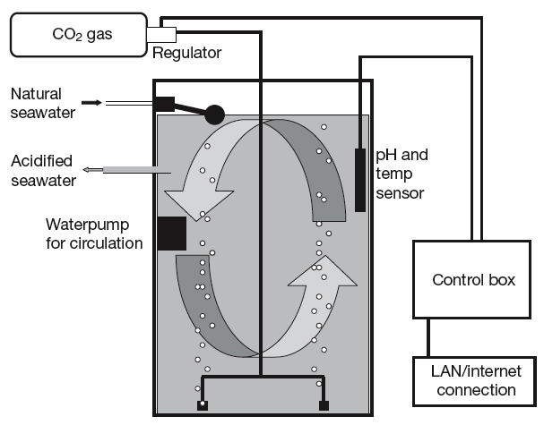

Simulating OA
  Acidified
  Ambient
  Current ocean
  (pH 7.96 ± 0.04)
Set pH: 7.60
  Future ocean
  (pH 7.60 ± 0.06)
Widdicombe and Needham 2007

Slide 30
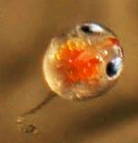
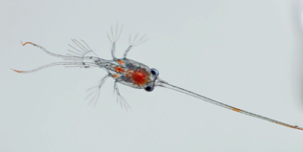
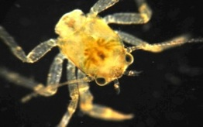
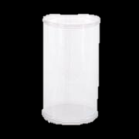



5-7 broods
7-10 days
7-10 days
  Current ocean
  (pH 7.96 ± 0.04)
  Future ocean
  (pH 7.60 ± 0.06)
  Seatable T = 13.2 ± 0.02° C

Slide 31
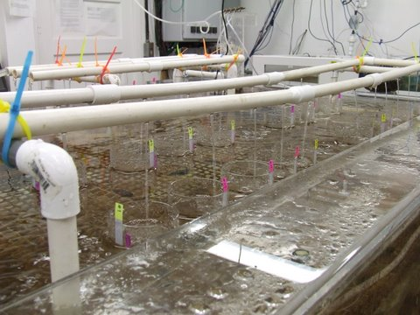
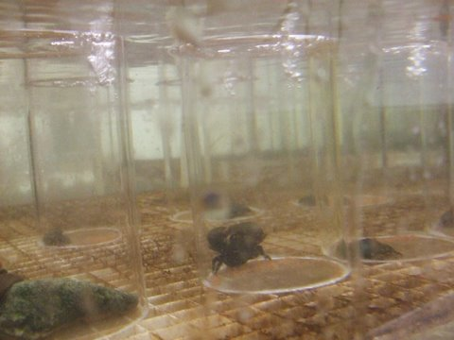
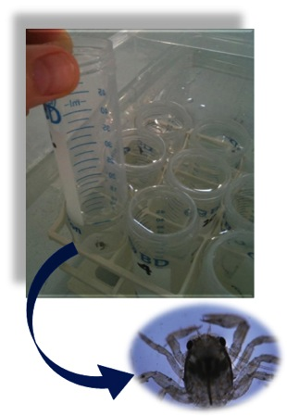
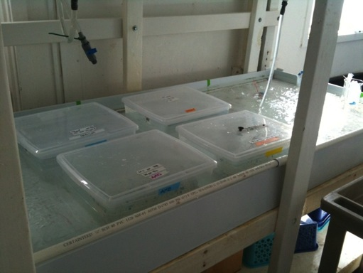
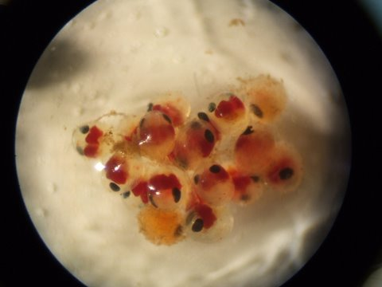
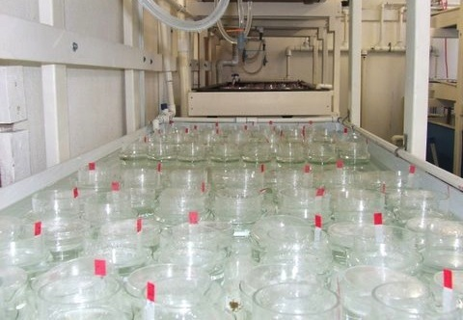

Slide 32
  Embryonic Suvival (hatching)
Broods
A
B
Notes:
----- Meeting Notes (4/24/12 15:22) -----
normalize

Slide 33

  Larval and Juvenile Survival reduced under OA
pH 7.9
pH 7.6
Kaplan-Meier survival probability
x ² = 2.7, p-value= 0.1
x ² = 7.8, p-value= 0.01*
A
B
Survival time (days)

Slide 34
  Embryonic Growth Stunted by OA
Volume (mm³)
2
Days pre-hatching

Slide 35



Stage dependent growth responses
p<0.00001
p<0.05
*
*
Mean values ± SE
Notes:
> grow$Stage <- factor(grow$Stage, levels =c("Embryo","Larvae","Juvenile"))
> w=ggplot(grow,aes(factor(Variable), PercentDiff))
> limitsP <- aes(ymax = PercentDiff + SE, ymin= PercentDiff - SE)
> w+geom_bar(aes(fill=factor(Variable)), colour="black",width=.6)+opts(axis.title.x=theme_blank())+opts(axis.title.y=theme_text(size=15, angle=90))+ylab(expression(atop(paste("Effect of OA"),("% difference from control mean"))))+opts(axis.text.y=theme_text(size=15))+opts(axis.text.x=theme_text(size=10))+geom_errorbar(limitsP, width=.05, colour="#666666")+facet_wrap(~Stage,ncol=3, nrow=1)+scale_fill_manual(name = "Variable",breaks=c("Total Protein","Dry Weight"),values=c("#66C2A5","#FC8D62"))+geom_hline(aes(intercept=0),colour="black")+opts(strip.text.x = theme_text(size=13))+opts(panel.border=theme_rect(colour="dark gray",size=0.71))

Slide 36

Lipid content not affected by OA
  pH 7.96 ± 0.04
  pH 7.60 ± 0.06

Slide 37

  Heart Rate Measurement

Slide 38


Responses to Ocean Acidification:
Taking the pulse of crabs
Crab Embryo
Crab Larva

Slide 39
  Acidification reduces heart rate
Embryo
Larvae
21% lower
*
37% lower
*

Slide 40
  Acidification reduces heart rate
Embryo
Larvae
Broods

Slide 41



  Metabolic Rate: Respirometry
0.3 mL

Slide 42
  Respiration rate response to OA varies among broods
d
Notes:
mean=ddply(emb,.(Stage, Treat,Female), function(d)mean(d$umolO2hr))
SE=ddply(emb,.(Stage, Treat,Female), function(d)std.error(d$umolO2hr))
colnames(mean)=c("Stage","Treat","Female","Mean")
colnames(SE)=c("Stage","Treat","Female","SE")
a=merge(mean,SE)
a
EmbFem=ggplot(a,aes(factor(Treat),group=factor(Female),Mean))
EmbFem+geom_errorbar(limitsE, width=.05, colour="#666666")+geom_smooth(colour="black",method="lm", linetype=5,size=.4)+geom_point(aes(shape=factor(Treat),fill=factor(Female)), size=4)+ylab(expression("Total Protein "(mu*g*~ind^-1)))+opts(axis.text.x=theme_text(size=15),axis.text.y=theme_text(size=15))+ylab(expression(atop(paste("Metabolic Rate"),(mu*mol*~O[2]*~h^-1*~ind^-1))))+opts(axis.title.x=theme_blank())+scale_shape_manual("pH Treatment",breaks=c("Ambient","Low"),labels=c("Ambient pH (8.0)", "Low pH (7.6)"),value=c(21,22))+scale_fill_brewer("Female Clutch",palette="Set1")+opts(panel.border=theme_rect(colour="dark gray",size=0.71))

Slide 43



Summary
Rate Processes
Respiration Rate
Heart Rate & Output |  |  | n/d
Maxilliped Rate | n/a |  | n/a
Growth
Size & Shape
Energetics
Dry Weight
C & N content
Protein Content
Total Lipids |  |  | nd
N
C/N

Slide 44



Model systems inform research on economically-important species
Notes:
Whether it be red king crab, maryland blue crab, or west coast Dungeness crab, we are concerned with managing our important fishery stocks and planning for how to protect the health of these economically and culturally important species in a new ocean that is warmer, and that has a different chemistry. Some of these stocks are already in decline and our ability to fish them into the future is in question.

Slide 45


Notes:
When you think of red king crab, you probably think of a delicious dinner
OR
A deadly, daring (dreadfully dull) Discovery channel drama. (and now video game!)

Slide 46

This juvenile king crab is approximately five months old. (Photo by Ben Daly.)
http://seagrant.uaf.edu/research/projects/initiatives/king-crab/photo_gallery/
Notes:
But you probably don’t think of this. A juvenile king crab is really quite small, and they grow slowly.

Slide 47




Juvenile Red king crab (RKC) response to ocean acidification (OA)
Long et al. PLoS ONE 2013, doi:10.1371/journal.pone.0060959
In acidified water (pH 7.8, 7.5) vs control (pH 8.0)
  Decreased growth rate
Increased mortality
Notes:
Results from our collaborators’ past research on the whole-organism physiological effects of ocean acidification in red king crab shows that in acidified water, their growth and survival is decreased. Their study compared red king crab to Tanner crab, both of which are harvested in Alaska. When red king crab response is compared to the Tanner crab, it shows that the two species have different underlying physiological responses. The Tanner crab appears to be less sensitive than the red king crab. This is not too shocking since they are only distantly related; red king crab is an anomuran decapod, whereas the Tanner crab is a brachyuran, a true crab. Particularly interesting about these results is that, though red king crab growth and survival is impaired more than Tanner crab, calcification is not impaired. Tanner crabs calcify less in acidic conditions but perform better overall. This suggests that perhaps red king crab spend more energy in osmoregulation than Tanners – a fact that we’ll want to remember later when looking at the genetic data.

Slide 48





Kathy Swiney
Scott Fay
Mudasir Andrabi
Bob Foy

Slide 49

Experiments conducted in NOAA NMFS OA laboratory: Kodiak, Alaska
INTERACTIVE EFFECTS OF T°C and CO₂?
9 Treatments
  3 levels of pH: 8.0, 7.8, and 7.6
  3 temperatures: 11, 13, and 14°C
N=12 RKC juveniles/treatment in individual chambers
20 d exposure → preserved specimens in RNAlater
Notes:
The experiments on juvenile crabs were conducted at NOAA fisheries in Kodiak Alaska. We implemented a fully crossed design with three levels of pH, ambient pH 8.0, pH 7.8, and pH 7.6, and three temperatures, ambient 11ºC, 13ºC, and 14ºC. This gave nine total different treatments, done in nine different buckets with twelve individuals per bucket, one each in an individual insert. The organisms were exposed 20 days and then preserved and sent to us. We extracted RNA and made Illumina RNA-seq libraries from them.

Slide 50

 | pH | 8.0 | 7.8 | 7.6
 | 11°C
 | 13°C
 | 14°C
Temperature increases always influenced gene expression.
pH 8.0 and 7.8 overall similar.
pH 7.6 distinct.
11°C
13°C
11°C
14°C
pH 8 + 7.8
14°C
pH 7.6
13°C
Notes:
As a first look at the data, we can cluster the samples to see how similar they are with respect to gene expression across all the transcripts. First we see that the replicates group very tightly with respect to treatment.
Let’s focus on the three different pH treatments at ambient temperature, here in blue. The ambient pH and pH 7.8 have similar expression profiles; pH 7.8 does not appear to have a drastic effect on expression across all the transcripts. This makes sense since the measurements taken from the whole organisms show that while there are measurable effects at pH 7.8, they are not devastating.
When we look at the more extreme pH, 7.6, there is a large shift in expression across the transcriptome.
We see here in orange and green that there is a significant effect of just the increase in temperature.
And we see again for each of the two experimental temperatures only the most drastic change in the pH 7.6 treatment.

Slide 51
CO₂ Emissions
Caldeira and Wickett (2003)

Slide 52
Summary
Ocean chemistry and temperature is changing and will continue to change for 100s-1000s of years even if we stopped burning fossil fuels today.
Organismal and ecosystem responses to those changes are complex and widespread
It’s not too late to act, but globalization and economic crises makes action increasingly difficult

Slide 53
What will you do to reduce your carbon footprint?
How will you inspire others to reduce theirs?

Slide 54

“Lucy and the Blue Hope” pg. 4

Slide 55

Page 7

