Slide 1
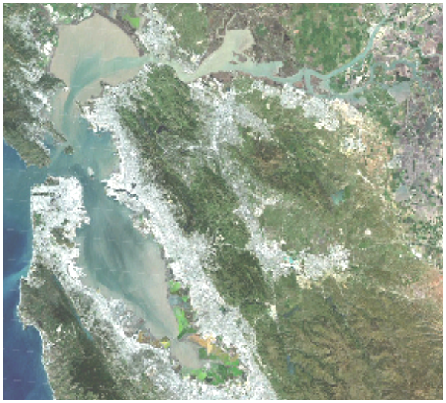
Clearing waters of San Francisco Bay: A legacy of California’s Gold Rush
David Schoellhamer
USGS California Water Science Center

Slide 2
Outline
San Francisco Bay Hydrology
Suspended sediment
Sudden clearing of the Bay
Effect of Gold Rush hydraulic mining
Sediment supply and flood control

Slide 3
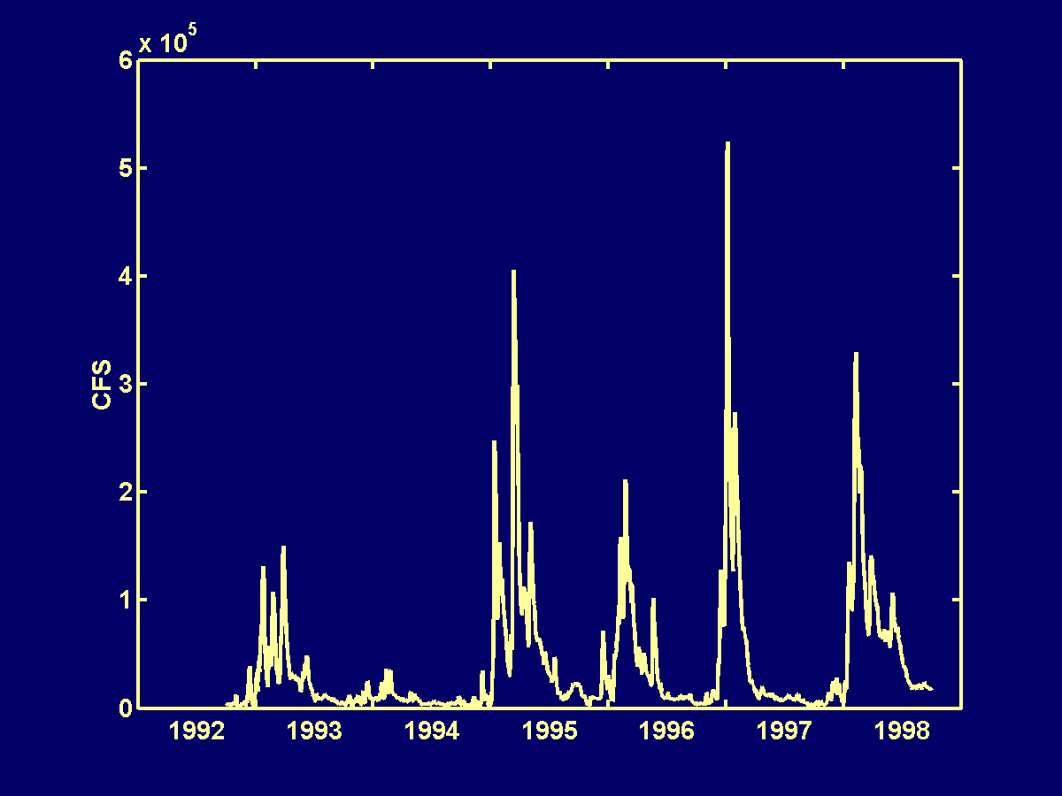
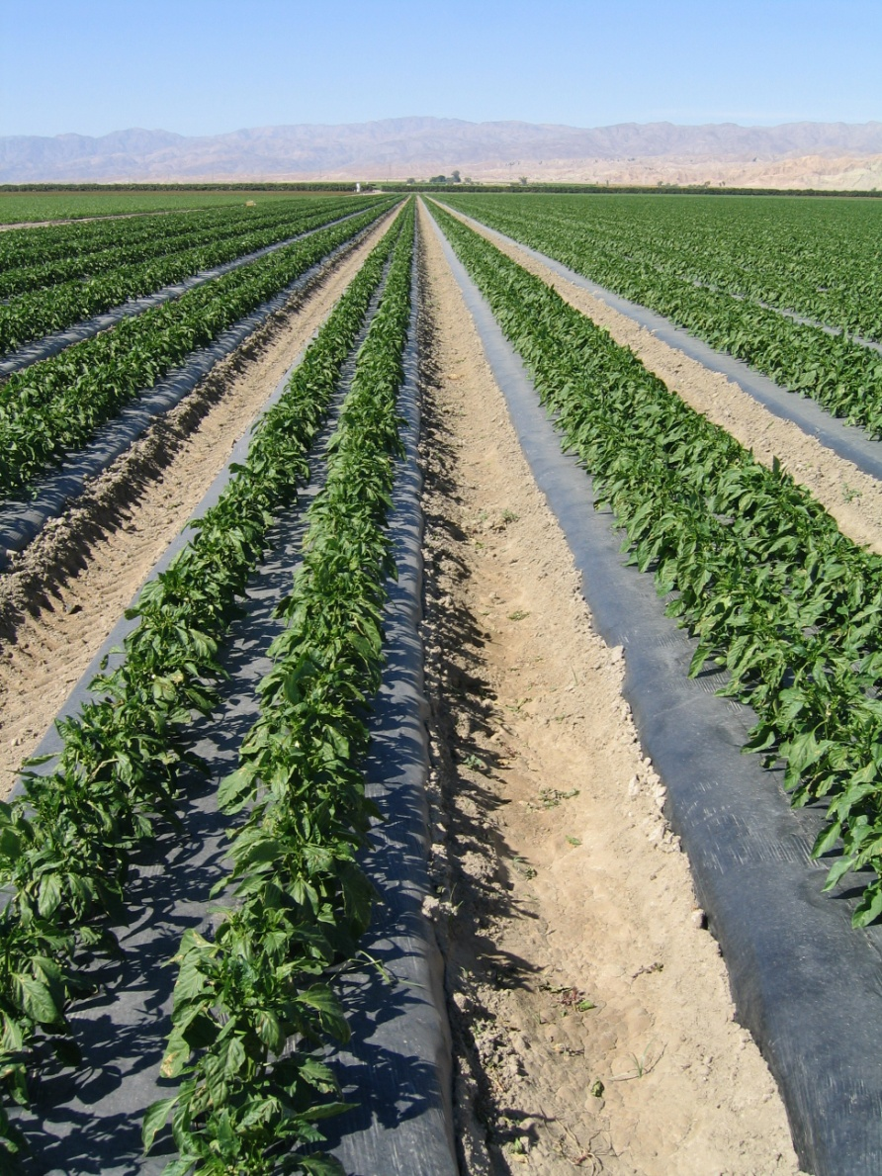
Central Valley Hydrograph

Slide 4
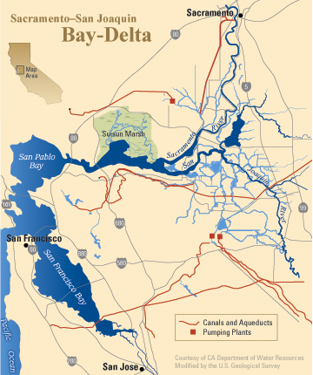
Sacramento-San Joaquin River Delta

Slide 5
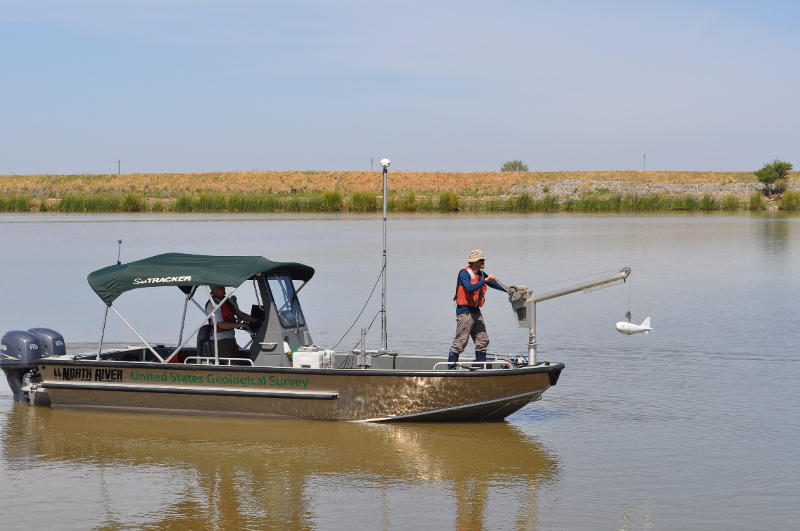
Rare large floods transport a lot of sediment
During water years 1999 to 2002, 82% of the sediment was delivered to the Delta during the wet period (31% of the time) (Wright and Schoellhamer 2005).
A large flood in January 1997 transported 11% of the sediment to Suisun Bay from 1995 to 2003 (McKee et al. 2006).

Slide 6
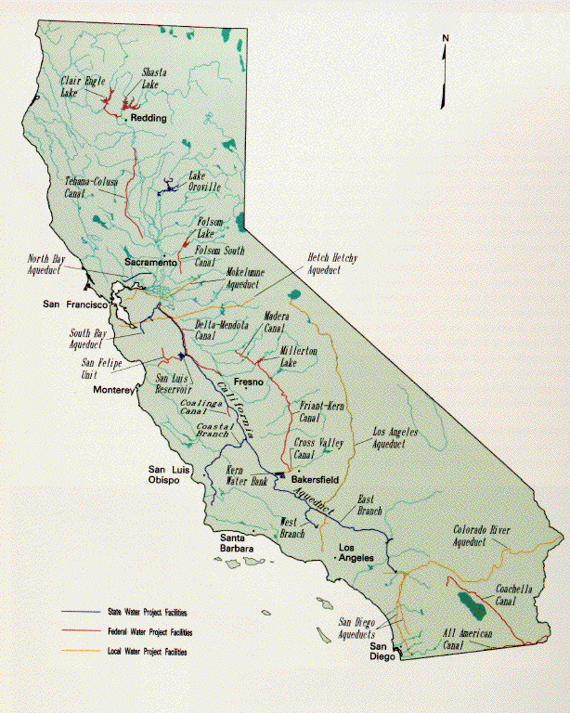
Water Projects
North to south transfer
Other transfers to urban areas
Reservoirs
Altered hydrograph
Altered ecology
DWR

Slide 7
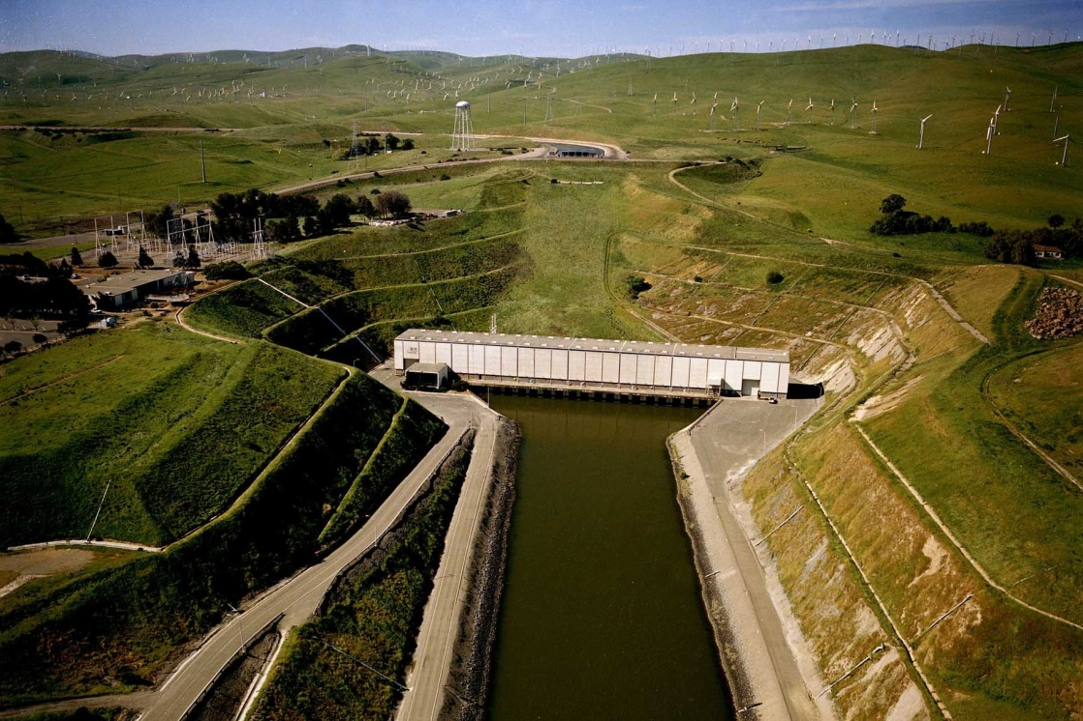
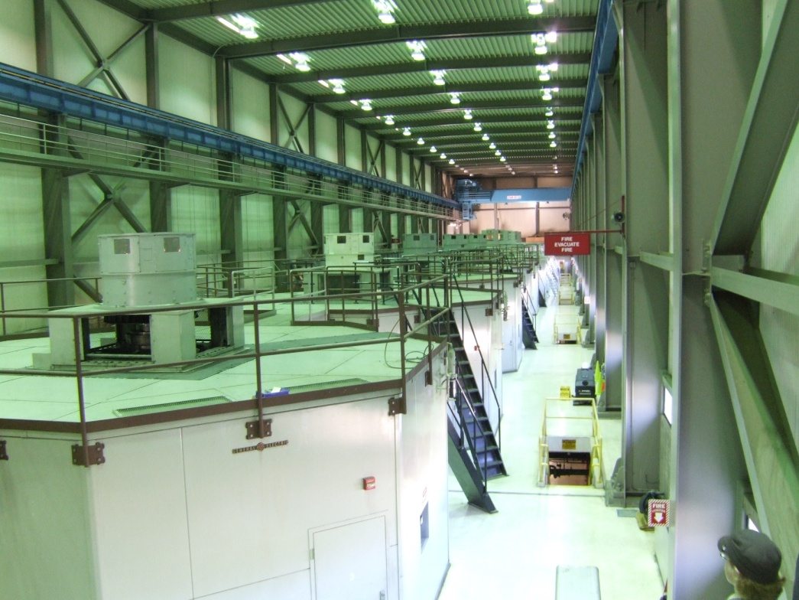
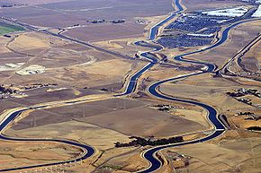
Water Projects

Slide 8
Tide Propagation

Slide 9
Longitudinal Density Gradient
Freshwater
Saltwater

Slide 10
Summer wind

Slide 11
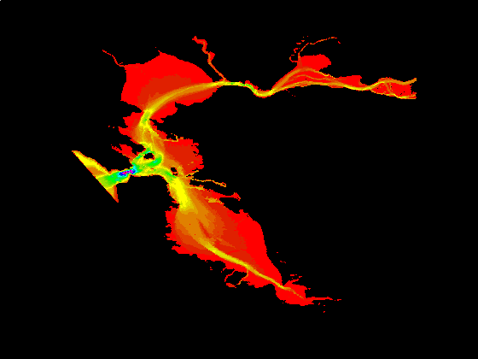
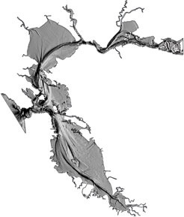
Bathymetry

Slide 12
Bay bottom is mostly fine sediment
Barnard et al. 2013

Slide 13
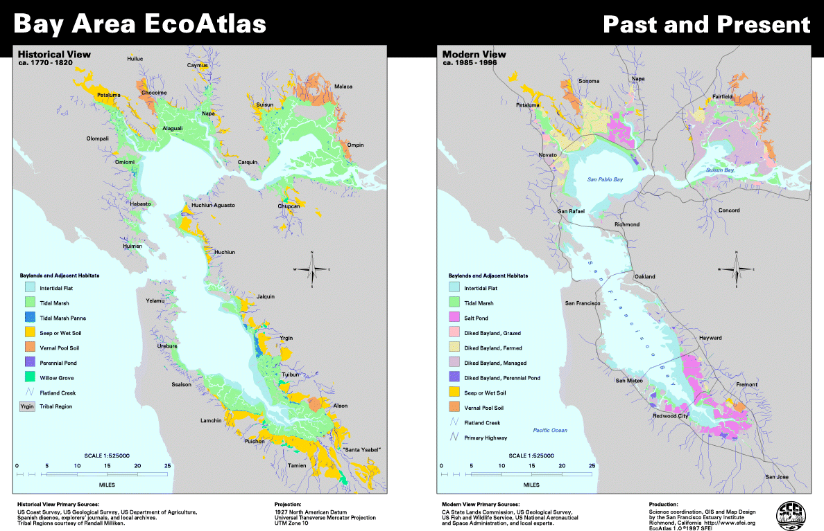
Diking and draining of Bay wetlands

Slide 14
Outline
San Francisco Bay Hydrology
Suspended sediment
Sudden clearing of the Bay
Effect of Gold Rush hydraulic mining
Sediment supply and flood control

Slide 15
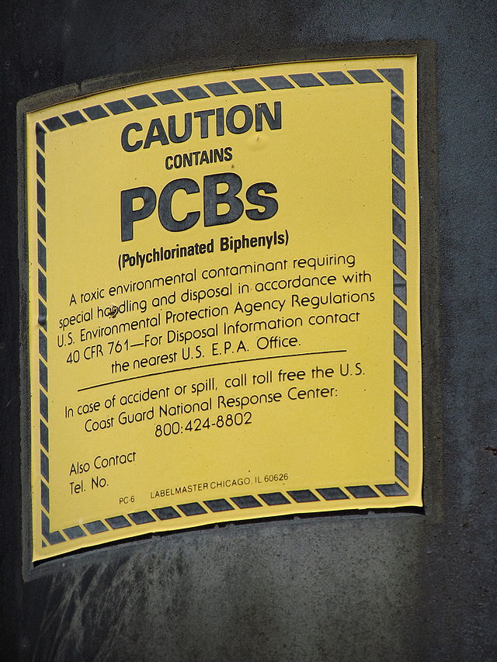
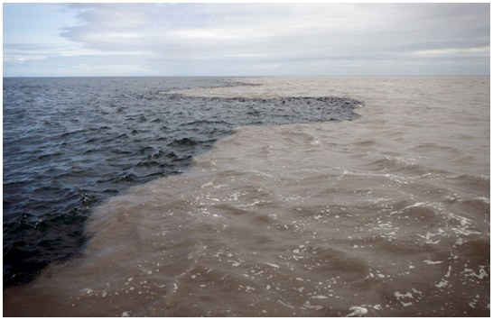
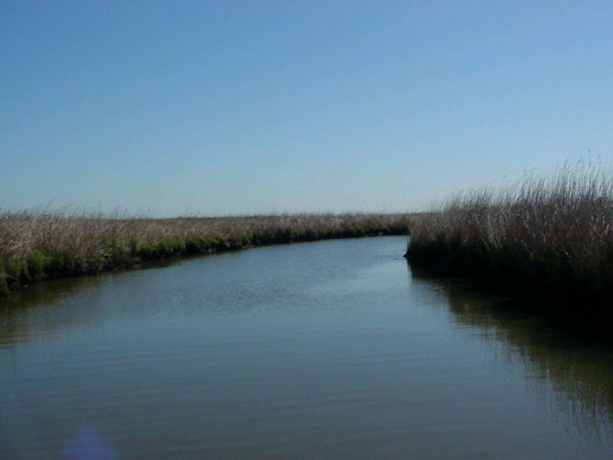
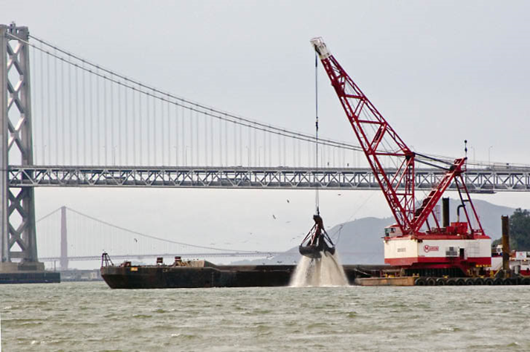
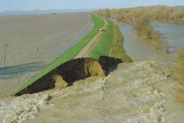
Notes:
15
1. In the 2011 AMP, one of the hypotheses is that the amount of abiotic habitat for delta smelt varies with the position of X2.
CLICK: there only one prediction that relates to turbidity, and it predicts that turbidity in LSZ will decrease as X2 increases (moves upstream into Delta). Example: when X2 is in Suisun Bay, the turbidity will be higher.
CLICK: Related to this, we came up with 2 related predictions: 1st that Suisun Bay is more turbid than the confluence, and 2nd that Suisun Bay is more turbid than Cache Slough
CLICK: Disclaimer: The analysis to this point is still preliminary.
This table is from page 47 of draft flash study report.

Slide 16
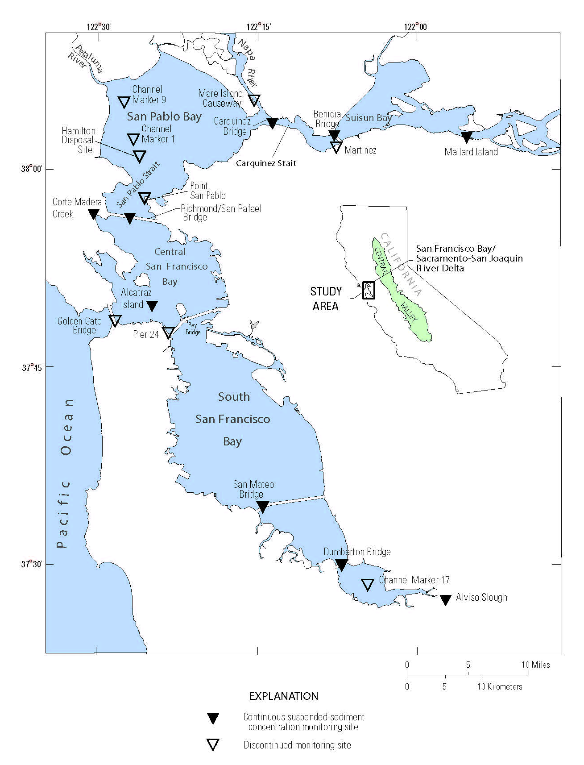
Continuous monitoring of SSC 1991-present

Slide 17
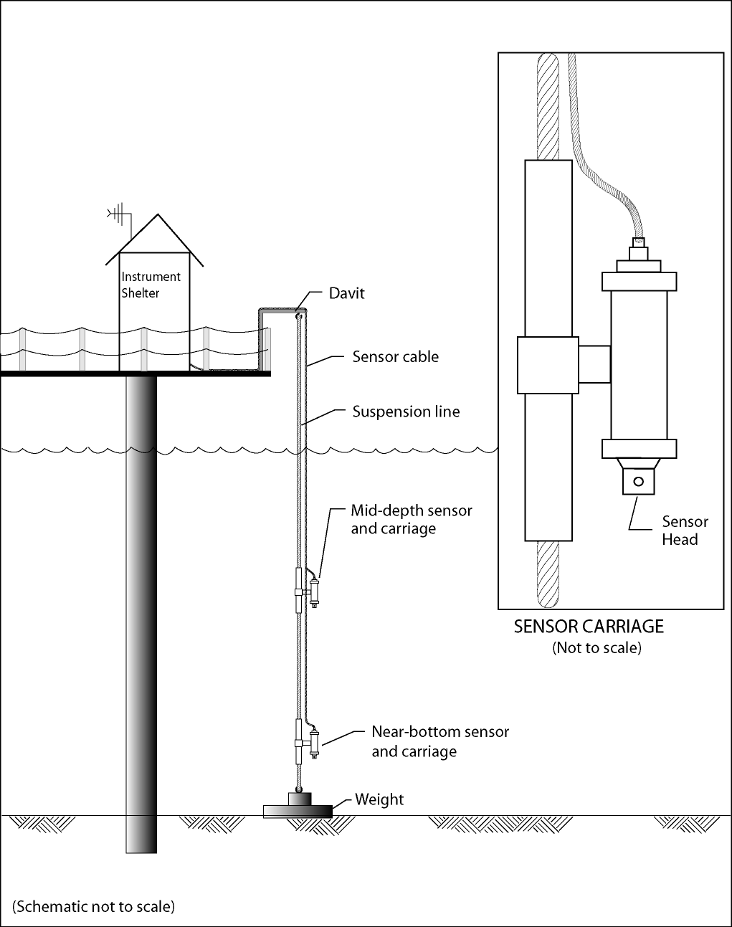
Buchanan and others 2014

Slide 18
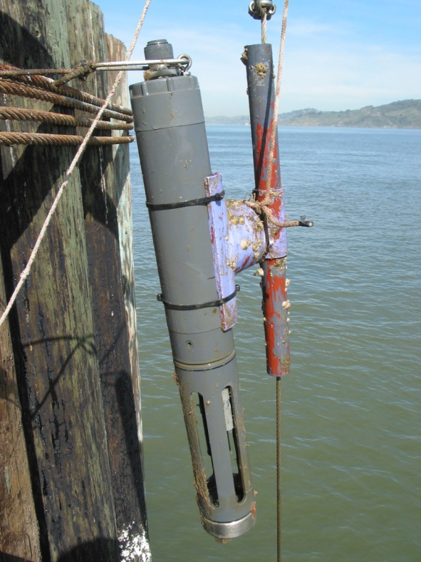
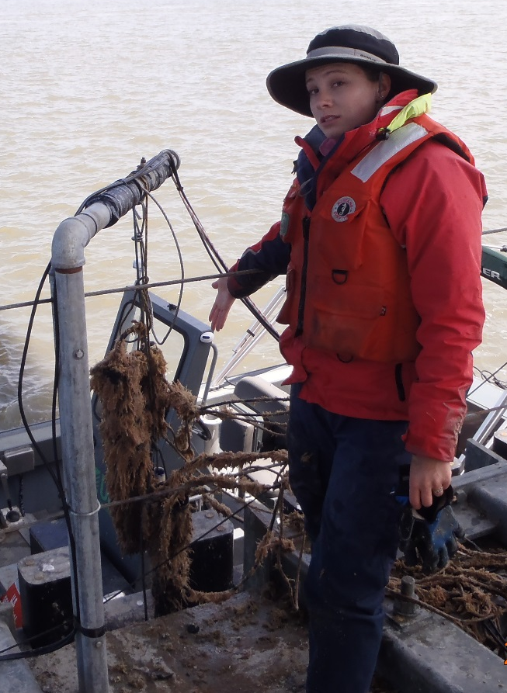
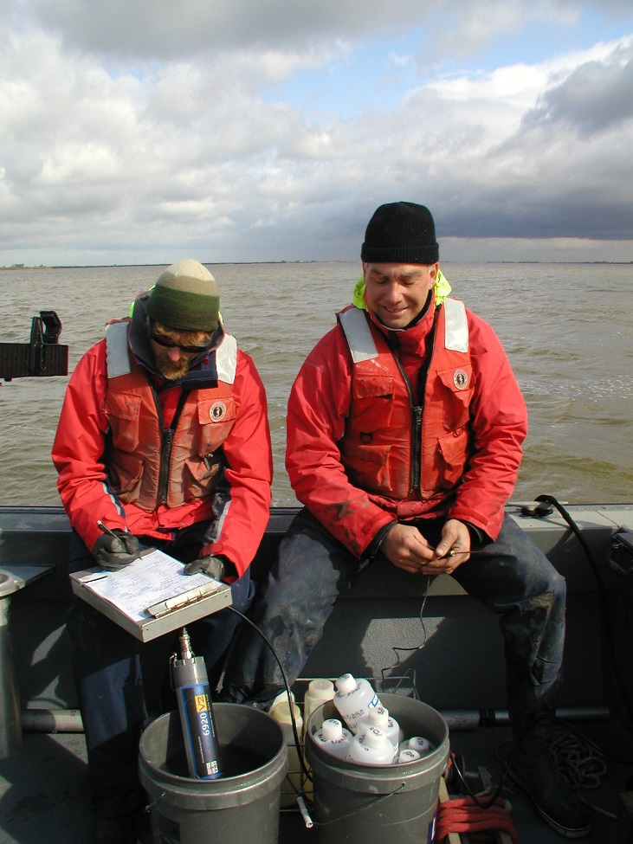
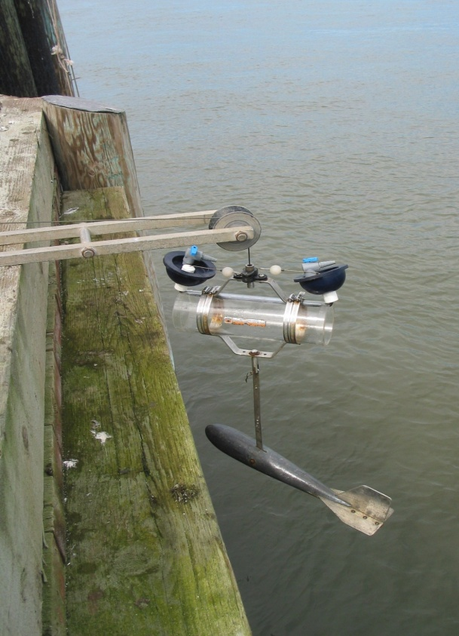
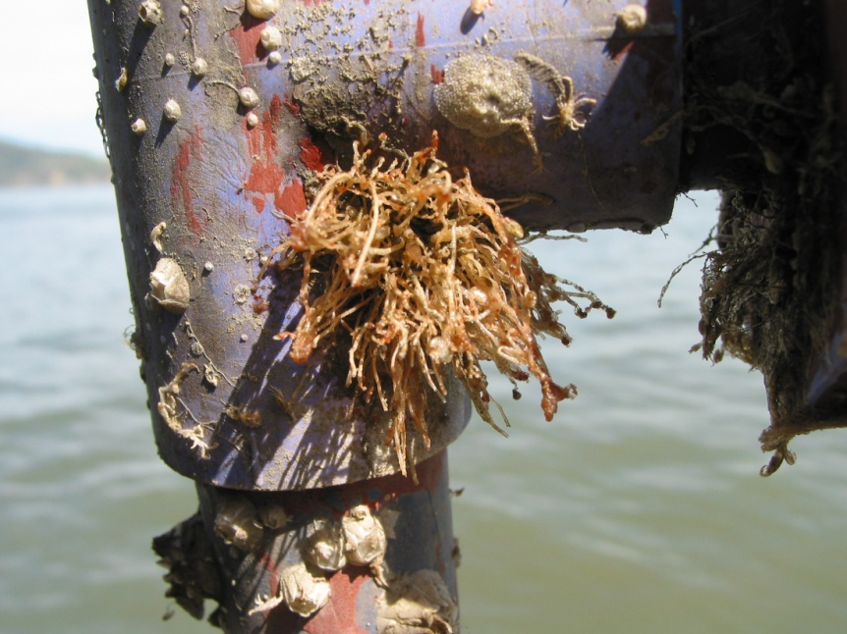
Notes:
18

Slide 19
Point San Pablo, mid-depth

Slide 20
WY1999: 36% step decrease in Bay SSC
Point San Pablo, mid-depth, Schoellhamer 2011

Slide 21
WY1999: 36% step decrease in Bay SSC
Dumbarton Bridge
Dumbarton Bridge, mid-depth

Slide 22
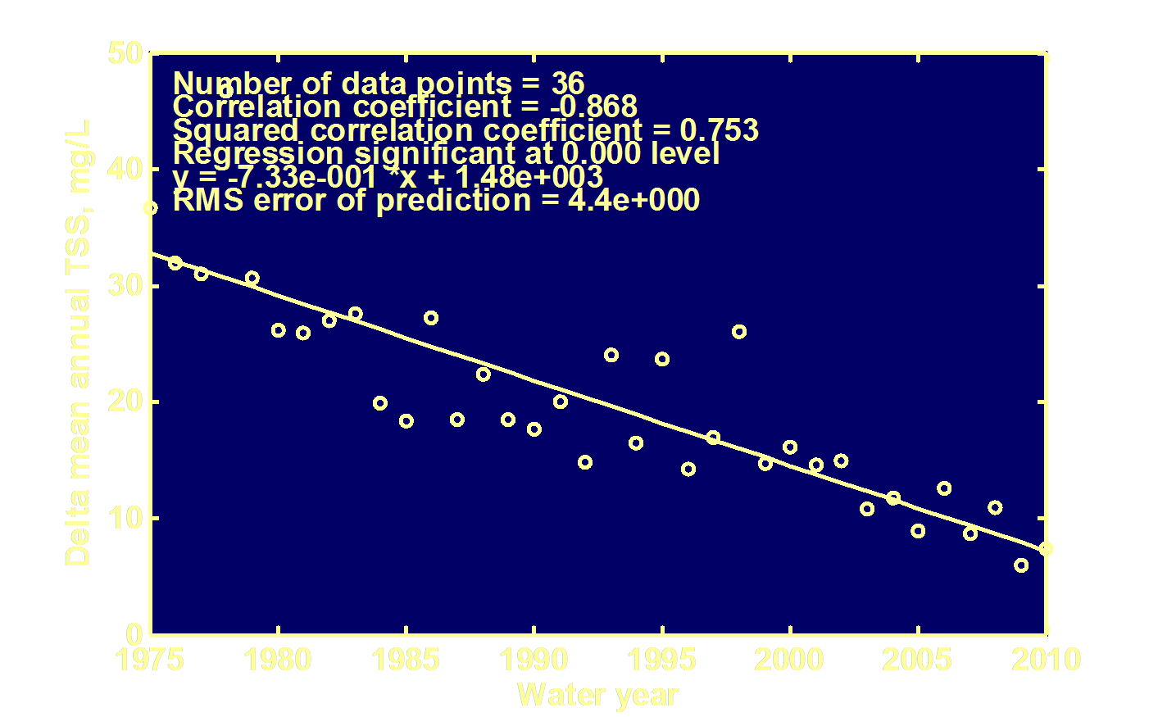
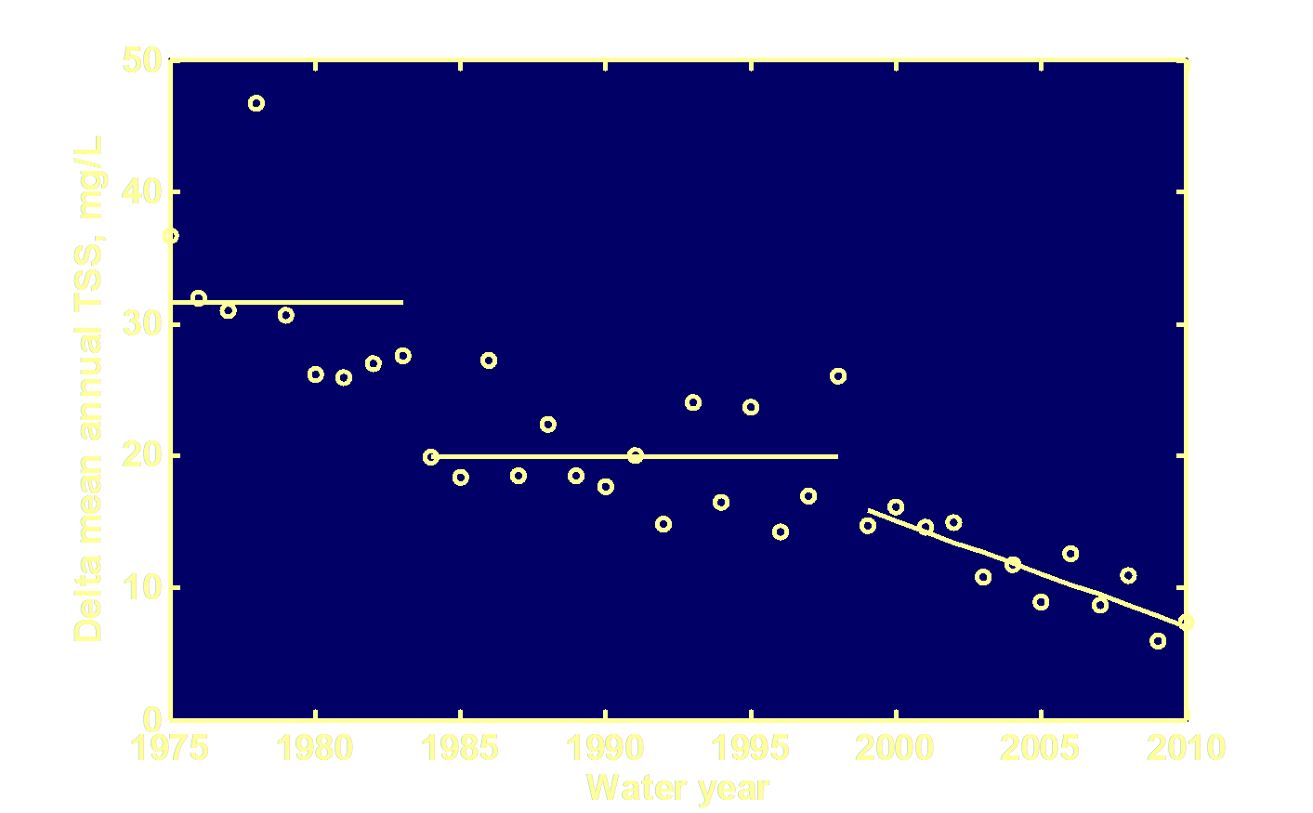
Less suspended sediment in the Delta
IEP
Step decreases after El Nino floods in 1983 and 1998
IEP
IEP
Schoellhamer et al. 2013, Hestir et al. 2013

Slide 23
More phytoplankton
4.3 mg/L before 1999, 6.1 mg/L after
USGS, RV Polaris, Hunters Point, 1 m below surface

Slide 24
Challenges posed by a clearing estuary
Potential eutrophication
Tidal marsh sustainability: Less sediment accretion as sea level rises
More sunlight in Delta water column: reduced habitat for native fish, increased habitat for invasive aquatic vegetation
Notes:
In some estuaries including San Francisco Bay, suspended
sediment limits light in the water column which limits
phytoplankton growth (Cloern 1987) and the potential for eutrophication. Thus, a decrease in
SSC would increase phytoplankton. In San Francisco Bay
beginning in 1999, chlorophyll concentrations increased,
and autumn blooms occurred for the first time since at least
1978 (Cloern et al. 2007). Both SSC and chlorophyll
indicate that the bay crossed a threshold and fundamentally
changed in 1999. San Francisco Bay has been transformed
from a low-productivity estuary to one having primary
production typical of temperate-latitude estuaries. Cloern et
al. (2007) also state that a shift in currents in the Pacific
Ocean, improved wastewater treatment, reduced sediment
inputs, and introductions of new species may be responsible
for the chlorophyll increase. The Chesapeake Bay Program has reduced the adverse affects of eutrophication.
Reduced SSC may be one of several factors contributing
to a collapse of several San Francisco Bay estuary fish
species that occurred around 2000 (Sommer et al. 2007).
Abundance of some fish species increases in more turbid
waters (Feyrer et al. 2007). The population collapse has had
the most serious consequences for Delta smelt which
require turbid water for successful feeding and predator
avoidance.
The plant Egeria densa invaded some of the open waters of the Delta beginning in the 1960s (Jassby and Cloern 2000). It is a likely contributor to the decline in Delta turbidity and alters near-shore fish assembleges (Nobriga et al. 2008). Thus, Chesapeake Bay has been harmed by loss of native submerged vegetation while the Delta has been harmed by an increase of invasive submerged vegetation.
Wetland restoration typically involves opening a diked area
to tidal action, allowing sediment to deposit until the bed
elevation is high enough for plant colonization. The rate of
deposition is proportional to SSC (Krone and Hu 2001). The
time required to create a wetland increases as SSC decreases.
If the rate of deposition is less than the rate of sea level rise,
a vegetated wetland will never form. Thus, decreased SSC
affects restoration of subsided land to tidal marsh by (1)
increasing the time needed to restore tidal marsh vegetation
and (2) increasing the possibility that natural sedimentation
cannot restore tidal marsh as sea level rises. Along the Gulf Coast, outflow from the Mississippi River is being modified to provide more sediment to tidal marshes and help slow land loss.

Slide 25
Outline
San Francisco Bay Hydrology
Suspended sediment
Sudden clearing of the Bay
Effect of Gold Rush hydraulic mining
Sediment supply and flood control

Slide 26
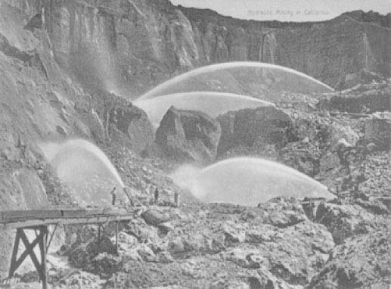
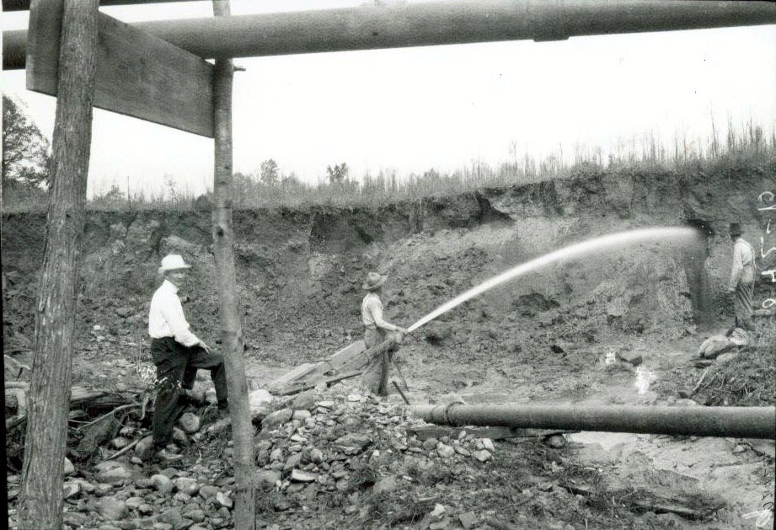
Hydraulic mining in the watershed
Gold mining using hydraulic methods dramatically increased sediment runoff to the valley, Delta, and Bay, primarily in the late 1800s
Extensive deposition in valley rivers lead to increased flooding and the mandated cessation of mining in 1884

Slide 27
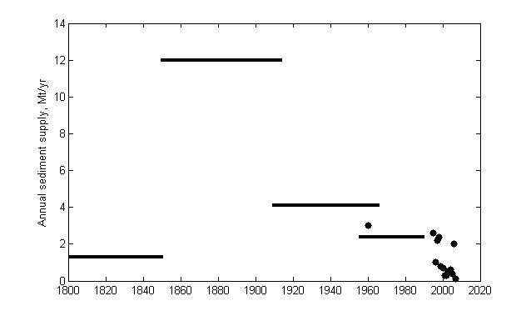
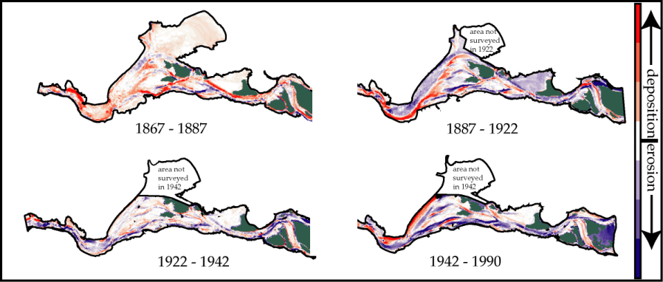
Increased sediment and aggradation
Schoellhamer 2011
Bear River, 19th century, James 1999
From data in Cappiella et al. (1999), Fergoso et al. (2008),
Foxgrover et al. (2004), and Jaffe et al. (1998)

Slide 28
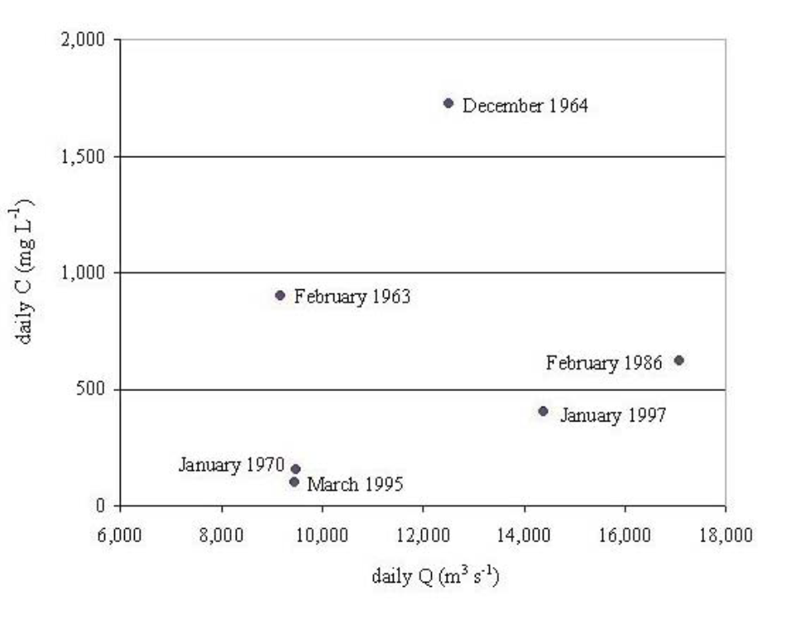
Decreased sediment and degradation
Schoellhamer 2011
Sacramento River at Freeport, flow peaks, Wright and Schoellhamer 2004
From data in Cappiella et al. (1999), Fergoso et al. (2008),
Foxgrover et al. (2004), and Jaffe et al. (1998)

Slide 29
Sacramento River sediment yield
>99% probability (p<0.01) of decreasing trends, both discharge bins
Wright and Schoellhamer, 2004

Slide 30
Why less sediment?
12~13 Mm³/yr less than peak (~90%)
Diminishment of hydraulic mining pulse: adjustment in steps with larger flows
Reservoir deposition: Deposition in Oroville, Folsom, and Englebright ~2.4 Mm³/yr (Wright and Schoellhamer 2004)
3) Flood bypasses: Deposition in Colusa, Sutter, Yolo near Fremont Weir 1.3 Mm³/yr (Singer and Aalto 2008)
4) Bank protection: Banks on over half the lower Sacramento River were protected from 1960-2000 (USFWS 2000)
5) New sediment traps: Invasive aquatic vegetation in Delta

Slide 31
WY1999: 36% step decrease in Bay SSC
Transport regulation
Supply regulation
Hydraulic
Mining
Record
flow
Point San Pablo, mid-depth, Schoellhamer 2011

Slide 32
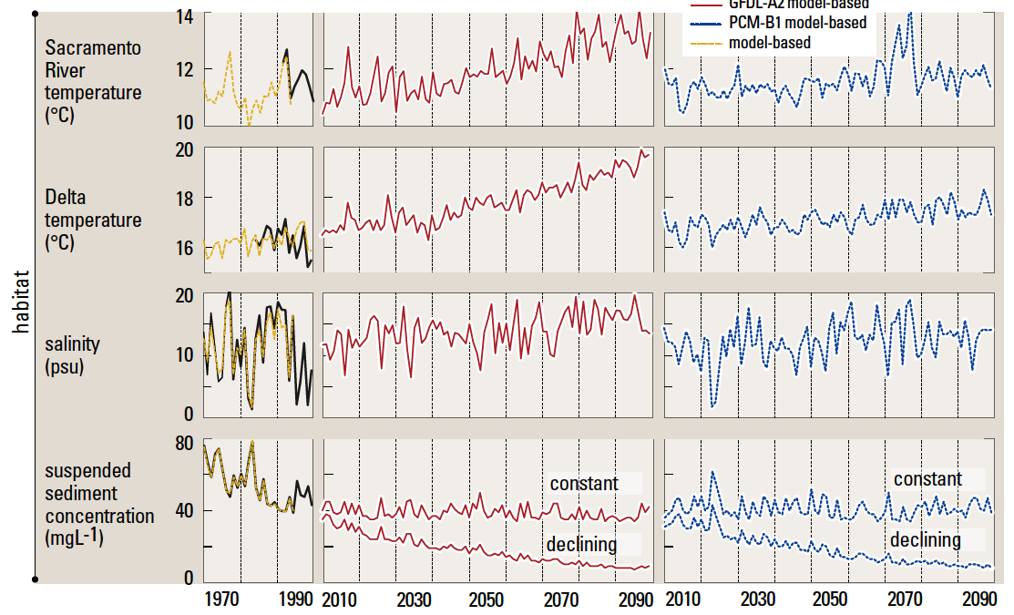
Will decreasing trend continue?
CASCaDE: Cloern et al 2011

Slide 33
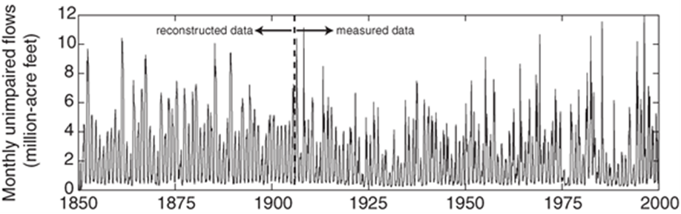
What we know
Sediment supply is decreasing
The watershed and estuary are adjusting to decreased supply
Rare large floods transport a lot of sediment
Recent step changes in bed elevation and suspended sediment are associated with the largest floods since hydraulic mining
Ganju et al. 2008

Slide 34
Hypothesis: adjusting to less sediment
It is likely that the estuary and watershed are still capable of adjusting but further adjustment will be as steps that occur only during greater floods than previously experienced during the adjustment period.
Larger and larger floods are needed to exceed geomorphic thresholds and cause adjustment. Between large floods are periods of equilibrium.
Schoellhamer et al. 2013, Hestir et al. 2013

Slide 35
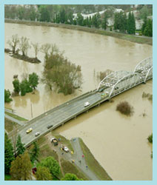
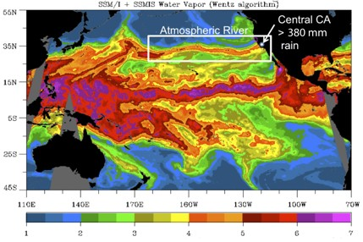
Flood control
Humans are trying to prevent larger floods
Success: No more adjustment, watershed and
Bay are in a stable adjusted regime.
Failure: Catastrophic flooding, further adjustment
A flood with a 500 year or greater return period would overwhelm the Sacramento Valley flood control system (Porter et al. 2011)

Slide 36
Tidal marsh sustainability
When the return interval of adjustment floods becomes greater than ecological response times, ecological variables will adjust to the prevalent environmental conditions.
Elevation
Time

Slide 37
Concluding comments
Value of collecting and analyzing long-term data
Dependence of the estuary on watershed processes
Rick Adorador, Lee Bergfeld, Matt Brennan, Greg Brewster, Paul Buchanan, Laurie Campbell, Robert Castagna, Randal Dinehart, Maureen Downing-Kunz, Trinia Dzurny, Darin Einhell, Haley Fassett, Amber Forest, Neil Ganju, Tom Hankins, Jessica Lacy, Larry Lindsay, Megan Lionberger, Allan Mlodnosky, Tara Morgan-King, Heather Ramil, Cathy Ruhl, Greg Shellenbarger, Rob Sheipline, Chris Silva, Brad Sullivan, Kathleen Swanson, Ann Tobin, Robert Turner, Travis von Dessonneck, John Warner, Kurt Weidich, Brooks Weissner, Dan Whealdon-Haught, Rob Wilson, Jessica Wood, and Scott Wright
Notes:
Finally, thank you to the agencies and people that have helped with this work.

