Slide 1

Crisis at the end of the Permian: global change and the greatest mass extinction in the history of life
Pedro J Marenco
Bryn Mawr College Department of Geology

Slide 2
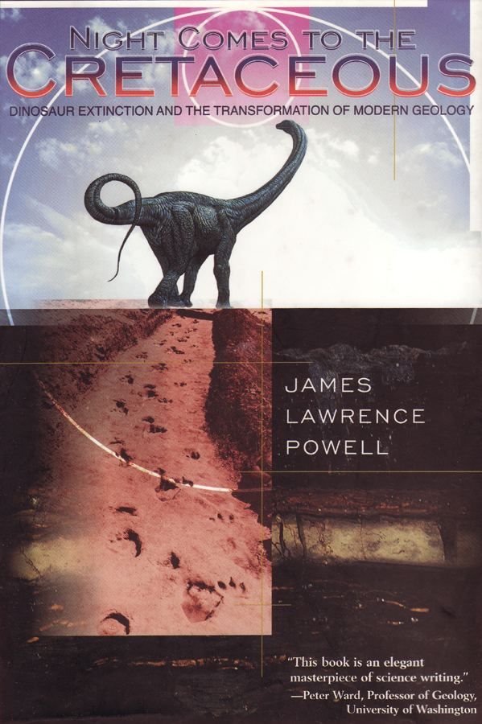
End Cretaceous Mass Extinction

Slide 3
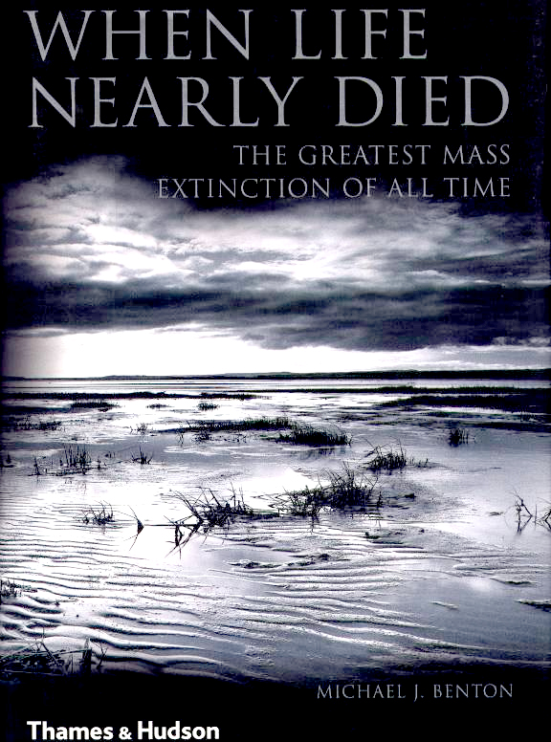
End Permian Mass Extinction

Slide 4
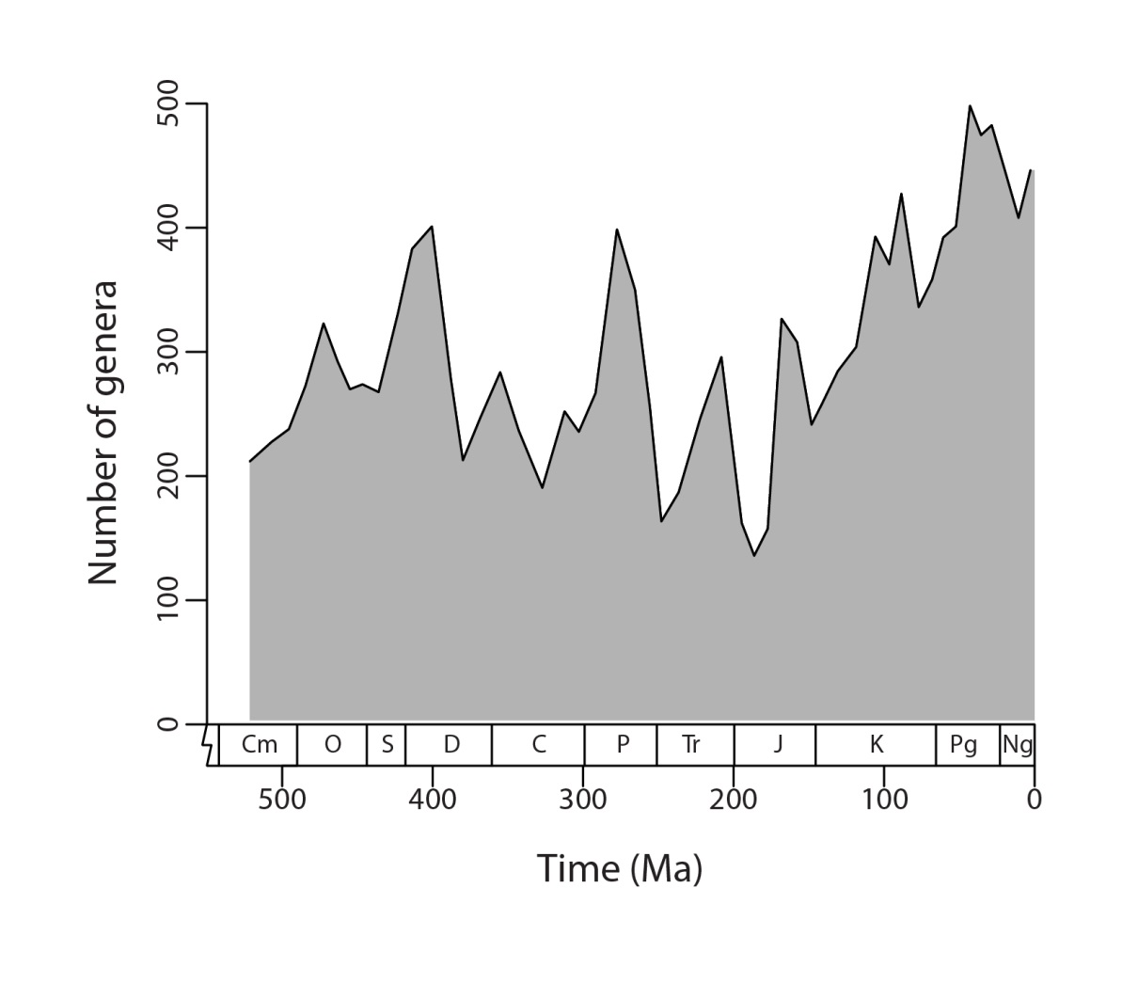
The Big 5 Mass Extinctions
End Cretaceous
End Permian
End Ordovician
Late Devonian
End Triassic
Paleozoic
Mesozoic
Cenozoic
(modified from Alroy, 2010)

Slide 5
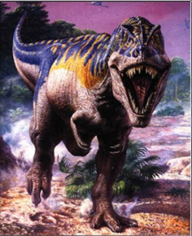
End Cretaceous Mass Extinction
K-T event
50% of marine species
47% of marine genera
(Raup 1979, Erwin 1993, Hallam & Wignall 1997)

Slide 6
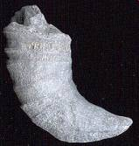
End Permian Mass Extinction
Largest mass extinction
P-Tr event | K-T event
80-96% of marine species | 50% of marine species
84% of marine genera | 47% of marine genera
(Raup 1979, Erwin 1993, Hallam & Wignall 1997)

Slide 7
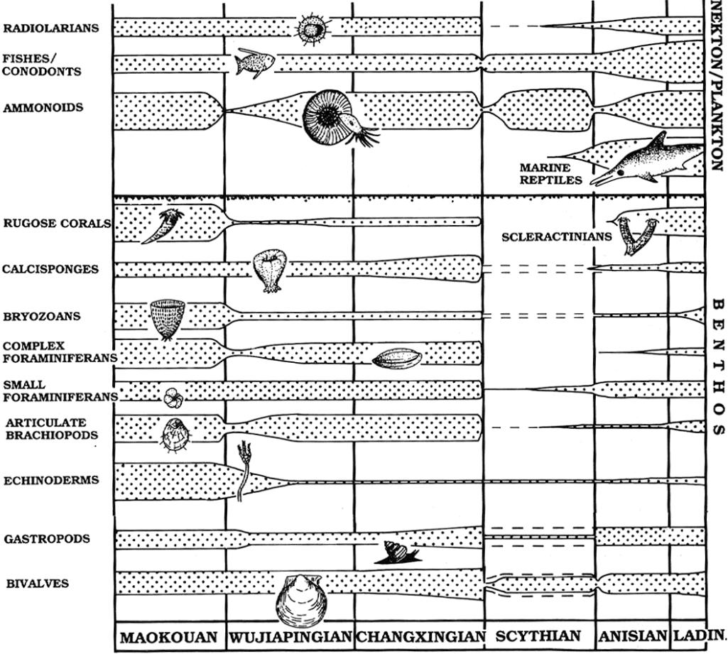
End Permian
Permian
Triassic
50% family
84% genus
80% species

Slide 8
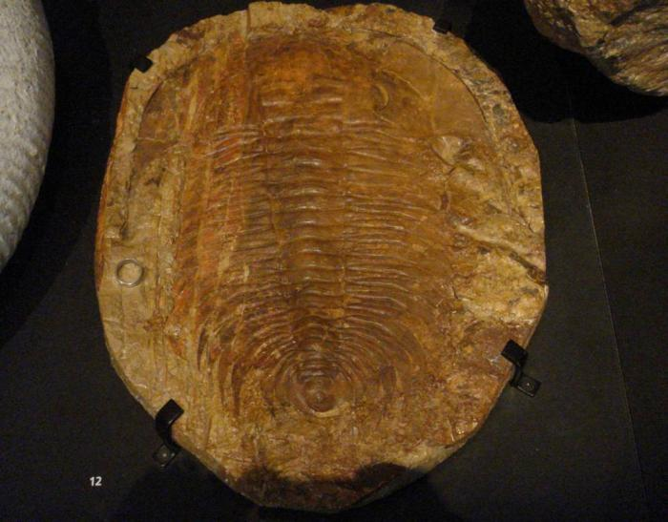
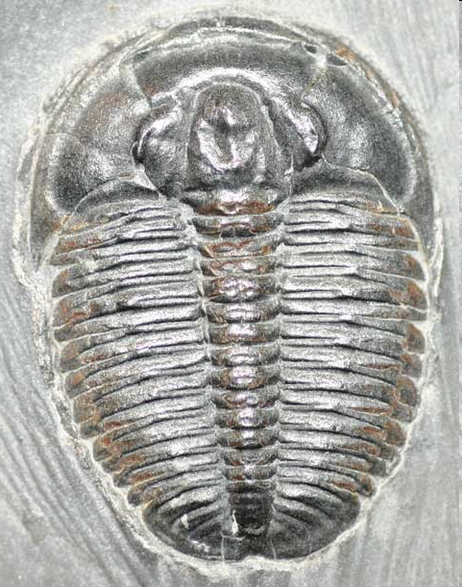
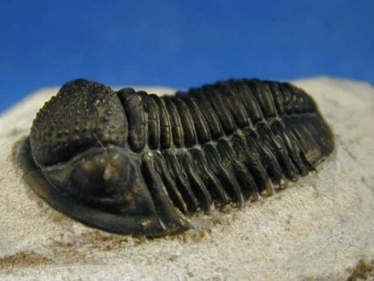
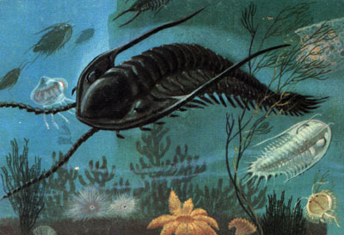
Trilobites

Slide 9
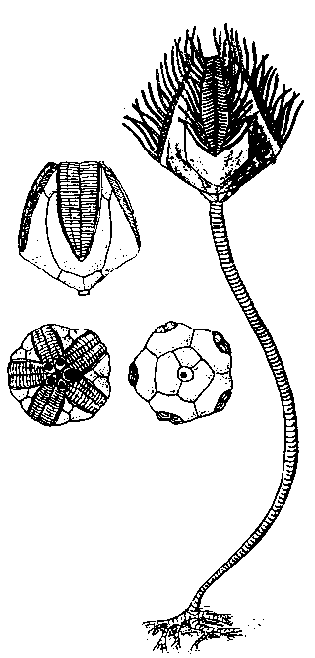
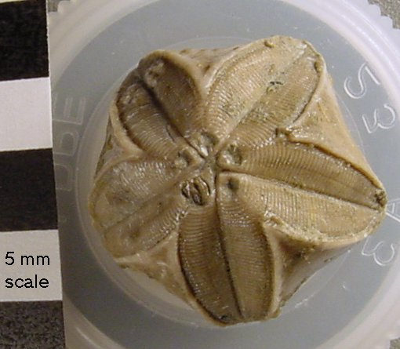
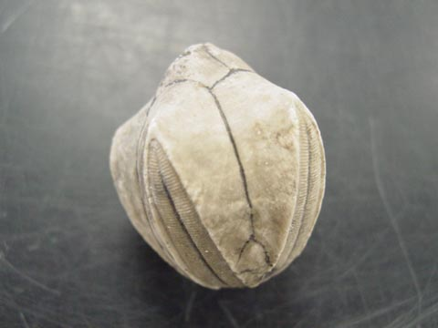
Blastoids

Slide 10
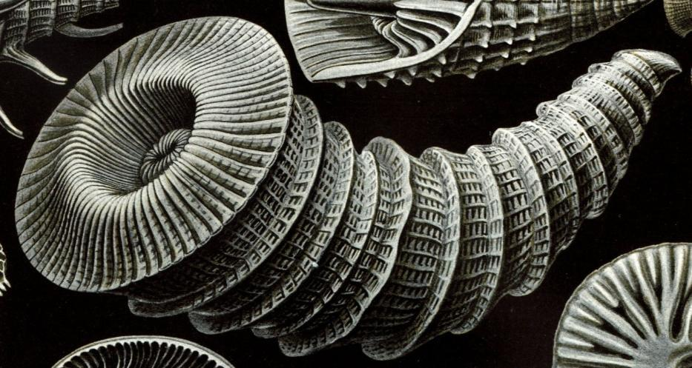
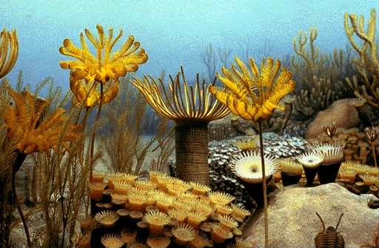
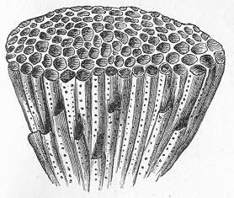
Rugose Corals and Tabulate Corals

Slide 11
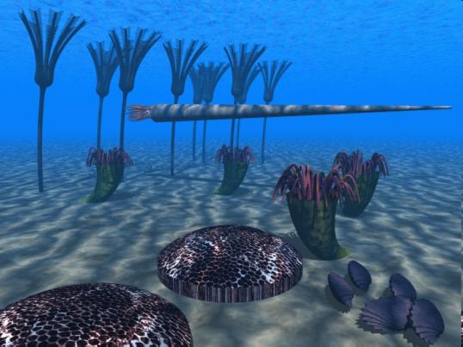
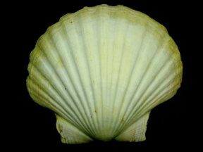
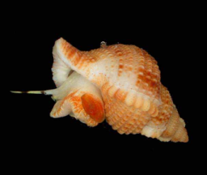
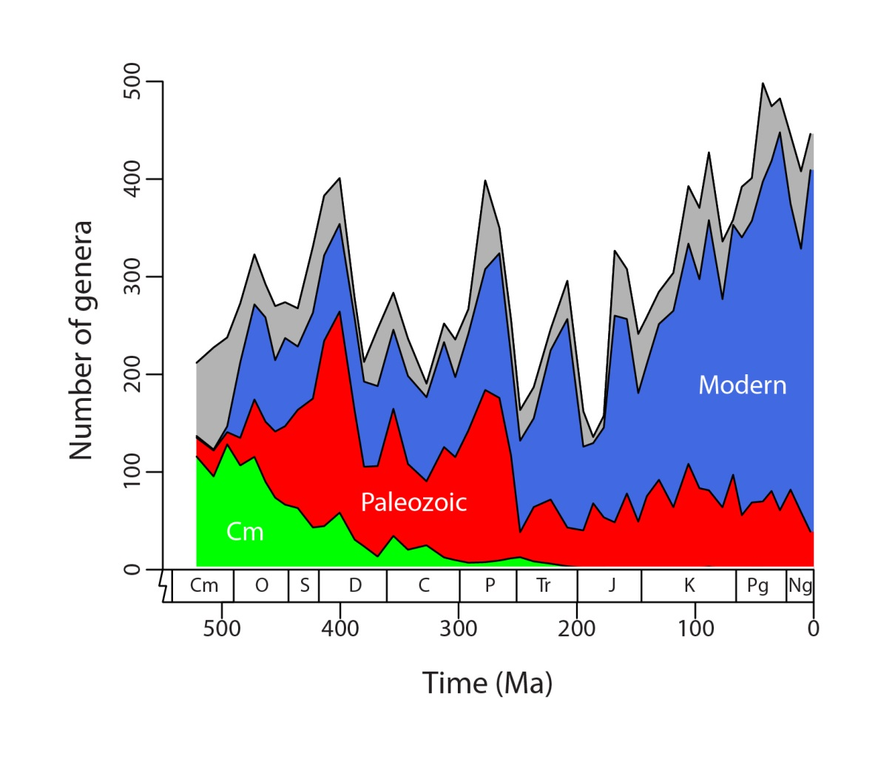
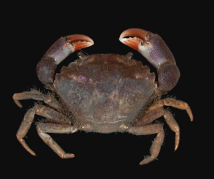
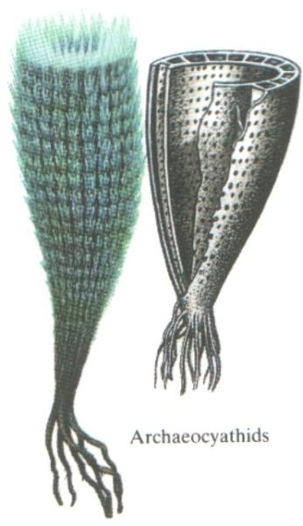
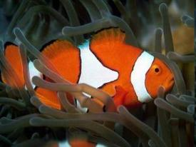
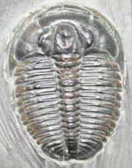
Major Ecological Shift
Paleozoic fauna to Modern fauna

Slide 12
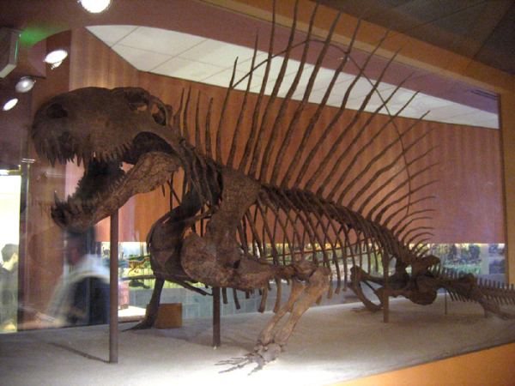
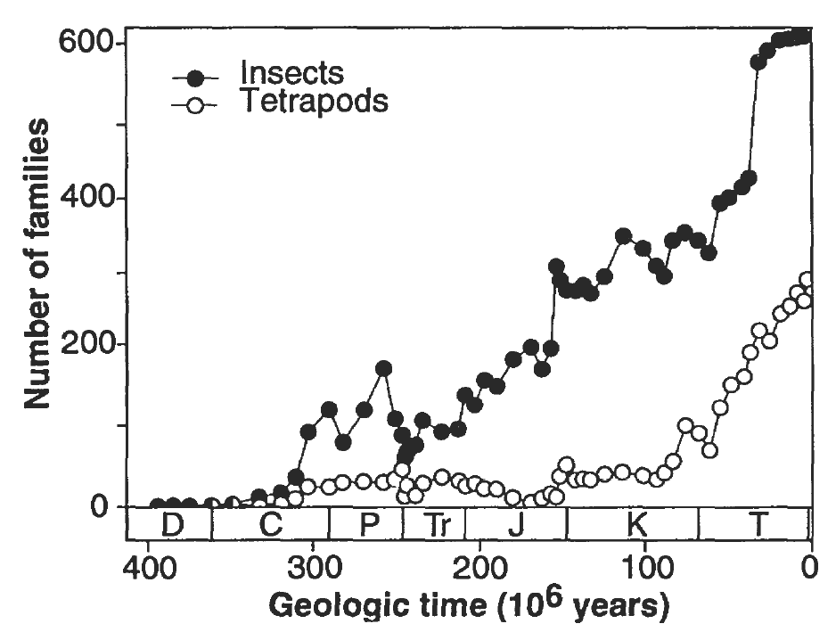
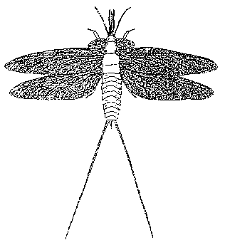
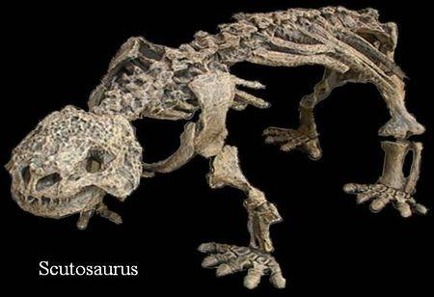
Dimetrodon
Extinctions on land as well
Paleodictyopteroidea

Slide 13
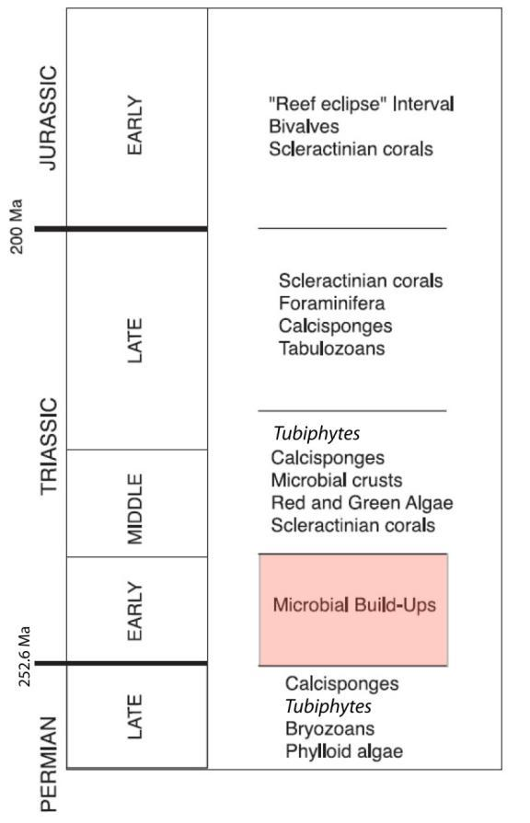
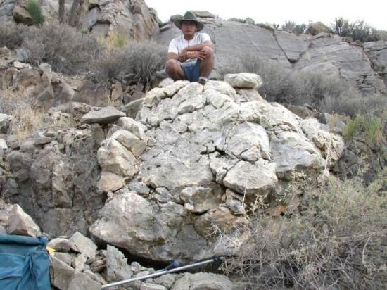
The Animal Reef Gap
Reef constructed entirely by microbial communities
(Nevada, USA)

Slide 14
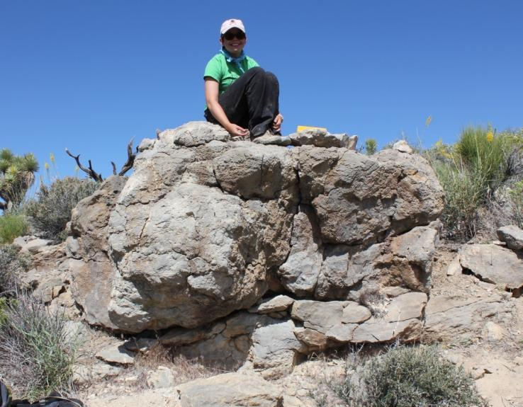
The Animal Reef “Eclipse”?
BMC ‘11
Reef constructed by microbial communities and sponges. (Nevada, USA)

Slide 15
Where are the corals?
No corals for 5-7 million years

Slide 16
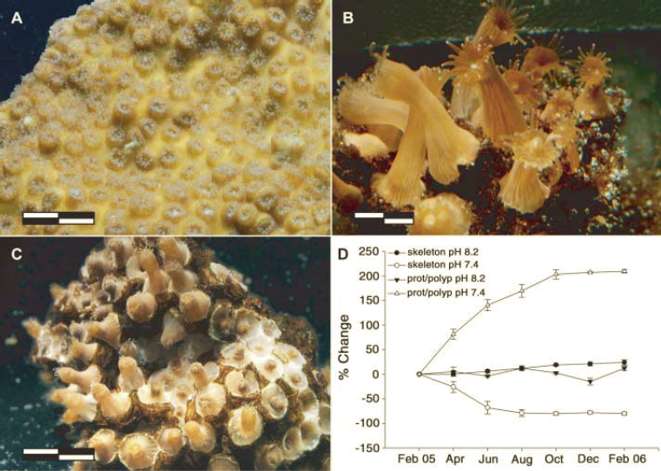
The Naked Coral Hypothesis
(Fine & Tchernov, 2007

Slide 17
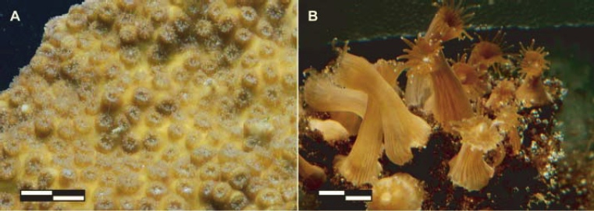
How do you make seawater acidic?
Carbonic Acid
Carbon dioxide
CO₂ + H₂O ↔ H₂CO₃
H₂CO₃ + CaCO₃ ↔ Ca²⁺ + 2HCO₃⁻
Carbonic Acid
Coral skeleton

Slide 18
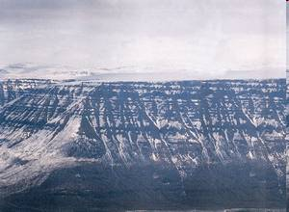
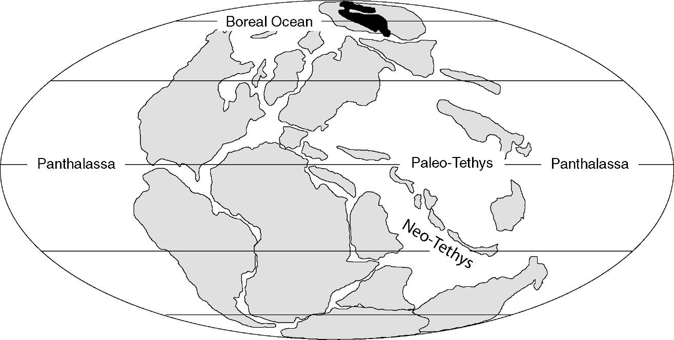
Siberian Trap Volcanism
  4 X 10¹³ metric tons of carbon dioxide erupted within 2 million years
  2 X 10⁷ metric tons of carbon dioxide per year
2 million km²

Slide 19
Siberian Trap Volcanism
  4 X 10¹³ metric tons of carbon dioxide erupted within 2 million years
  2 X 10⁷ metric tons of carbon dioxide per year
Humans in 2012
  3.5 X 10¹⁰
2 million km²

Slide 20
Triggers versus Mechanisms
Bolide Impact Trigger
Volcanism Trigger
Climate Change Trigger/Mechanism
Anoxia (low oxygen) Mechanism
Triggers cause the mechanism to happen. Mechanisms do the killing.

Slide 21
Trigger for the End Permian?
Volcanism Trigger
Triggers cause the mechanism to happen. Mechanisms do the killing.

Slide 22
Mechanism for the End Permian?
Extreme climate warming

Slide 23
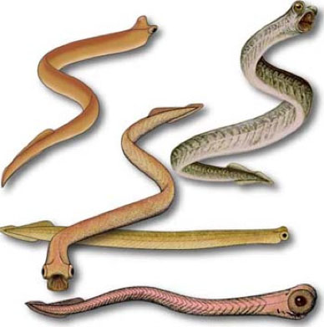
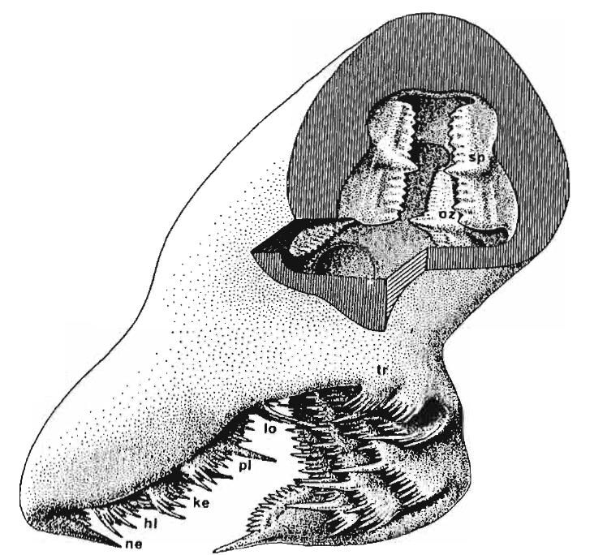
Evidence for climate warming
Lack of evidence for ice on the continents
Chemical analysis of conodont fossils act as a paleothermometer

Slide 24
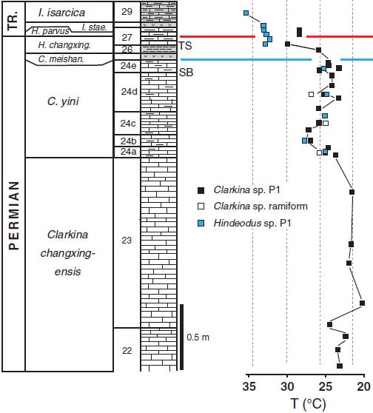
Evidence for climate warming
Seawater temperatures ~35°C (95°F)
Joachimski et al., 2012

Slide 25
Observations explained by climate warming
Lack of skeletonized corals
Small body size of various organisms

Slide 26
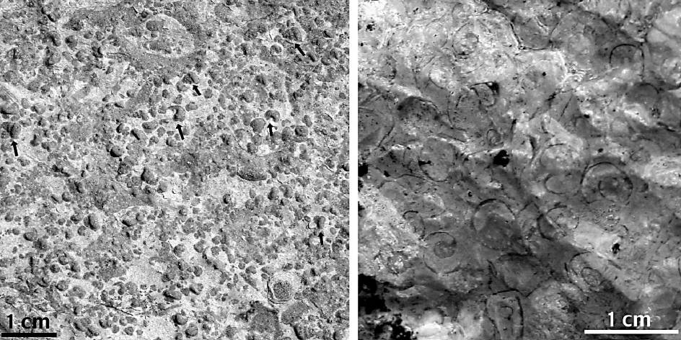
Microgastropods (smaller than 1cm) during the aftermath (e.g., Batten and Stokes, 1986; Twitchett, 2007; Fraiser and Bottjer, 2004; Payne et al., 2004)
(from Fraiser and Bottjer, 2004)

Slide 27
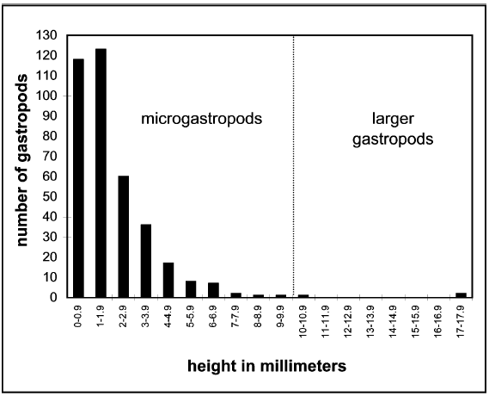
Gastropods from the Sinbad Limestone of Utah are predominantly small (Fraiser and Bottjer, 2004)
n= 376
Mean = 2.5mm
(from Fraiser and Bottjer, 2004)

Slide 28
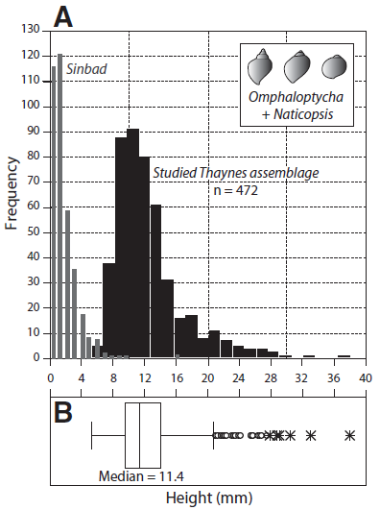
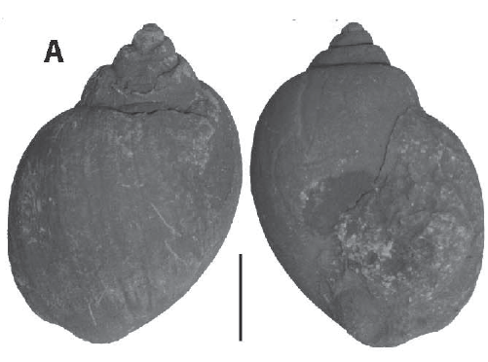
Gastropods from the Thaynes Formation of the Confusion Range, Utah are larger (Brayard et al., 2010)
1 cm
(from Brayard et al., 2010)

Slide 29
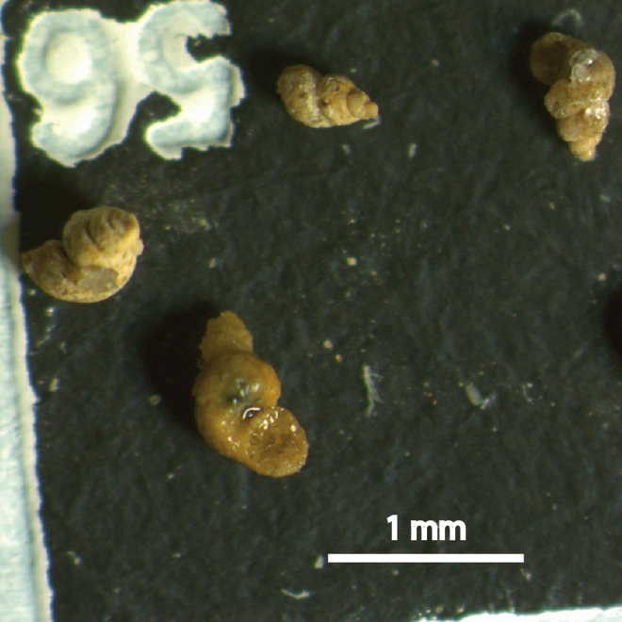
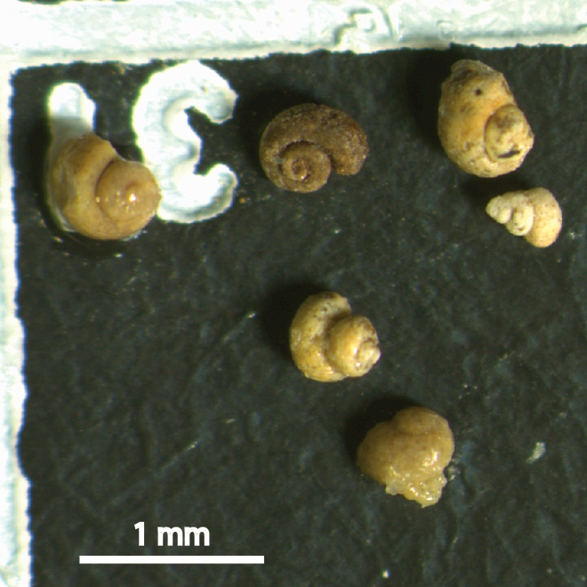
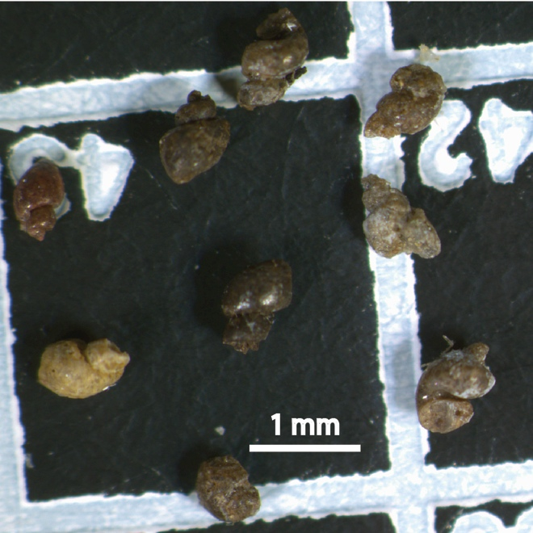
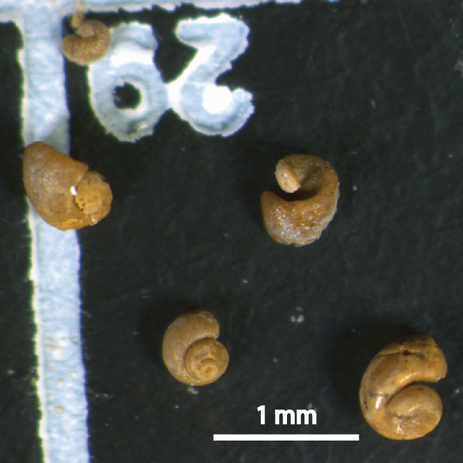
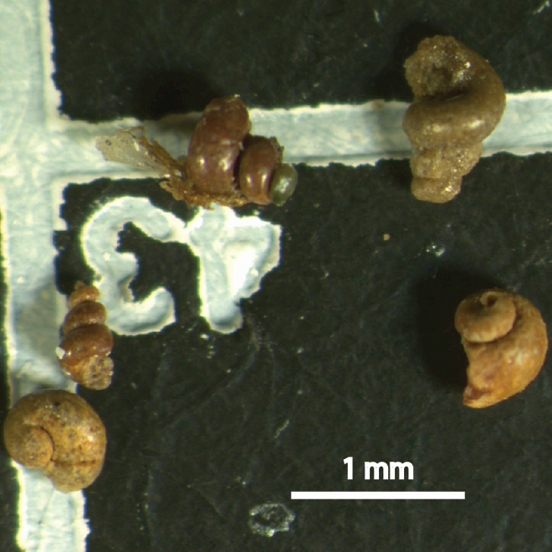
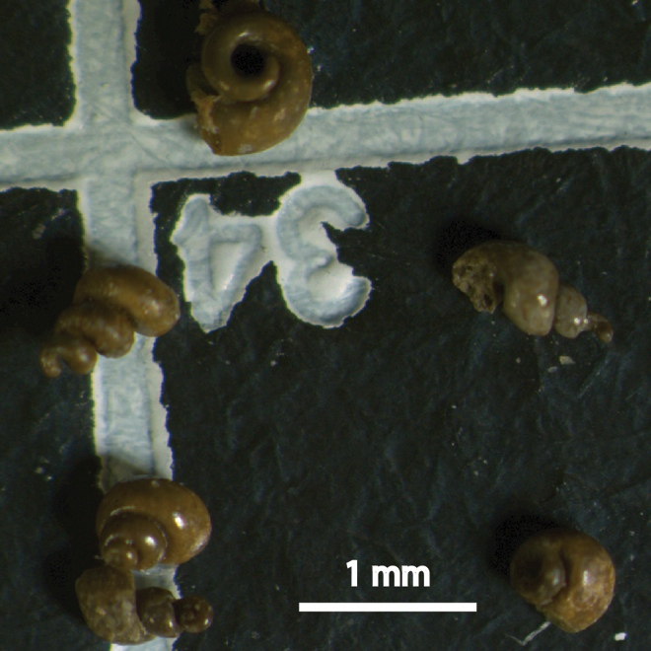
(from Marenco et al., in prep.)

Slide 30
Larger gastropods have only been found in deeper (cooler) water environments
(modified from Blakey)
(from Marenco et al., in prep.)

Slide 31
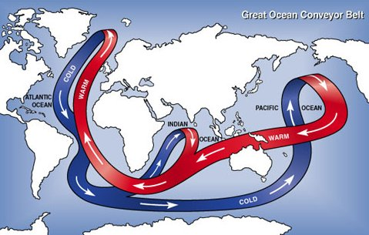
Mechanism for the End Permian?
Extreme climate warming
Anoxia (low oxygen) in the oceans triggered by warming

Slide 32
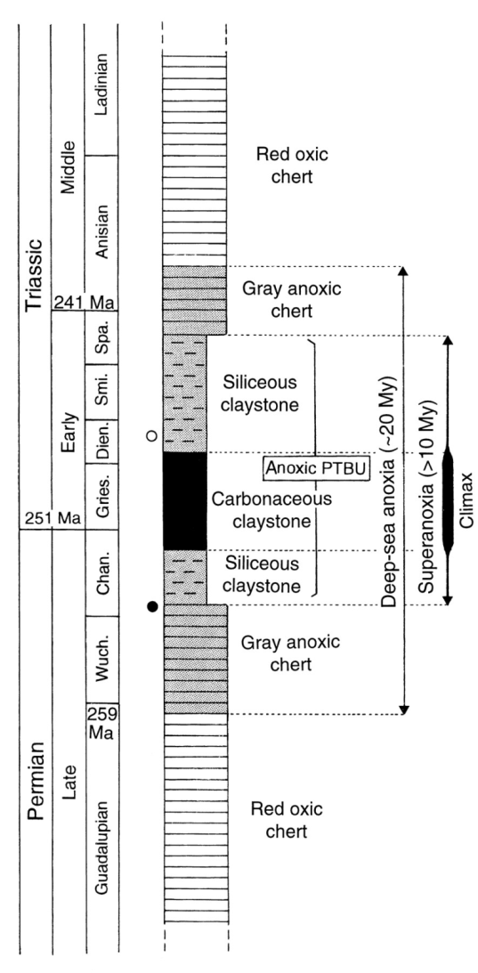

Deep ocean anoxia
The mineral pyrite forms in anaerobic environments
Pyrite Framboids
(from Shen et al. 2007)
(from Isozaki 1997)

Slide 33
Mechanism for the End Permian?
Extreme climate warming
Anoxia (low oxygen) in the oceans triggered by warming
  Pattern of extinction does not agree with anoxia as a mechanism
Carbon dioxide poisoning
  Pattern of extinction seems to agree

Slide 34

Extinction selectivity
Pattern of extinction shows weak preference for organisms that do not tolerate high levels of carbon dioxide.

Slide 35
So what on Earth happened?
What we know
  There was extreme volcanism
  There was extreme warming
What we are fairly sure about
  There were likely high levels of carbon dioxide
  There was likely widespread oceanic anoxia

Slide 36
So what on Earth happened?
What we are not sure about
  What exactly did the killing?
  Why did some groups recover more quickly than other groups?
  Were some regions less affected than others?
  How long did it all last?

Slide 37
Can this happen again?
The End Permian mass extinction can be treated as a natural laboratory to explore the effects of anthropogenic carbon dioxide and global warming.

Slide 38
Thank you!

