Slide 1
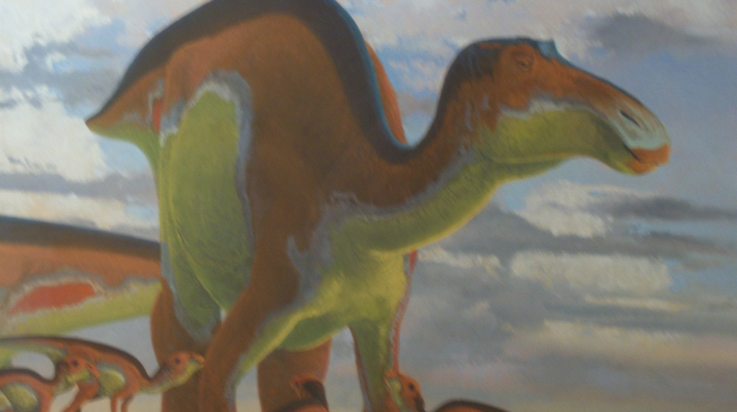
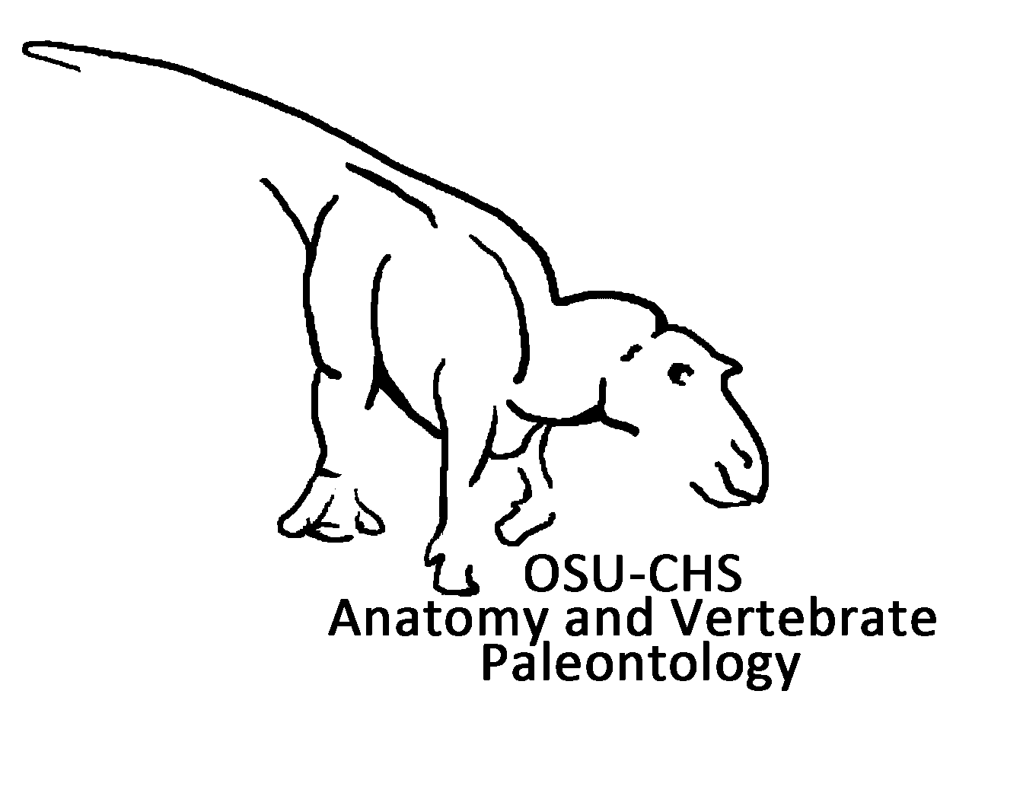

The Maiasaura Life History Project: Using Fossil Bone Histology to Infer Growth Dynamics of the "Good Mother" Dinosaur
Holly N. Woodward
holly.ballard@okstate.edu
Woodward Ballard Lab

Slide 2
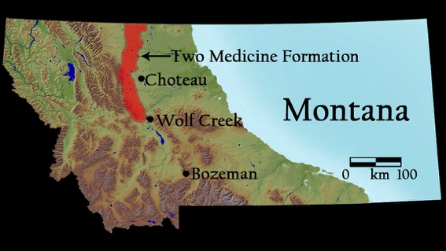
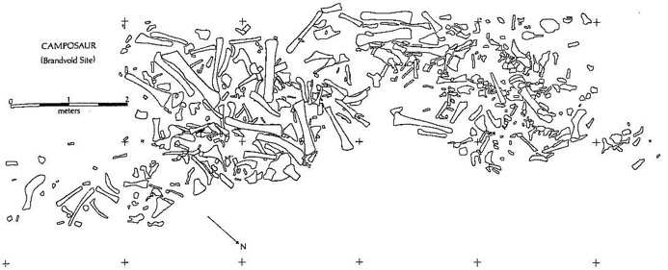
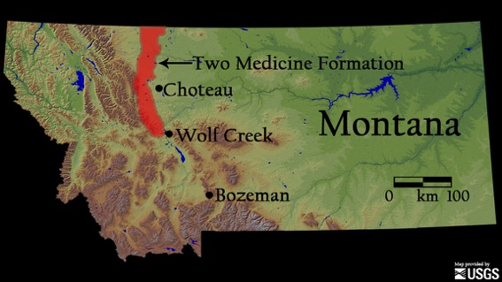
Maiasaura: the good mother dinosaur
76 million years ago
Varricchio and Horner 1993

Slide 3
The Maiasaura Life History Project
Lab component (paleohistology)
Field component (excavation and outreach)

Slide 4
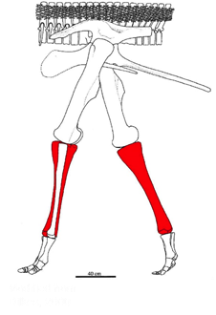
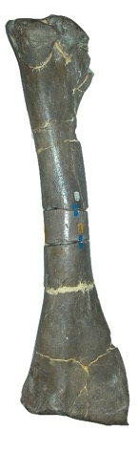
Maiasaura and Paleohistology

Slide 5
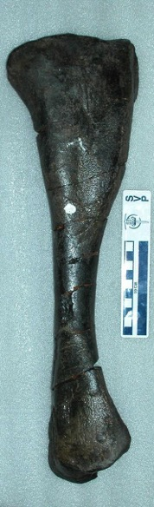
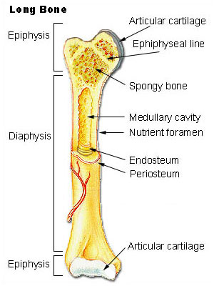
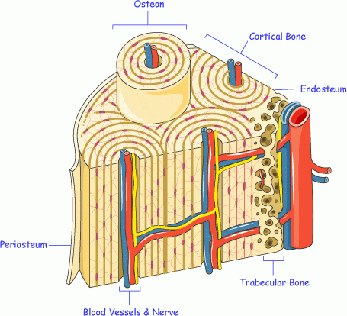
Paleohistology: the study of fossil bone microstructure
http://www.iofbonehealth.org/
http://training.seer.cancer.gov/module_anatomy/unit3_4_bone_classification.html
Notes:
5

Slide 6
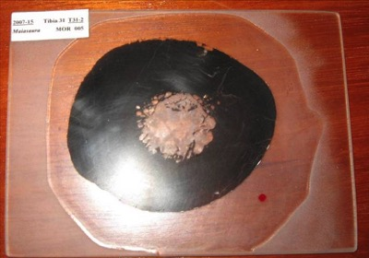
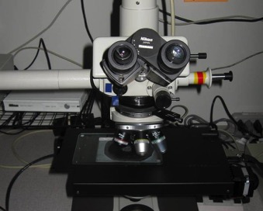
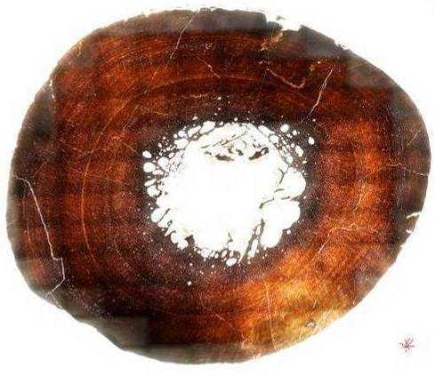
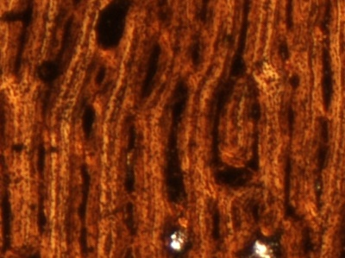
Scale bar = 100 μm
Notes:
6

Slide 7
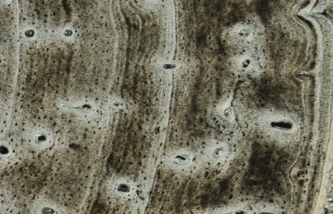
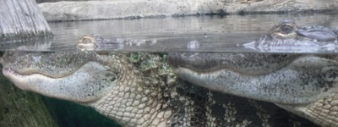
Paleohistologists study modern bone tissue to understand fossil bone
200 μm
Scale bar = 100 μm

Slide 8
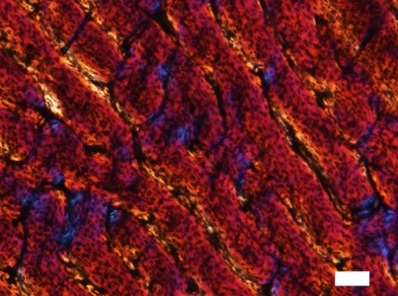
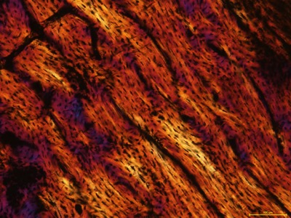
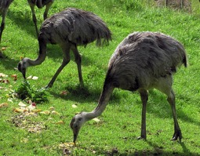
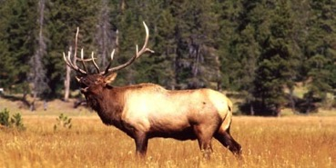
Paleohistologists study modern bone tissue to understand fossil bone
Scale bars = 100 μm

Slide 9
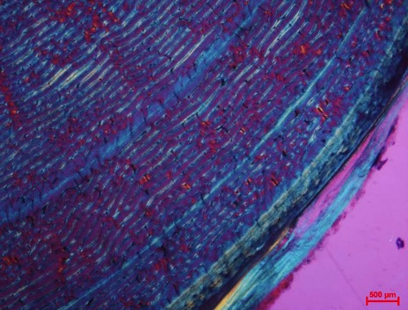
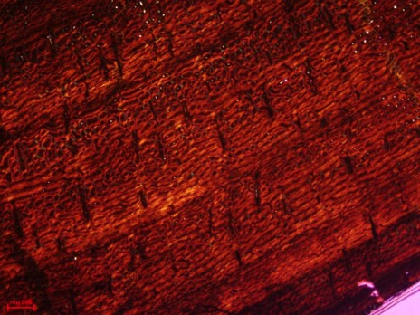
Vertebrates annually stop or slow growth
1 mm
1mm

Slide 10
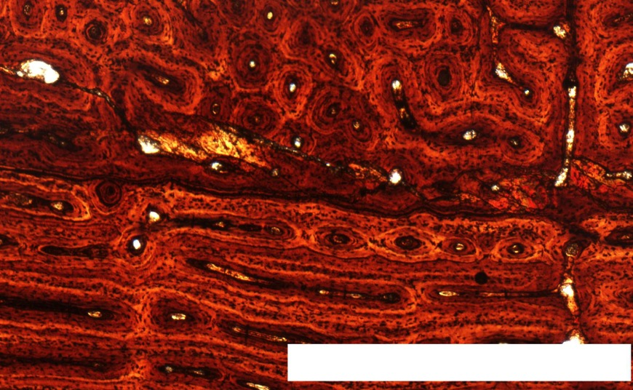
Vertebrates annually stop or slow growth
1 mm

Slide 11
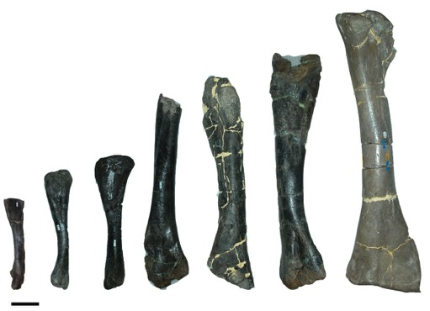
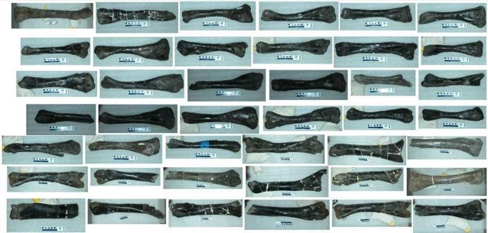
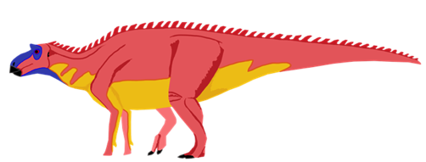


The Maiasaura Dataset
50 tibiae!

Slide 12
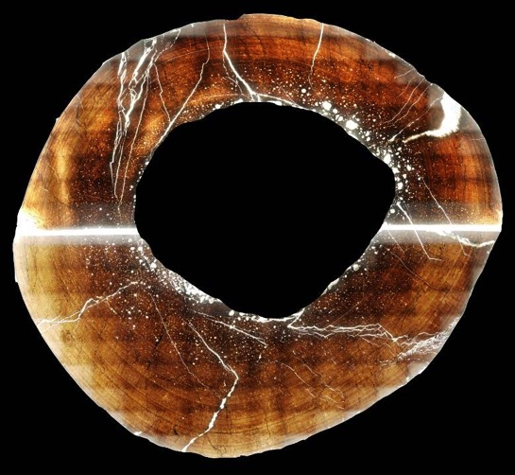
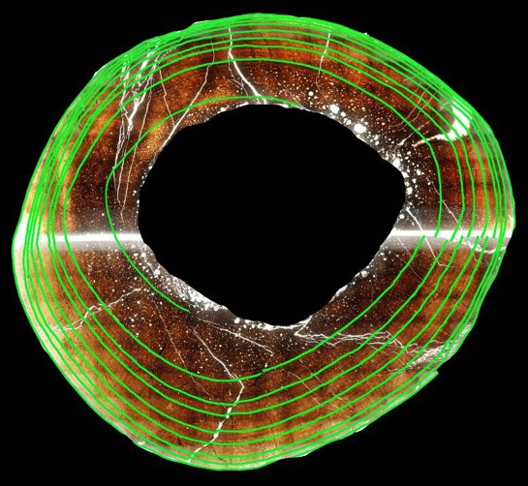
The Maiasaura Dataset

Slide 13
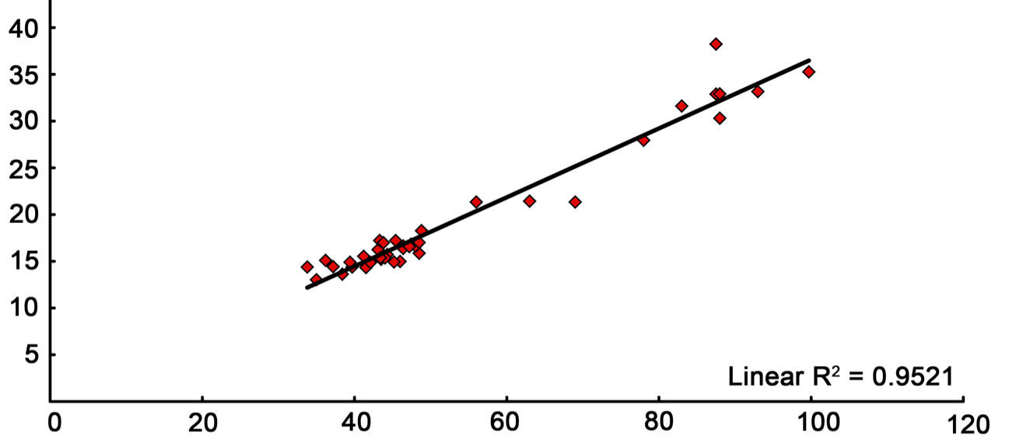
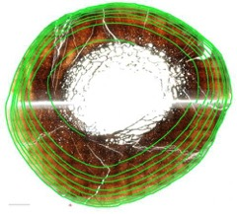

The Maiasaura Dataset
Relationship Between Tibia Length and Tibia Shaft Circumference
Tibia Shaft Circumference (cm)
1mm
Tibia Length (cm)
Notes:
13

Slide 14
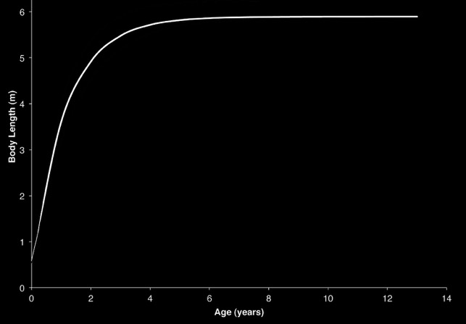

Averaged Maiasaura body length growth curve

Slide 15
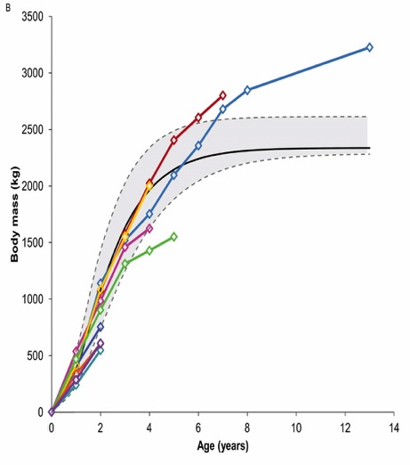
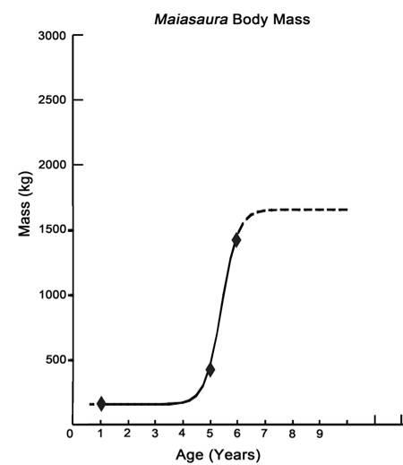
Averaged Maiasaura body mass growth curve
Modified from Erickson et al., 2001
Erickson et al., 2001

Slide 16
Averaged Maiasaura body mass growth curve
Modified from Erickson et al., 2001
Erickson et al., 2001

Slide 17
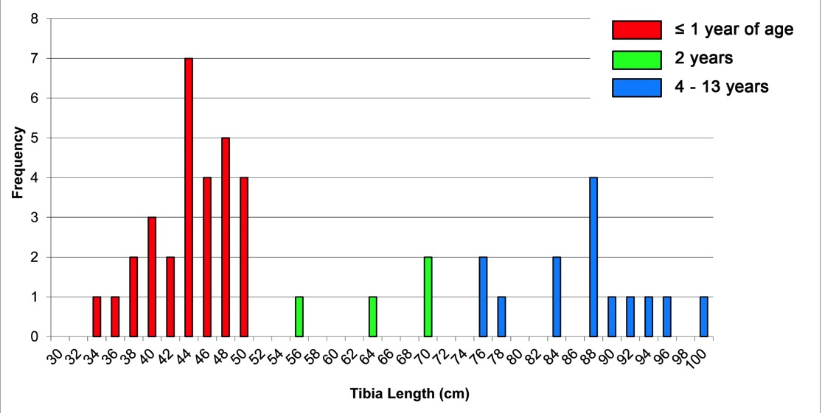
Maiasaura tibia frequency can tell us about population structure

Slide 18
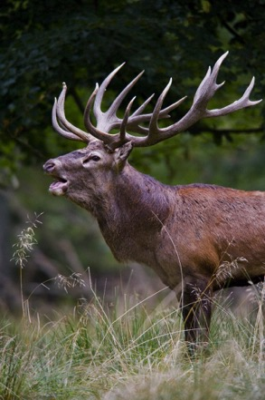
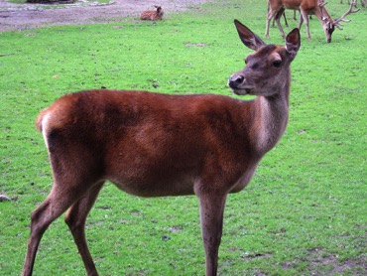
Paleohistologists study modern populations to understand extinct ones
Isle of Rum, Scotland
Red Deer research conducted since 1953
Bill Ebbesen
Matthias Dortmund

Slide 19
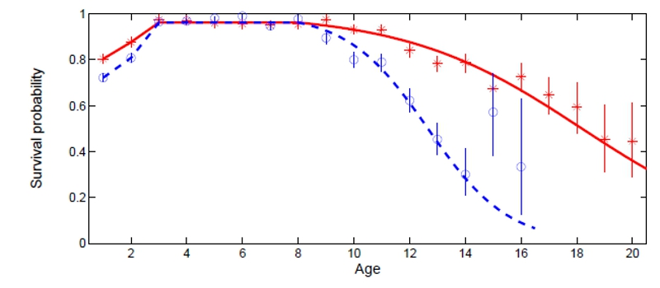
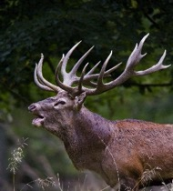
Survivorship: Juveniles
http://rumdeer.biology.ed.ac.uk/ageing
Juvenile mortality high during first and second winters after weaning
Due to high energy costs of rapid growth, and more pronounced in males

Slide 20
Survivorship: Peak Performance
Peak performance
http://rumdeer.biology.ed.ac.uk/ageing
Peak performance: the period where survivorship and fecundity is highest
Bill Ebbesen
Matthias Dortmund

Slide 21

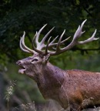
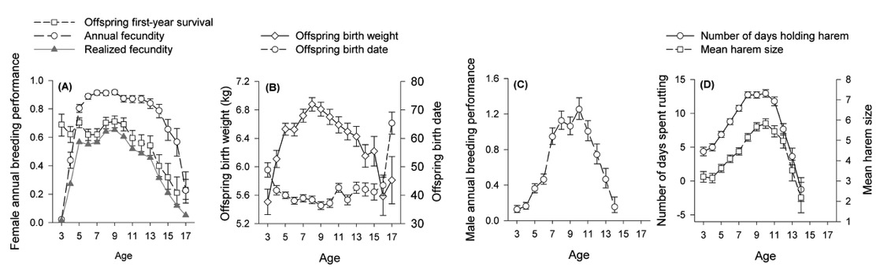
Survivorship: Peak performance
Period when female fecundity is highest, their offspring are most likely to survive the first year, and high birth weight
Males are most successful at breeding, are able to hold their harems the longest, and have the largest harem sizes
http://rumdeer.biology.ed.ac.uk/ageing
Nussey et al., 2009

Slide 22
Survivorship: Senescence
Senescence
http://rumdeer.biology.ed.ac.uk/ageing
Senescence: “A decline in fitness with age caused by physiological degradation” (Wickings et al. 2008)
Bill Ebbesen
Matthias Dortmund

Slide 23
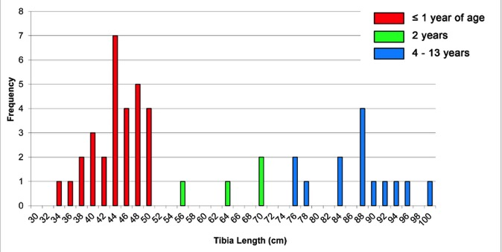
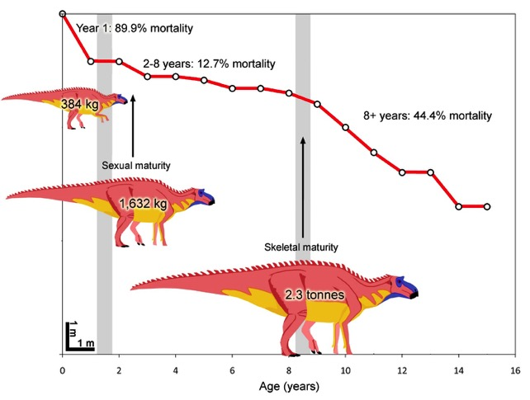
We can predict survivorship in Maiasaura

Slide 24

Survivorship: Juveniles
Year 1: 89.9% Mortality
Trade-off: growing rapidly to escape predatory/ environmental pressure, but comes with high energy demands

Slide 25
Survivorship: Peak Performance
Years 2-8: 8.6% Mortality
Onset of sexual maturity followed by highest fecundity, mating success, survival probability

Slide 26
Survivorship: Senescence
Years 9-15: 44% Mortality
  Growing quickly to cross a size barrier and breed as early as possible
  Consequence is early senescence after the early peak performance window

Slide 27
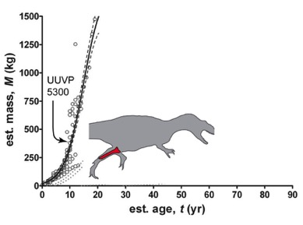
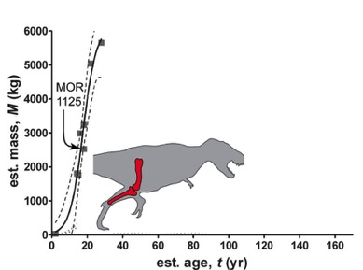
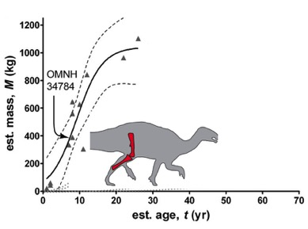
Can we predict age a sexual maturity in Maiasaura?
Allosaurus
Tyrannosaurus
Tenontosaurus
Modified from Lee and Werning, 2008
In dinosaurs, sexual maturity occurred between 1/3 and 1/2 asymptotic body mass

Slide 28


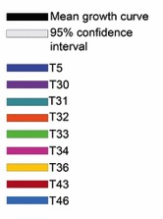
Can we predict age a sexual maturity in Maiasaura?
1/3 – 1/2 asymptotic mass during third year of life
Sexual Maturity
Years 2-8: Peak Performance

Slide 29
How can large sample sizes help test hypotheses?

Slide 30
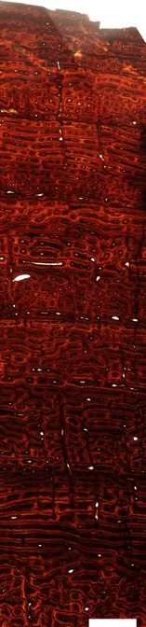
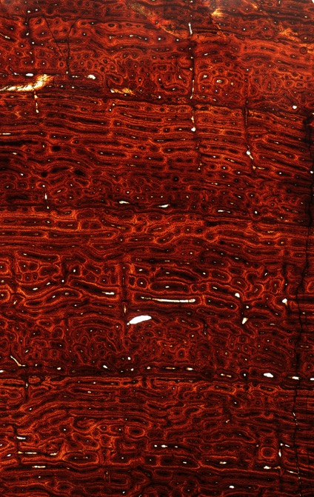
R
C
R
C
R
C
R
C
C
R
C
R
C
R
C
R
C
R
1 mm
1 mm

Slide 31
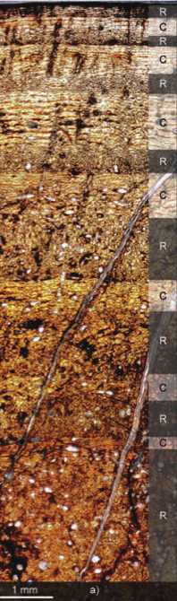
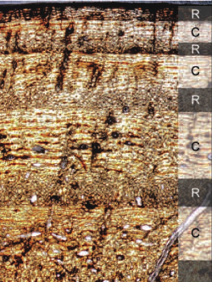
Edmontosaurus
Modified from Chinsamy et al., 2012
From Chinsamy et al., 2012

Slide 32

Edmontosaurus
Modified from Chinsamy et al., 2012
From Chinsamy et al., 2012

Slide 33


Edmontosaurus
Maiasaura
C
R
C
R
C
R
C
R
C
R
Modified from Chinsamy et al., 2012
1 mm

Slide 34


Maiasaura
C
R
C
R
C
R
C
R
C
R
Sexual maturity during third year of life
In Maiasaura, this pattern begins between two and three years of age.
If pattern does not indicate polar living, may be an indicator of sexual maturity.
1 mm

Slide 35





Special cases: what can bone injuries tell us about growth?
“T09”
“T42”

Slide 36


T09
10% increase in area

Slide 37



Are the outgrowths a response to biomechanical compensation?
T42
15% increase in area

Slide 38

Are the outgrowths a response to biomechanical compensation?
radius
ulna
radius
ulna
Goodship et al., 1979

Slide 39
Are the outgrowths a response to biomechanical compensation?
radius
ulna
Radius, three weeks after removal
Goodship et al., 1979

Slide 40
Missing Ulna
Three months after removal
Goodship et al., 1979

Slide 41

Are the outgrowths a response to biomechanical compensation?
“T09”
“T42”
Modified from Dilkes, 2000

Slide 42


T09
T42
Fibula
Fibula
Bipedal juvenile
Quadrupedal sub-adult

Slide 43

The Maiasaura Life History Project Summary
Paleohistology should be viewed as data enhancement.
Understanding what modern bone tissue patterns mean is the only way to know what they mean in extinct animals.
Large sample size is key to understanding life history patterns of extinct animals.
Maiasaura cared for its young; grew to adult size in 8 years; had a high mortality rate after hatching; reached sexual maturity near three years of age; and switched from a bipedal to quadrupedal gait during growth.

Slide 44
The Maiasaura Life History Project
Field component (excavation and outreach)

Slide 45


The Maiasaura Life History Project

Slide 46




The Maiasaura Life History Project

Slide 47

Acknowledgements
The Museum of the Rockies paleontology program contributed funding for this project. Additional funding was provided by Gerry Ohrstrom, the Jurassic Foundation, and the Geological Society of America. Statistical analyses done by E. Freedman benefitted from the Paleobiology Database Intensive Summer Course in Analytical Paleobiology and discussions with Andrew Lee. A special thanks to Lisa White and UC Berkeley for inviting me to tell you about the most interesting dinosaur ever!
Information on the Isle of Rum Red Deer Project: rumdeer.biology.edu.ac.uk

