Slide 1
Comparing Extant Mammalian Species Diversity to Paleospecies Richness: Problems and Solutions
Marc A. Carrasco
Dept. of Integrative Biology and the Museum of Paleontology
UC Berkeley

Slide 2
www.ucmp.berkeley.edu/neomap

Slide 3
NEOMAP Database
Distributed database that combines FAUNMAP I, FAUNMAP II, and MIOMAP
Fossil mammals from North America between 30 million and 500 years old
All species occurrences have associated geologic and geographic information
Over 9,000 georeferenced localities and 80,000 occurrences of taxa

Slide 4
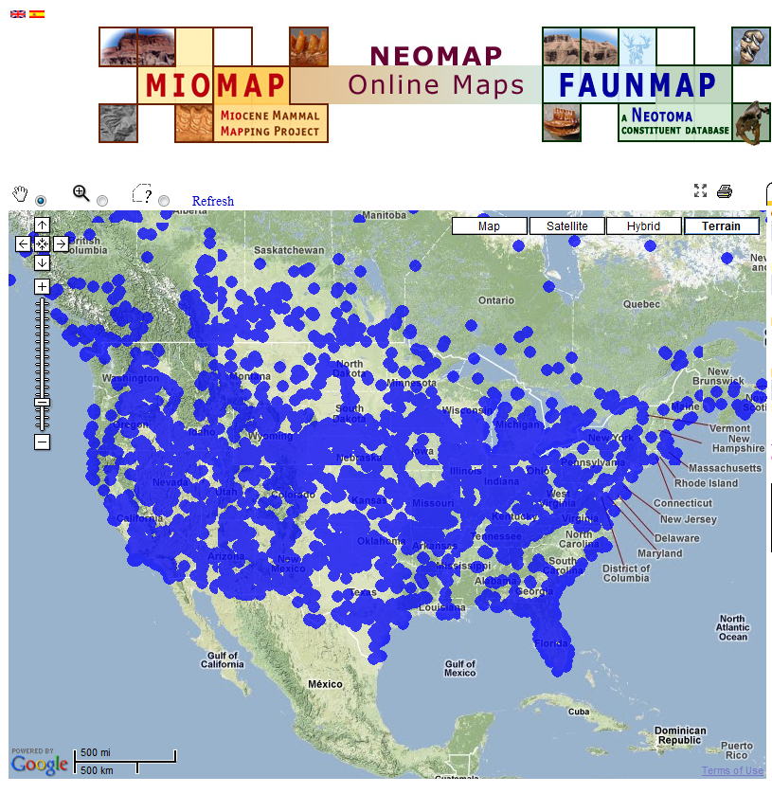

Slide 5
Methodology
All localities placed within one of eighteen subdivisions of the North American Land Mammal Ages
Also included a Holocene and Modern time slice
Modern data from the Museum of Vertebrate Zoology, UC Berkeley

Slide 6
Methodology (Cont.)
Taxonomic occurrences were placed within one of ten biogeographic provinces

Slide 7
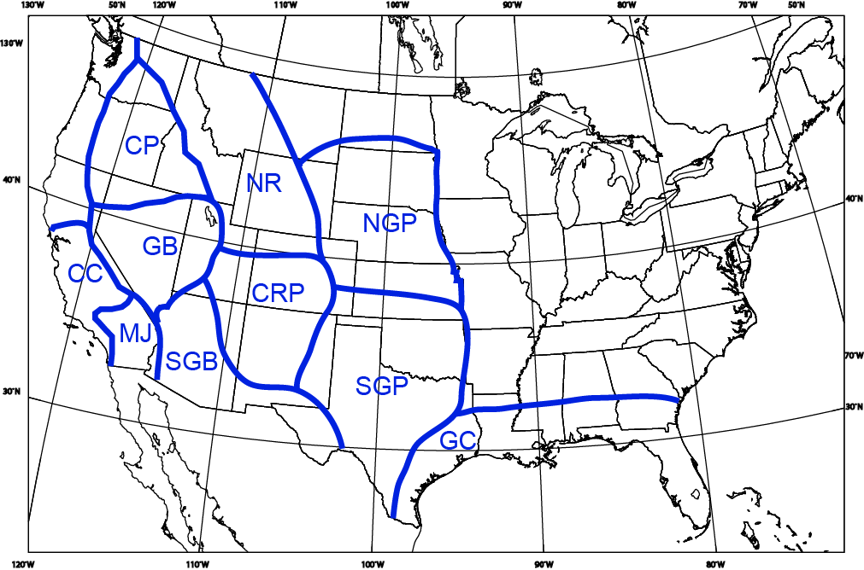

Slide 8
Methodology (Cont.)
Taxonomic occurrences were placed within one of the ten biogeographic provinces
Data standardized using rarefaction (set at 75 occurrences)
Plotted on species-area graphs to account for the species-area effect

Slide 9
All Mammals

Slide 10
All Mammals
Holocene

Slide 11
All Mammals
Modern
Holocene

Slide 12
Large Mammals

Slide 13
Large Mammals

Slide 14
Large Mammals

Slide 15
Small Mammals

Slide 16
Small Mammals
Holocene

Slide 17
Small Mammals
Modern
Holocene

Slide 18
Large Mammals by Province

Slide 19
Large Mammals by Province
Holocene

Slide 20
Large Mammals by Province
Holocene
Modern

Slide 21
Small Mammals by Province

Slide 22
Small Mammals by Province
Holocene

Slide 23
Small Mammals by Province
Modern
Holocene

Slide 24
Explanations
Sampling bias
Modern data from limited collections with irregular sampling as seen in the fossil record
Rarefaction and species-area curves
No correlation between diversity and number of occurrences or localities

Slide 25
Explanations Cont.
Real phenomenon
Large mammal data
All available current data suggests only decreases in the number of mammal species

Slide 26
Explanations Cont.
Different classification methodologies
Many extant species classified using non-bone criteria (e.g., soft parts, pelage, genes, etc.)
Fossil species rely on morphological criteria, predominantly from teeth
Convergence and conservative dental morphologies, particularly in small mammals, may lead to differing taxonomic allocations

Slide 27
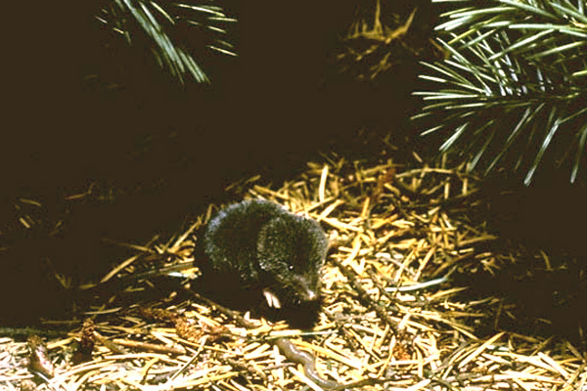
Soricidae (27.7% new species)
5 of 13 species of Sorex

Slide 28
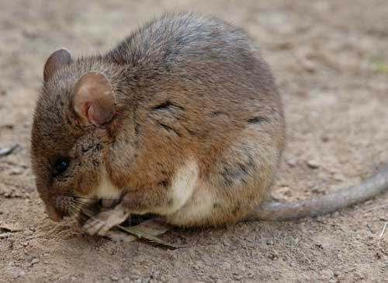
Muridae (26.7%)
4 of 11 species of Neotoma

Slide 29
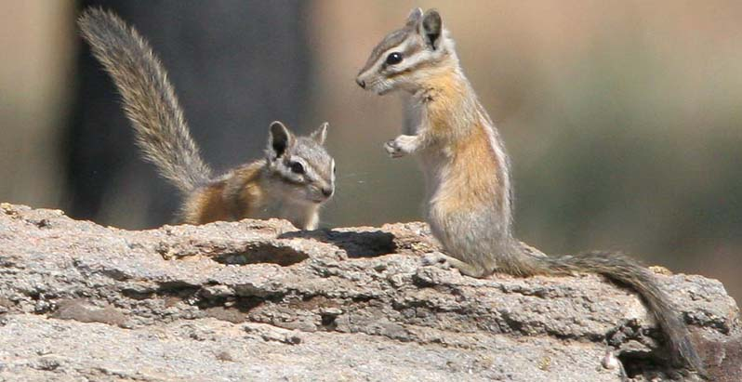
Sciuridae (35.7%)
12 of 18
species of Tamias

Slide 30
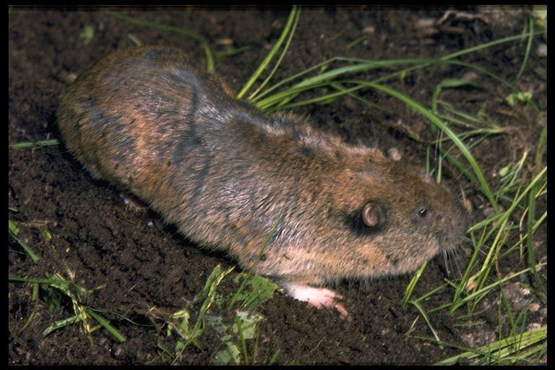
Geomyidae (46.2%)
4 of 8
species of Thomomys

Slide 31
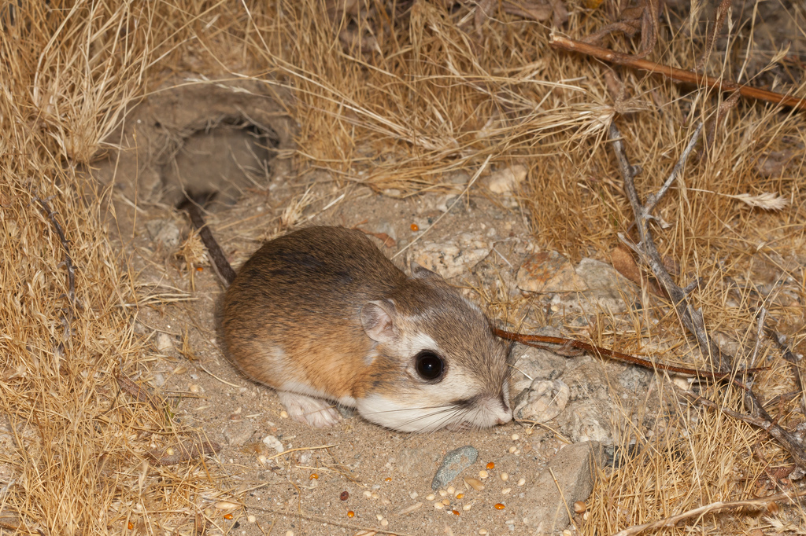
Heteromyidae (48.7%)
9 of 16
species of Dipodomys

Slide 32
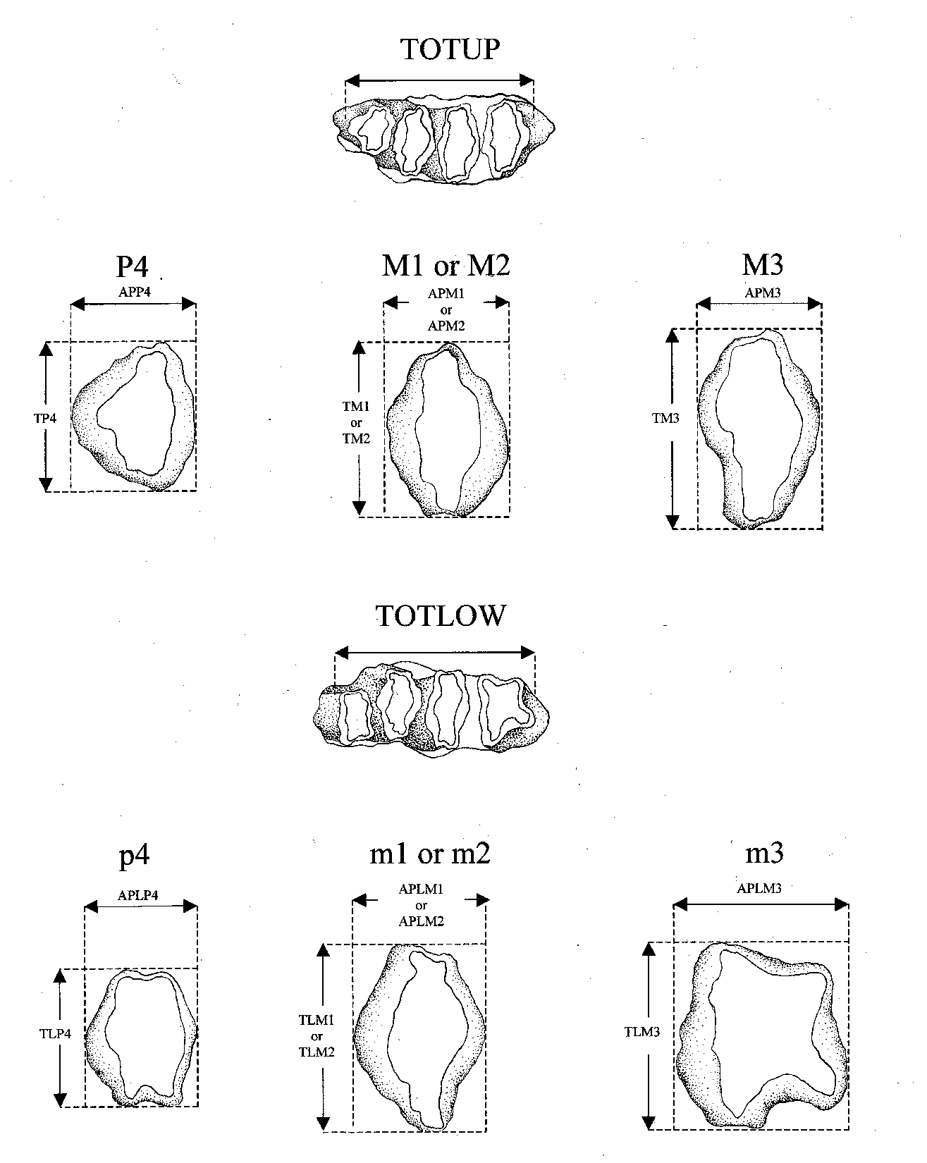

Slide 33
Analysis of Extant Dipodomys Teeth
Qualitative analysis revealed only 4 diagnostic characters that are not age dependent
A multivariate discriminant analysis was able to correctly allocate only 71% of specimens to species

Slide 34
Solutions
Careful reassessment of problematic fossil groups
e.g., multivariate analyses, comparisons to modern taxa, etc.

Slide 35
Solutions
Careful reassessment of problematic fossil groups
e.g., multivariate analyses, comparisons to modern taxa, etc.
Reevaluate extant species using paleontological methods
e.g., only use isolated teeth in diagnoses

